Slide 1
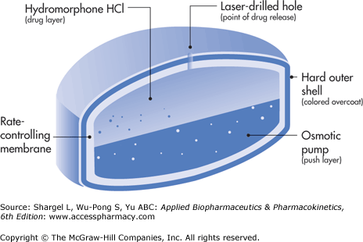
Concepts and System Design for Rate-Controlled Drug Delivery
Dr. Majed R. Feddah

Slide 2
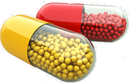
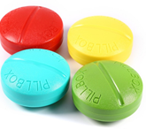
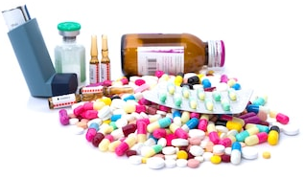
I. Introduction
For many decade treatment of an acute disease or chronic illness has been mostly accomplished by delivery of drugs to patients using various pharmaceutical dosage forms, including tablets, capsules, pills, suppositories, creams, ointments, liquids, aerosols, and injectables, as drug carriers.
These medications gives prompt release of drug.
To achieve & to maintain the therapeutic concentration in the body it is necessary to take the medication several times a day.
This results in a significant fluctuation in drug
Levels (Figure 1)

Slide 3
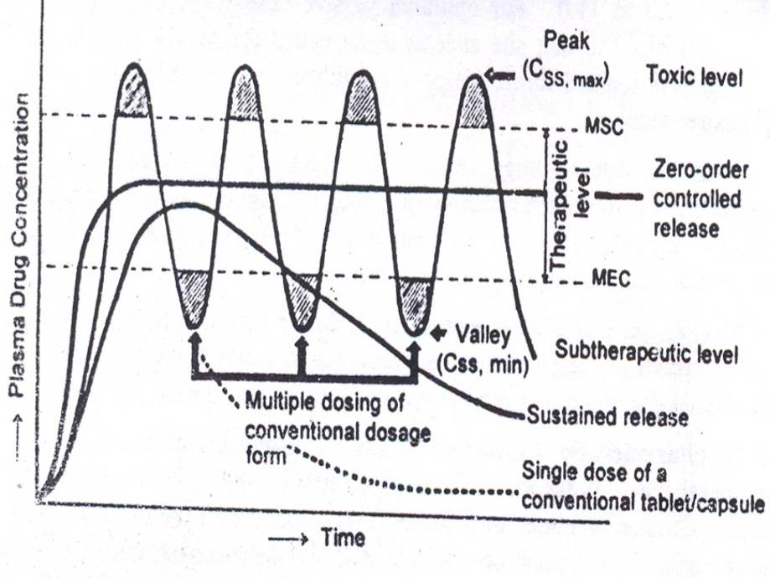
Plasma concentration time profile

Slide 4
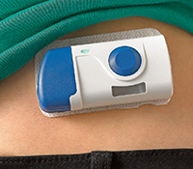
Several technical advancement have been made.
The result is the development of new techniques for drug delivery.
These techniques are capable of :
    Controlling the rate of drug delivery.
    Sustaining the duration of therapeutic activity.
    Targeting the delivery of drug to a tissue.

Slide 5
Advantages
Total dose is low.
Reduced GI side effects.
Reduced dosing frequency.
Better patient acceptance and compliance.
Less fluctuation at plasma drug levels.
More uniform drug effect
Improved efficacy/safety ratio.

Slide 6
Disadvantages
Dose dumping.
Reduced potential for accurate dose adjustment.
Need of additional patient education.
Stability problem.

Slide 7
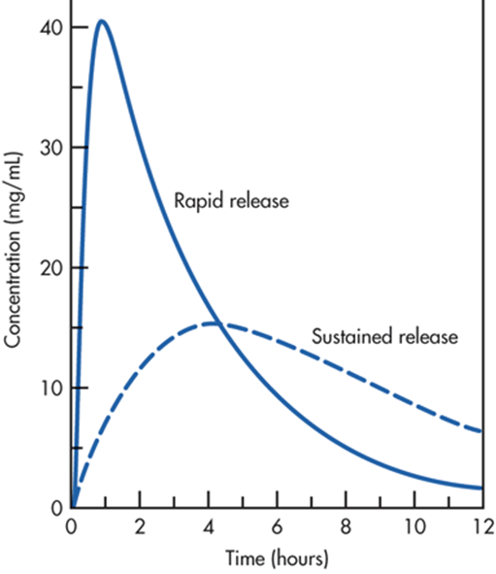
Immediate Release Dosage Form
Immediate release dosage forms are those for which ≥85% of labeled amount dissolves within 30 min.
For immediate release tablets, the only barrier to drug release is simple disintegration or erosion stage, which is generally accomplished in less than one hour.

Slide 8
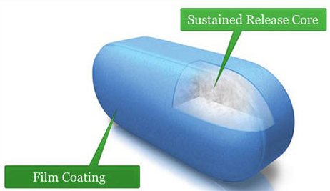
Sustained Release
This term is used to describe a pharmaceutical dosage form formulated to retard the release of API such that its appearance in the Blood or and Plasma is delayed and or prolonged and its plasma profile is sustained in duration.
The onset of its pharmacologic action is often delayed, and the duration of its therapeutic effect is sustained.

Slide 9
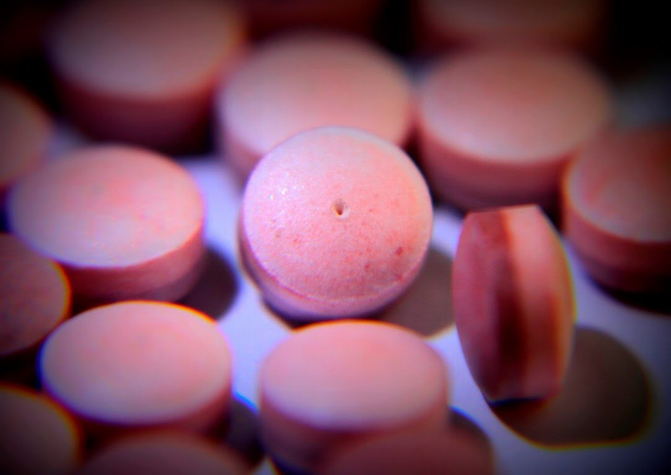
Controlled Release
The term controlled release has a meaning that goes beyond the scope of sustained drug action.
It also indicate a Predictability & Reproducibility in the drug release kinetics, which means that release of drug from controlled drug delivery system.
(which is prepared on the basis of Osmotic Pumping Technology), & Dexatrim®, a sustained-release drug delivery system (which is prepared on the basis of Spansule Coating Technology), are compared.

Slide 10
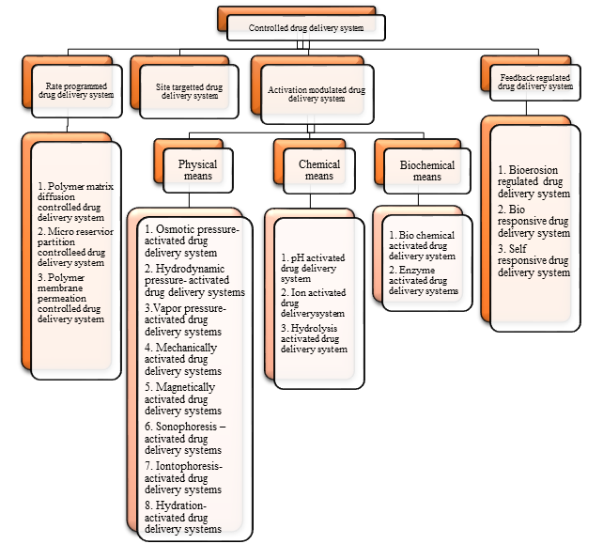

Slide 11
II. CLASSIFICATION OF RATE-CONTROLLED DRUG DELIVERY SYSTMS
Based on their technical sophistication controlled release drug delivery systems can be classified into four categories: (figure 3)
      Rate-preprogrammed DDS.
      Activation modulated DDS.
      Feedback regulated DDS.
      Site targeting DDS.

Slide 12
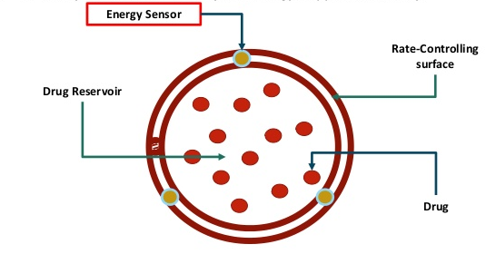
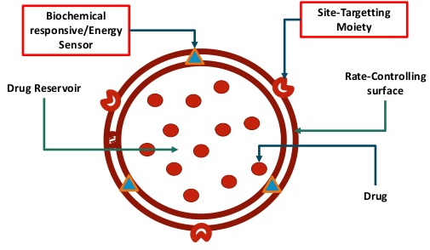
1. Rate-preprogrammed DDS
(figure 3)
2. Activation modulated DDS
Drug
3. Feedback regulated DDS
4. Site targeting DDS

Slide 13
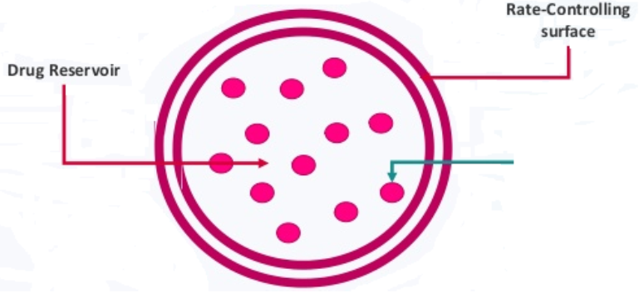
III. Rate preprogrammed D.D.S
In this group of controlled release drug devilry systems, the release of drug molecules from the delivery systems has been prep-programmed at specific rate profiles.
This was done by system design, which controls the molecular diffusion of drug molecules in and/or across the barrier medium within or surrounding the delivery system.
Fick’s lows of diffusion are often followed.
These systems can be further classified as
follows:
Drug

Slide 14
1. Rate-preprogrammed DDS
A. Polymer Membrane Permeation-Controlled DDS .
Progestasert IUD/Norplant sub-dermal implant / Ocusert System/Transderm-Nitro
B. Polymer Matrix Diffusion-Controlled DDS.
Nitro-Dur and Compudose Subdermal implant
C. Micro-reservoir Partition-Controlled DDS
Transdermal Nitrodisc System

Slide 15
A. Polymer Membrane Permeation-Controlled DDS
In this type, the drug formulation is totally or partially
encapsulated within a drug reservoir compartment.
The drug release surface is covered by a rate-controlling polymeric membrane having a specific permeability.
The drug reservoir may exist in:
  Solid form.
  Suspension form.
  Solution form.

Slide 16
The polymeric membrane can be fabricated from:
    Nonporous (homogeneous or heterogeneous) polymeric material.
    Microporous.
    Semipermeable membrane.
The encapsulation of drug formulation inside the reservoir compartment is accomplished by:
    Injection molding (I.M.), or Hot Melt Extrusion (HME)
    Spray drying.
    Capsulation.
    Microencapsulation, Or other technique.
(Figure 4)

Slide 17
The release of drug molecules from this type of rate controlled drug delivery systems is controlled at a pre-programmed rate by controlling:
      The partition coefficient of the drug molecule.
      The diffusivity of the drug molecule.
      The thickness of the rate controlling membrane.
Representatives of this type of drug delivery system are follows:

Slide 18
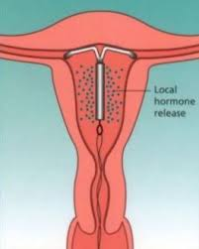
Progestasert IUD
Intrauterine device, the drug reservoir is a suspension of progesterone in silicone medical fluid & encapsulated in the vinyl acetate copolymer.
It is designed to deliver natural progesterone continuously in the uterine cavity at daily dosage rate of at least 65µg/day to achieve contraception for one year

Slide 19
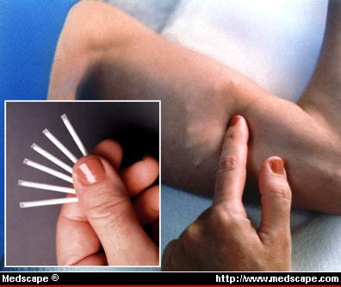
Norplant subdermal implant
Made from Non-porous silicone medical grade tubing (with both ends sealed with silicone medical grade adhesive) to encapsulate either:
Levonorgestrel crystals alone (generation I).
Levonorgestrel in silicone elastomer matrix “Solid dispersion” (generation II).
It is designed for the continuous subcutaneous release of levonorgestrel at a daily dosage rate of 30µg, to each subject (6 unites of I or 2 untints of II) for 7 years.

Slide 20
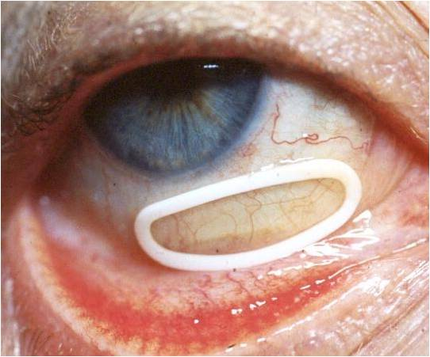
Ocusert System
The drug reservoir is a thin disk of pilocarpine alginate complex sandwiched between two transparent sheets of microporous ethylene-vinyl acetate copolymer membrane.
The microporous membrane permit the tears fluid to penetrate into the drug reservoir compartment to dissolve pilocarpine from the complex. Pilocarpine molecules are then released at constant rate of 20 µg to 40µg/ hr. for management of glaucoma for up to 7 days.

Slide 21
Ocusert Components

Slide 22
B. Polymer Matrix Diffusion-Controlled DDS

Slide 23
B. Polymer Matrix Diffusion-Controlled DDS
In this type of preprogramed DDS the drug reservoir is prepared by homogeneously dispersing drug particles in a rate-controlling polymer matrix fabricated from either:
    Lipophilic or
    Hydrophilic polymer.
The drug dispersion in the polymer matrix is accomplished by either:
  Blending the fine drug particles with a liquid polymer or viscous polymer, followed by `cross-linking of the polymer chains.
  Mixing drug solids with a rubbery polymer at an elevated temp.
  Dissolving the drug & the polymer in a common solvent, followed by solvent evaporation at elevated temp. & under vacuum.

Slide 24

The resultant drug polymer dispersion is then molded or extruded to form a drug delivery device of various shapes and sizes designed for specific application.​
The release of drug molecules from this type of DDS is controlled at a pre-programmed rate by controlling the:
    Loading dose.
    Drug solubility in the polymer.
    Diffusivity in the polymer matrix.
$\frac{Q}{t\frac{1}{2}}$ $=(2ACR$D_{p})$1/2$ Eq. 2
Where A is the initial drug loading dose in the polymer matrix; $CR$ is the drug solubility in the polymer, which also the drug reservoir concentration in the system, and D_{p} is the diffusivity of the drug molecules in the polymer matrix.
Notes:
The rate of drug release from this polymer matrix diffusion-controlled DDS is time dependent and is defined at steady state by $\frac{Q}{t1/2}=(2ACrD{p)}^{1/2}$
Where A is the initial drug loading dose in the polymer matrix; Cr is the drug solubility in the polymer, which is also the drug reservoir concentration in the system, and Dp is the diffusivity of the drug molecules in the polymer matrix.

Slide 25
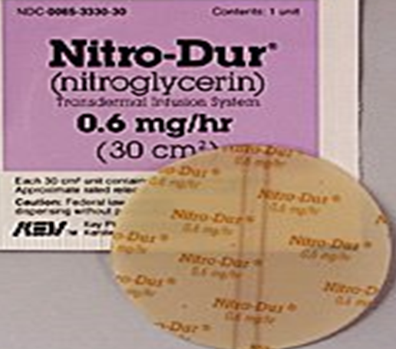
Nitro-Dur
Representatives of this type of drug delivery system are as follows:
Is Transdermal drug Delivery (TDD) system produced by:
Heating an aqueous solution of water-soluble
    polymer, (glycerol, & polyvinyl alcohol).
The temp. is then lowered.
Then “Nitroglycerin & lactose” triturated and dispersed just above the congealing temp. of the solution.
The mixture is solidified in a mold at or below room temp. & then sliced to form a medicated polymer disk.

Slide 26
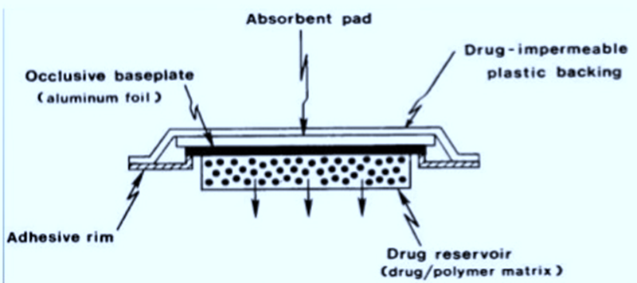
After assembly onto a drug impermeable metallic plastic laminate, a patch type TDD system is assembled with an adhesive rim surrounding the medicated disk (figure 10).
This TDDS provide a continuous transdermal infusion of Nitroglycerin at dosage rate of 0.5 mg/cm²/day (24 hr.).
Used for the treatment of Angina Pectoris.
Figure 10
Notes:
The drug reservoir can also be formulated by directly dispersing the drug in a pressure sensitive polymer. Eg. , poly(isobutylene) or poly acrylate

Slide 27
Compudose Subdermal implant
Dispersing micronized estradiol crystal in a viscous silicon elastomer.
Coating the dispersing polymer around a rigid (drug free) silicon rod by extrusion to form a cylindrical implant.
Compudose Implant is designed for subcutaneous implantation for growth promotion.
It release a controlled dose of estradiol for 200 or 400 days.
Silicon Rod
Estradiol Packing
Polymer Matrix

Slide 28
Compudose Cattle Growth Implant
Microcrystalline estradiol in a silicon rubber matrix, which is then used to coat a biocompatible inert core of silicone rubber.
Implants placed under skin of animals.
Estradiol release into systemic circulation.
Stimulate animals Pituitary Gland.
Increase in growth hormone production.
Animal gain weight at higher rate.
At end of growing period, implant easily removed.
Available as Campudose-400 and Campudose-200.

Slide 29
C. Micro-reservoir Partition-Controlled D.D.S

Slide 30
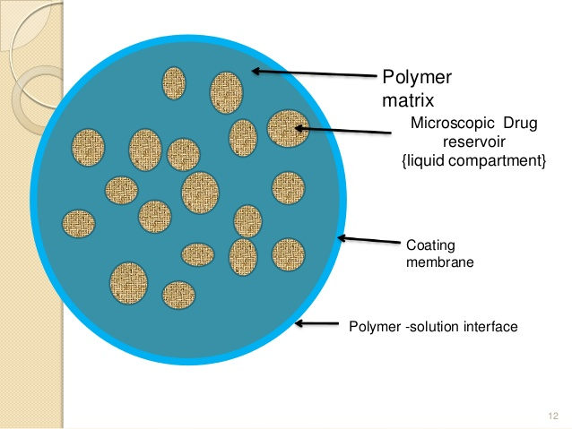
C. Micro-reservoir Partition-Controlled D.D.S
The drug reservoir is fabricated by:
Micro-dispersion of an aqueous suspension of drug using a high-energy dispersion technique in a suitable polymer, such as silicone elastomers, to form a homogeneous dispersion of many discrete, microscopic drug reservoir.
Different shapes and sizes of drug delivery devices can be produced from this micro-reservoir drug delivery system by molding or hot melt extrusion.

Slide 31
Depending upon the desired rate of drug release. The device can be further coated with layer of suitable polymer to modify the mechanism & the rate of drug release.
Release of drug molecules from this type of DDS can follow either:
Dissolution or a matrix diffusion-controlled process.
The rate of release is controlled at a pre-programed rate by controlling various physicochemical parameters.
Representatives of this type of drug deliver system are as follows:

Slide 32
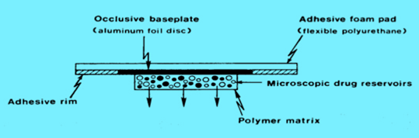
Transdermal Nitrodisc System
The drug reservoir formed as follows:
Preparing a suspension of Nitroglycerin & lactose triturate in an aqueous soliton of 40% Polyethylene Glycol (PEG) 400.
Dispersing it with isopropyl palmitate, in a mixture of viscous silicone elastomer.
It is engineered to provide a transdermal
administration of Nitroglycerin at a daily
dosage of 0.5mg/cm² for once-a-day
medication of angina pectoris.
Notes:
The resultant drug-polymer dispersion is then molded to form a solid medicated disk in situ on a drug-impermeable metallic plastic laminate, with surrounding adhesive rim, by injection molding under instantaneous heating.

Slide 33
IV. Activation-Modulated Drug Delivery Systems
In this group of controlled-release
DDS is activated by:
Physical process.
Chemical process.
Biochemical process
And or facilitated by the energy supplied externally (figure 3).
The rate of drug released is then controlled based on the nature of the process applied or the type of energy used.
figure 3

Slide 34
Classification of the Activation-Modulated DDS

Slide 35
1. Physical means
Osmotic pressure-activated DDS.
Hydrodynamic pressure-activated DDS.
Vapor pressure-activated DDS.
Mechanically activated DDS.
Magnetically activated DDS.
Sonophoresis-activated DDS.
Iontophoresis-activated DDS.
Hydration-activated DDS.

Slide 36
Chemical means
pH-activated DDS.
Ion-activated DDS.
Hydrolysis- activated DDS.

Slide 37
Biochemical means
Enzyme-activated DDS.
Biochemical-activated DDS.

Slide 38
Systems using this technology for controlled the release of drug.

Slide 39
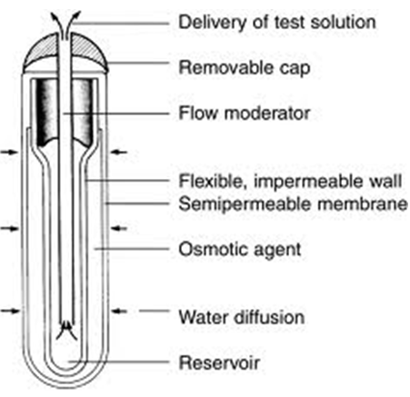
Osmotic pressure-activated DDS.
This type of activation-controlled drug delivery system depends on osmotic pressure to activate the release of drug. To release in solution form at a constant stem.
In this system the drug reservoir, which can be either a solution or solid formulation, contained within a semipermeable housing with controlled water permeability.
The drug is activated to release in solution form at a constant rate through a special delivery orifice.
The rate of drug release is modulated by controlling the gradient of osmotic pressure.

Slide 40
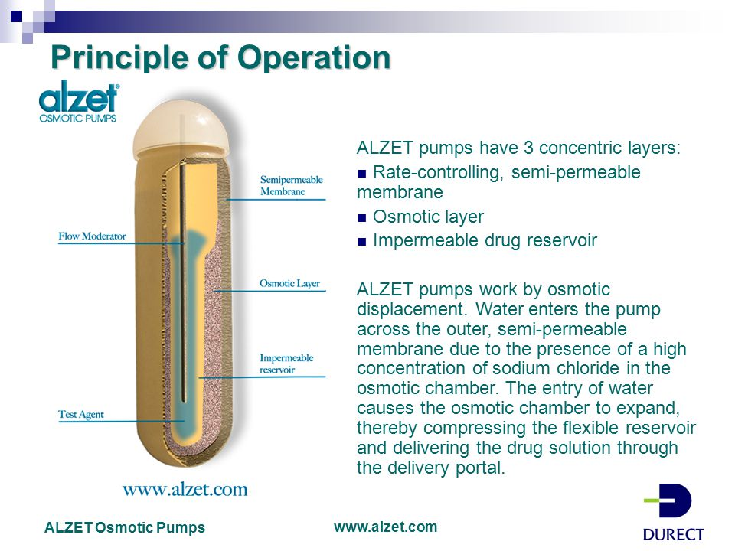

Slide 41
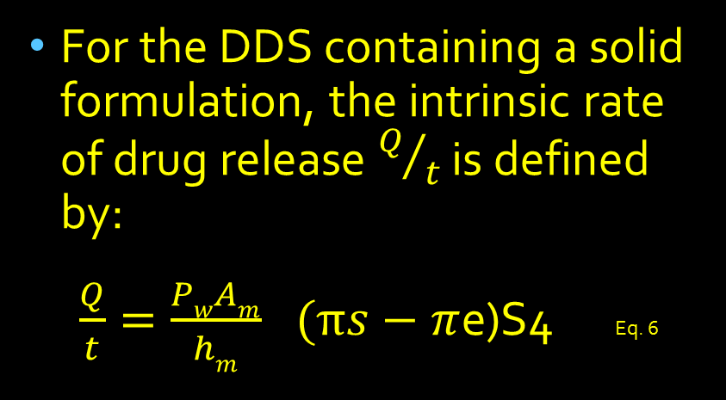
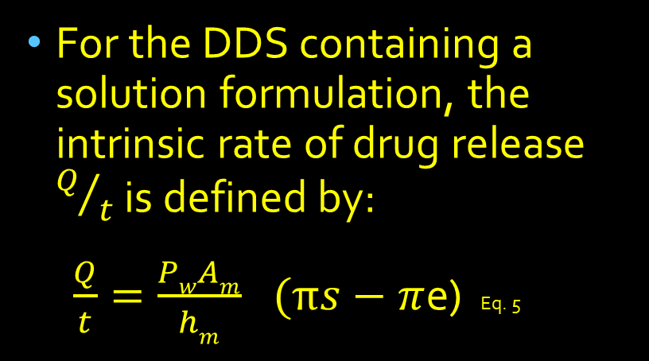
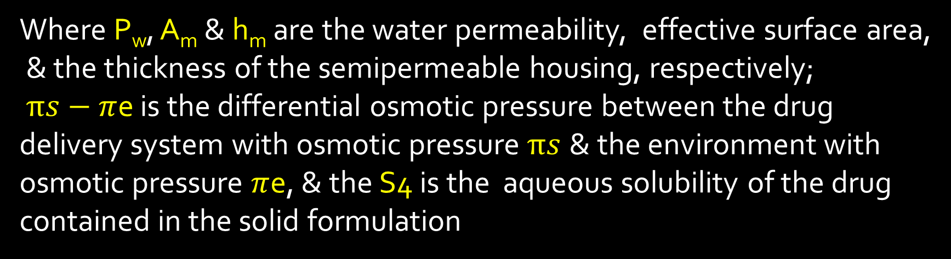
For the DDS containing a solution formulation, the intrinsic rate of drug release $Q/t$ is defined by:
$\frac{Q}{t}={\frac{PwAm}{hm}}^{}(πs−π$e) Eq. 5
For the DDS containing a solid formulation, the intrinsic rate of drug release $Q/t$ is defined by:
$\frac{Q}{t}={\frac{PwAm}{hm}}^{}(πs−π$e)S4 Eq. 6
Where P_{w}, A_{m} & h_{m} are the water permeability, effective surface area,
& the thickness of the semipermeable housing, respectively;
$πs−π$e is the differential osmotic pressure between the drug delivery system with osmotic pressure$πs$ & the environment with osmotic pressure $π$e, & the S4 is the aqueous solubility of the drug contained in the solid formulation

Slide 42
The release of drug molecules from this type of controlled-release drug delivery system is activated by osmotic pressure and controlled at a rate determined by:
  The water permeability.
  The effective surface area of the semipermeable housing
  Osmotic pressure gradient.
Representative of this type of drug delivery systems are as follows:

Slide 43
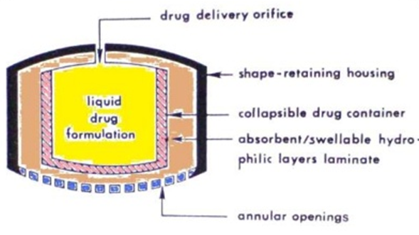
B. Hydrodynamic Pressure-Activated DDS σ 19
A hydrodynamic pressure-activated drug delivery system can be fabricated by enclosing a collapsible, impermeable container, which contains a liquid drug formulation to form a drug reservoir compartment, inside a rigid shape-retaining housing (figure 19).
Figure 19

Slide 44
A composite laminate of an absorbent layer & a swellable, hydrophilic polymer layer is sandwiched between the drug reservoir compartment & the housing.
In the GIT the laminate absorbs the G.I. fluid through the annular openings at the lower end of the housing & becomes swollen, which generates hydrodynamic pressure in the system.
The Hydrodynamic pressure created, forces the drug reservoir compartment to reduce in volume & causes the liquid drug formulation to release through the delivery orifice at a rate defined by eq. 7

Slide 45

$\frac{Q}{t}= \frac{PfAm}{hm}$ (θs – θe) Eq. 7
Where $Pf, Am$ and $hm$ are the fluid permeability, the effective surface area, and the thickness of the wall with annular openings, respectively.
The (θs – θe) is the difference in hydrodynamic pressure between the drug delivery system θs and the environment θe.

Slide 46
The release of drug molecules from this type of controlled-release drug delivery system is activated by:
Hydrodynamic pressure.
Controlled at a rate determined by the
  1. Fluid permeability.
  2. Effective surface area of the wall with annular opening.
  3. Hydrodynamic pressure gradient.
In this type the hydrodynamic pressure is used as a source of energy to activate the drug release.

Slide 47
C. Vapor Pressure-Activated D. D. S.
In this type of drug delivery system the drug reservoir, which also exists as a solution formulation, is contained inside the infusion compartment. It is physically separated from the pumping compartment by a freely movable partition
(figure 20).
The pumping compartment to be delivered through a series of flow regulator and delivery cannula into the blood circulation at a constant flow rate.

Slide 48
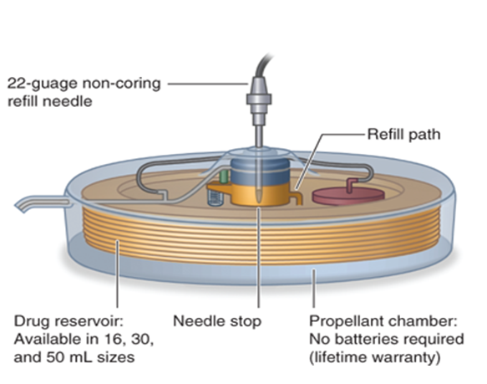
Vapor Pressure Activated
Vapor pressure is used as the power source.
Drug reservoir is in solution formulation.
Fluid which vaporizes at body temperature is used as HFA

Slide 49
The release of drug from this type of controlled-release drug delivery system is activated by vapor pressure, & controlled at a rate determined by:
    The differential vapor pressure.
    The formulation viscosity.
    The size of the delivery cannula.
Example :
      Implantable infusion pump (infusaid) for the constant infusion of:
      Heparin in anticoagulation treatment.
      Insulin in anti-diabetic medication.
      Morphine form patients suffering from the intense pain of terminal cancer.

Slide 50
D. Mechanically Activated DDS
In this type of activation controlled DDS the drug reservoir, is a solution or suspension formulation retained in a container equipped with a mechanically activated pumping system.
A measured dose of drug formulation is delivered into a body cavity, example the nose, through the spray head by manual activation of the drug delivery pumping system.
The volume of solution delivered is controllable, as small as 10-100 µl.
Atypical example of this type of rate-controlled DDS is the MDI, for the intranasal administration of many medications including hormones.

Slide 51
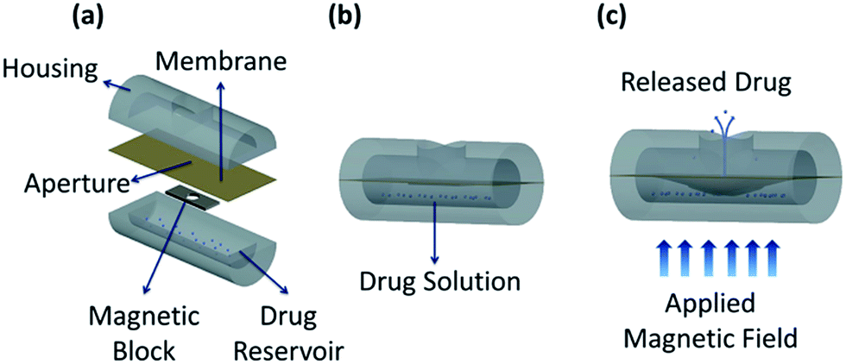
E. Magnetically Activated DDS
In this type of activation-controlled DDS the drug reservoir is a dispersion of peptide or protein powders in a polymer matrix from which drug can be delivered only at a relatively slow rate.
This low rate of delivery can be improved by incorporating an electromagnetically triggered vibration mechanism into the delivery device.
(figure 22)

Slide 52
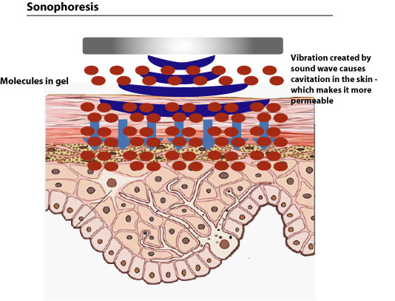
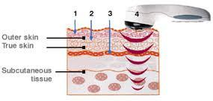
F. Sonophoresis-Activated DDS
This type of activation-controlled drug delivery systems utilizes ultrasonic energy to activate or (trigger) the delivery of drug from a polymeric drug delivery devices (figure 23).
Figure 23

Slide 53
G. Iontophoresis-Activated DDS σ 25
This type of activation-controlled drug delivery systems uses electrical current to activate & to modulate the diffusion of a charged drug molecule across the skin, in a manner similar to passive diffusion under a concentration gradient, but at a much facilitated rate.
The iontophoresis-facilitated skin permeation rate of a charged molecule.

