Slide 1
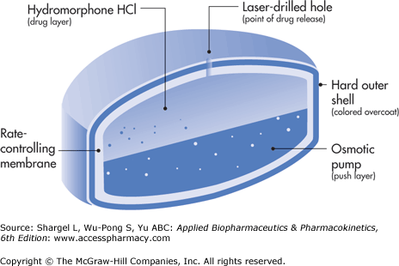
Concepts and System Design for Rate-Controlled Drug Delivery
Dr. Majed R. Feddah

Slide 2
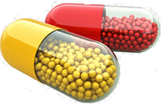
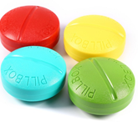
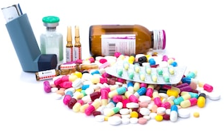
I. Introduction
For many decade treatment of an acute disease or chronic illness has been mostly accomplished by delivery of drugs to patients using various pharmaceutical dosage forms, including tablets, capsules, pills, suppositories, creams, ointments, liquids, aerosols, and injectables, as drug carriers.
These medications gives prompt release of drug.
To achieve & to maintain the therapeutic concentration in the body it is necessary to take the medication several times a day.
This results in a significant fluctuation in drug
Levels (Figure 1)

Slide 3
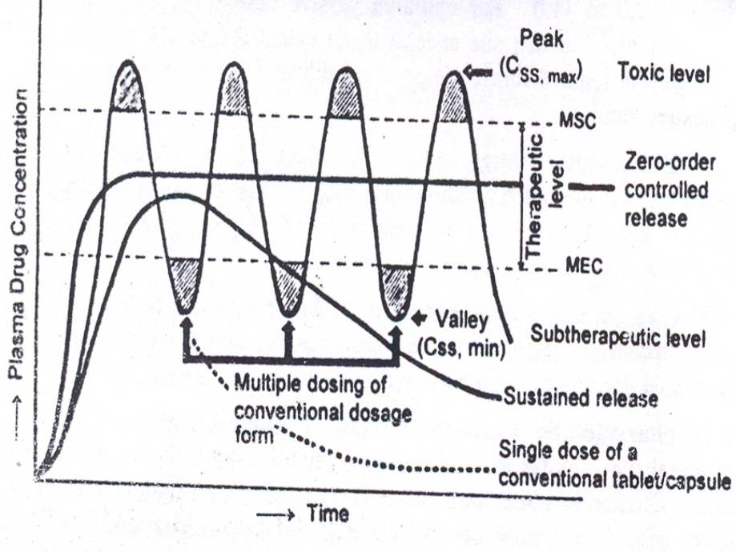
Plasma concentration time profile

Slide 4
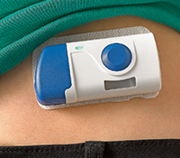
Several technical advancement have been made.
The result is the development of new techniques for drug delivery.
These techniques are capable of :
    Controlling the rate of drug delivery.
    Sustaining the duration of therapeutic activity.
    Targeting the delivery of drug to a tissue.

Slide 5
Advantages
Total dose is low.
Reduced GI side effects.
Reduced dosing frequency.
Better patient acceptance and compliance.
Less fluctuation at plasma drug levels.
More uniform drug effect
Improved efficacy/safety ratio.

Slide 6
Disadvantages
Dose dumping.
Reduced potential for accurate dose adjustment.
Need of additional patient education.
Stability problem.

Slide 7
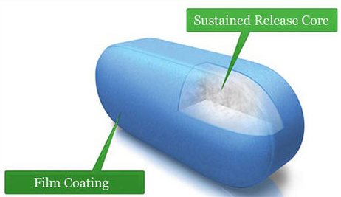
Sustained Release
This term is used to describe a pharmaceutical dosage form formulated to retard the release of API such that its appearance in the Blood or and Plasma is delayed and or prolonged and its plasma profile is sustained in duration.
The onset of its pharmacologic action is often delayed, and the duration of its therapeutic effect is sustained.

Slide 8
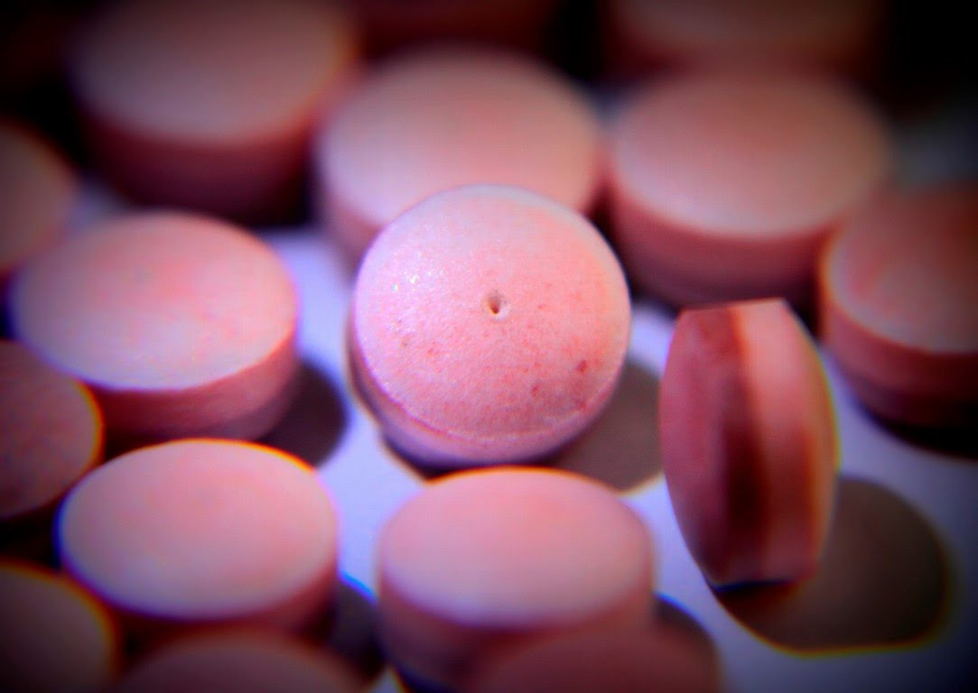
Controlled Release
The term controlled release has a meaning that goes beyond the scope of sustained drug action.
It also indicate a Predictability & Reproducibility in the drug release kinetics, which means that release of drug from controlled drug delivery system (which is prepared on the basis of Osmotic Pumping Technology), & Dexatrim®, a sustained-release drug delivery system (which is prepared on the basis of Spansule Coating Technology), are compared.

Slide 9
II. CLASSIFICATION OF RATE-CONTROLLED DRUG DELIVERY SYSTMS
Based on their technical sophistication controlled release drug delivery systems can be classified into four categories: (figure 3)
      Rate-preprogrammed DDS.
      Activation modulated DDS.
      Feedback regulated DDS.
      Site targeting DDS.

Slide 10
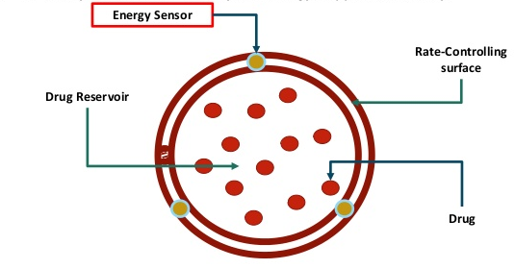
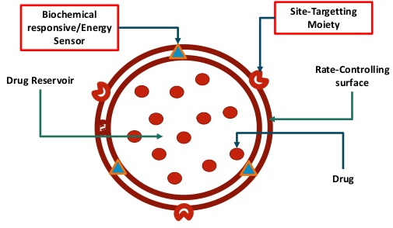
1. Rate-preprogrammed DDS
(figure 3)
2. Activation modulated DDS
Drug
3. Feedback regulated DDS
4. Site targeting DDS

Slide 11
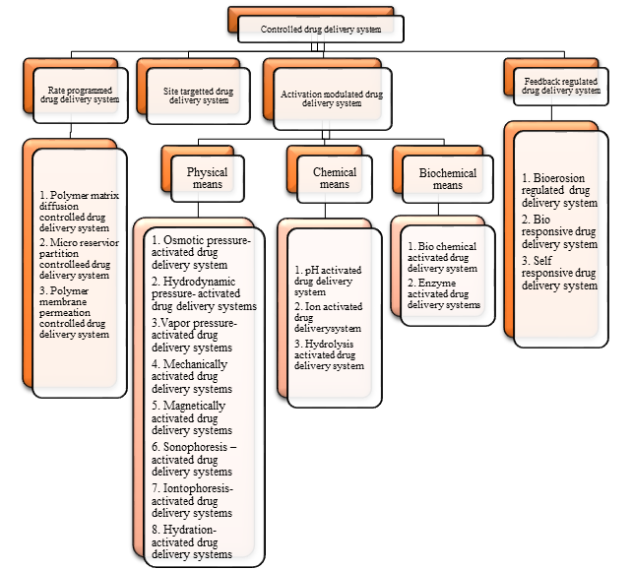

Slide 12
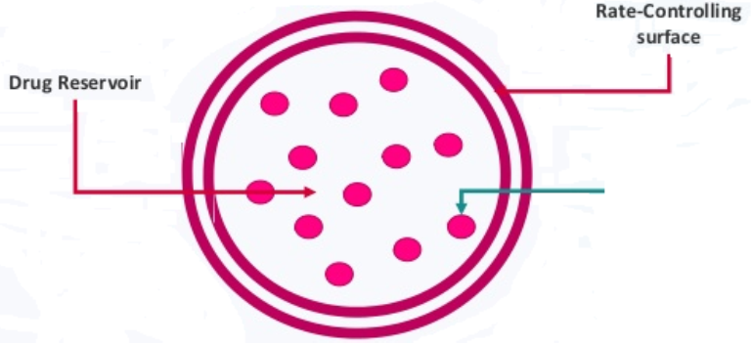
III. Rate preprogrammed D.D.S
In this group of controlled release drug devilry systems, the release of drug molecules from the delivery systems has been prep-programmed at specific rate profiles.
This was done by system design, which controls the molecular diffusion of drug molecules in and/or across the barrier medium within or surrounding the delivery system.
Fick’s lows of diffusion are often followed.
These systems can be further classified as
follows:
Drug

Slide 13
1. Rate-preprogrammed DDS
A. Polymer Membrane Permeation-Controlled DDS .
Progestasert IUD/Norplant subdermal implant/Ocusert System/Transderm-Nitro
B. Polymer Matrix Diffusion-Controlled DDS.
Nitro-Dur and Compudose Subdermal implant
C. Micro-reservoir Partition-Controlled DDS
Transdermal Nitrodisc System

Slide 14
A. Polymer Membrane Permeation-Controlled DDS
In this type of pre-programmed DDS, a drug formulation is totally or partially encapsulated within a drug reservoir compartment.
The drug release surface is covered by a rate-controlling polymeric membrane having a specific permeability.
The drug reservoir may exist in:
  Solid form.
  Suspension form.
  Solution form.

Slide 15
The polymeric membrane can be fabricated from:
  Nonporous (homogeneous or heterogeneous) polymeric material.
  Microporous.
  Semipermeable membrane.
The encapsulation of drug formulation inside the reservoir compartment is accomplished by:
  Injection molding (I.M.), or Hot Melt Extrusion (HME)
  Spray drying.
  Capsulation.
  Microencapsulation, Or other technique.
Different shapes and sizes of drug delivery systems can be fabricated. (Figure 4)

Slide 16
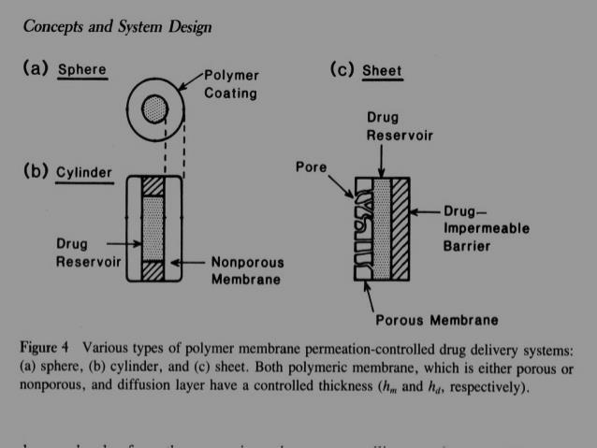

Slide 17
The release of drug molecules from this type of rate controlled drug delivery systems is controlled at a pre-programmed rate by controlling:
      The partition coefficient of the drug molecule.
      The diffusivity of the drug molecule.
      The thickness of the rate controlling membrane.
Representatives of this type of drug delivery system are follows:

Slide 18
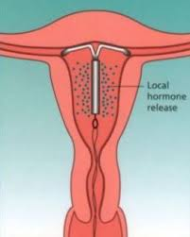
Progestasert IUD
Intrauterine device, the drug reservoir is a suspension of progesterone in silicone medical fluid & encapsulated in the vinyl acetate copolymer.
It is designed to deliver natural progesterone continuously in the uterine cavity at daily dosage rate of at least 65µg/day to achieve contraception for one year

Slide 19
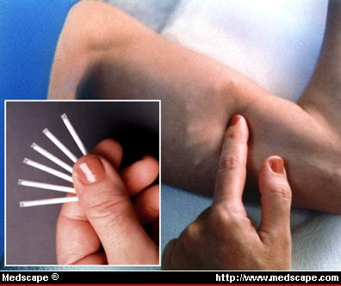
Norplant subdermal implant
Made from Non-porous silicone medical grade tubing (with both ends sealed with silicone medical grade adhesive) to encapsulate either:
Levonorgestrel crystals alone (generation I).
Levonorgestrel in silicone elastomer matrix “Solid dispersion” (generation II).
It is designed for the continuous subcutaneous release of levonorgestrel at a daily dosage rate of 30µg, to each subject (6 unites of I or 2 untints of II) for 7 years.

Slide 20
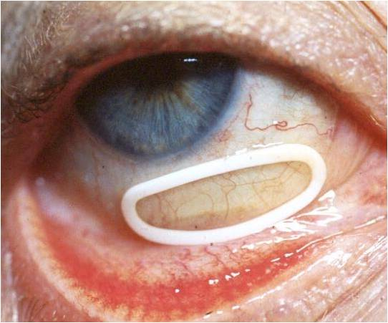
Ocusert System
The drug reservoir is a thin disk of pilocarpine alginate complex sandwiched between two transparent sheets of microporous ethylene-vinyl acetate copolymer membrane.
The microporous membrane permit the tears fluid to penetrate into the drug reservoir compartment to dissolve pilocarpine from the complex. Pilocarpine molecules are then released at constant rate of 20 µg to 40µg/ hr. for management of glaucoma for up to 7 days.

Slide 21
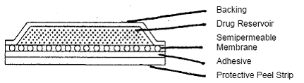
Transderm-Nitro
It is a transdermal therapeutic system in which the drug reservoir a dispersion of Nitroglycerin-lactose triturate in silicone medical fluid, is encapsulated in a thin ellipsoidal patch.
The transdermal patch is constructed from a drug impermeable metallic plastic laminate as the backing membrane & a constant surface of rate controlling Microporous membrane of ethylene vinyl-acetate copolymer as the drug releasing surface.

Slide 22
This device is fabricated by an Injection molding process.
Additionally, a thin layer of pressure sensitive silicone adhesive polymer is coated on the surface on the rate controlling membrane to adhesive an intimate constant of the drug release surface with the skin.
It designed to deliver nitroglycerin at dosage rate of 0.5 mg/cm/day for transdermal absorption to provide daily relief of anginal attacks.

Slide 23
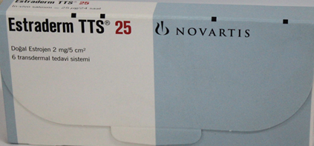
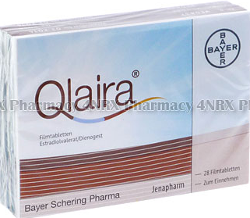
The same technology has also been utilized in the development of Estraderm, which administers a controlled dose of estradiol trans-dermally over 3-4 days for the relief of postmenopausal syndrome

Slide 24
B. Polymer Matrix Diffusion-Controlled DDS
In this type of preprogramed DDS the drug reservoir is prepared by homogeneously dispersing drug particles in a rate-controlling polymer matrix fabricated from either:
    Lipophilic or
    Hydrophilic polymer.
The drug dispersion in the polymer matrix is accomplished by either:
  Blending the fine drug particles with a liquid polymer or viscous polymer, followed by `cross-linking of the polymer chains.
  Mixing drug solids with a rubbery polymer at an elevated temp.
  Dissolving the drug & the polymer in a common solvent, followed by solvent evaporation at elevated temp. & under vacuum.

Slide 25
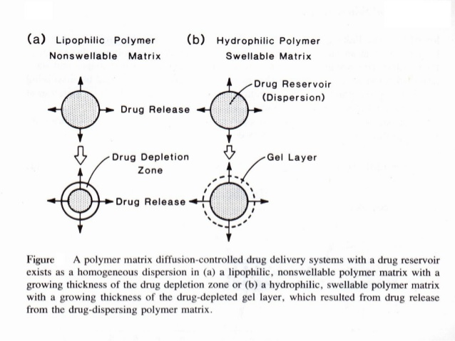
The resultant drug polymer dispersion is then molded or extruded to form a drug delivery device of various shapes and sizes designed for specific application. (figure 9).
(figure 9).

Slide 26

The release of drug molecules from this type of DDS is controlled at a pre-programmed rate by controlling the:
    Loading dose.
    Drug solubility in the polymer.
    Diffusivity in the polymer matrix.
$\frac{Q}{t\frac{1}{2}}$ $=(2ACR$D_{p})$1/2$ Eq. 2
Where A is the initial drug loading dose in the polymer matrix; $CR$ is the drug solubility in the polymer, which also the drug reservoir concentration in the system, and D_{p} is the diffusivity of the drug molecules in the polymer matrix.
Notes:
The rate of drug release from this polymer matrix diffusion-controlled DDS is time dependent and is defined at steady state by $\frac{Q}{t1/2}=(2ACrD{p)}^{1/2}$
Where A is the initial drug loading dose in the polymer matrix; Cr is the drug solubility in the polymer, which is also the drug reservoir concentration in the system, and Dp is the diffusivity of the drug molecules in the polymer matrix.

Slide 27
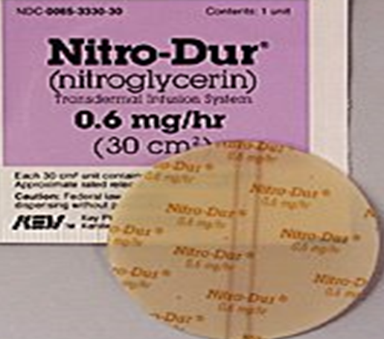
Nitro-Dur
Representatives of this type of drug delivery system are as follows:
Is a transdermal drug Delivery (TDD) system produced by:
Heating an aqueous solution of water-soluble polymer,
(glycerol, & polyvinyl alcohol).
The temp. is then lowered & “Nitroglycerin & lactose” triturated are dispersed just above the congealing temp. of the solution.
The mixture is solidified in a mold at or below room temp. & then sliced to form a medicated polymer disk.

Slide 28
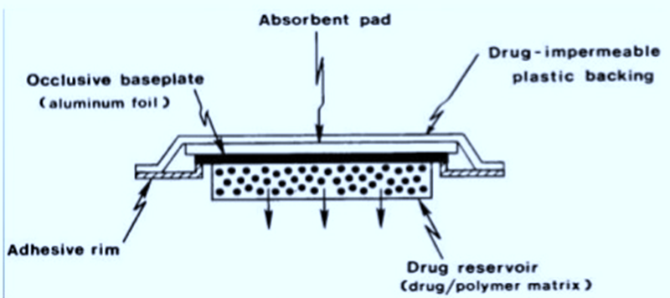
After assembly onto a drug impermeable metallic plastic laminate, a patch type TDD system is assembled with an adhesive rim surrounding the medicated disk (figure 10).
This TDDS provide a continuous transdermal infusion of Nitroglycerin at dosage rate of 0.5 mg/cm²/day (24 hr.).
Used for the treatment of angina pectoris.
Figure 10
Notes:
The drug reservoir can also be formulated by directly dispersing the drug in a pressure sensitive polymer. Eg. , poly(isobutylene) or poly acrylate

Slide 29
Compudose Subdermal implant
Dispersing micronized estradiol crystal in a viscous silicon elastomer.
Coating the dispersing polymer around a rigid (drug free) silicon rod by extrusion to form a cylindrical implant.
Compudose Implant is designed for subcutaneous implantation for growth promotion.
It release a controlled dose of estradiol for 200 or 400 days.
Silicon Rod
Estradiol Packing
Polymer Matrix

Slide 30
Compudose Cattle Growth Implant
Microcrystalline estradiol in a silicon rubber matrix, which is then used to coat a biocompatible inert core of silicone rubber.
Implants placed under skin of animals.
Estradiol release into systemic circulation.
Stimulate animals Pituitary Gland.
Increase in growth hormone production.
Animal gain weight at higher rate.
At end of growing period, implant easily removed.
Available as Campudose-400 and Campudose-200.

Slide 31
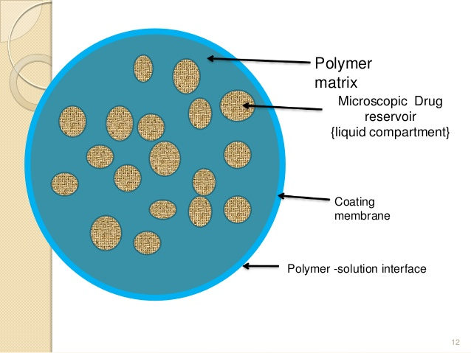
C. Micro-reservoir Partition-Controlled D.D.S
The drug reservoir is fabricated by:
Micro-dispersion of an aqueous suspension of drug using a high-energy dispersion technique in a suitable polymer, such as silicone elastomers, to form a homogeneous dispersion of many discrete, microscopic drug reservoir.
Different shapes and sizes of drug delivery devices can be produced from this micro-reservoir drug delivery system by molding or hot melt extrusion.

Slide 32
Depending upon the desired rate of drug release. The device can be further coated with layer of suitable polymer to modify the mechanism & the rate of drug release.
Release of drug molecules from this type of DDS can follow either:
Dissolution or a matrix diffusion-controlled process.
The rate of release is controlled at a preprogram rate by controlling various physicochemical parameters.
Representatives of this type of drug deliver system are as follows:

Slide 33
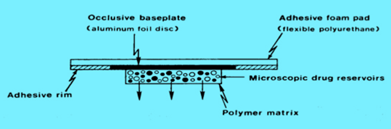
Transdermal Nitrodisc System
The drug reservoir formed as follows:
Preparing a suspension of Nitroglycerin & lactose triturate in an aqueous soliton of 40% Polyethylene Glycol (PEG) 400.
Dispersing it with isopropyl palmitate, in a mixture of viscous silicone elastomer.
It is engineered to provide a transdermal administration of Nitroglycerin at a daily dosage of 0.5mg/cm² for once-a-day medication of angina pectoris.
Notes:
The resultant drug-polymer dispersion is then molded to form a solid medicated disk in situ on a drug-impermeable metallic plastic laminate, with surrounding adhesive rim, by injection molding under instantaneous heating.

Slide 34
IV. Activation-Modulated Drug Delivery Systems
In this group of controlled-release
DDS is activated by:
Physical process.
Chemical process.
Biochemical process
And or facilitated by the energy supplied externally (figure 3).
The rate of drug released is then controlled based on the nature of the process applied or the type of energy used.
figure 3

Slide 35
Classification of the Activation-Modulated DDS

Slide 36
1. Physical means
Osmotic pressure-activated DDS.
Hydrodynamic pressure-activated DDS.
Vapor pressure-activated DDS.
Mechanically activated DDS.
Magnetically activated DDS.
Sonophoresis-activated DDS.
Iontophoresis-activated DDS.
Hydration-activated DDS.

Slide 37
Chemical means
pH-activated DDS.
Ion-activated DDS.
Hydrolysis- activated DDS.

Slide 38
Biochemical means
Enzyme-activated DDS.
Biochemical-activated DDS.

Slide 39
Systems using this technology for controlled the release of drug.

Slide 40
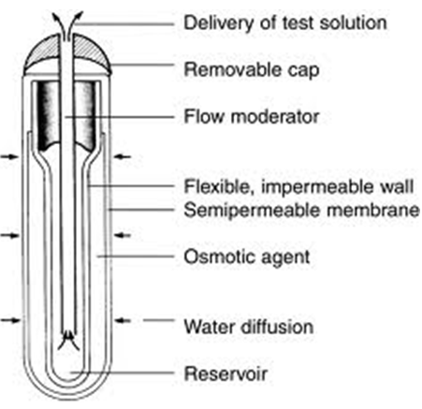
Osmotic pressure-activated DDS.
This type of activation-controlled drug delivery system depends on osmotic pressure to activate the release of drug. To release in solution form at a constant stem.
In this system the drug reservoir, which can be either a solution or solid formulation, contained within a semipermeable housing with controlled water permeability.
The drug is activated to release in solution form at a constant rate through a special delivery orifice.
The rate of drug release is modulated by controlling the gradient of osmotic pressure.

Slide 41
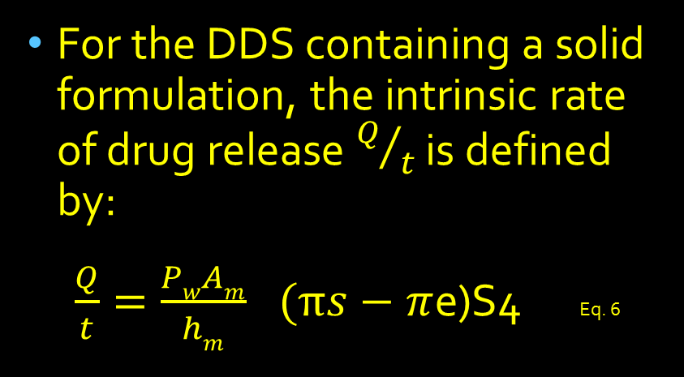
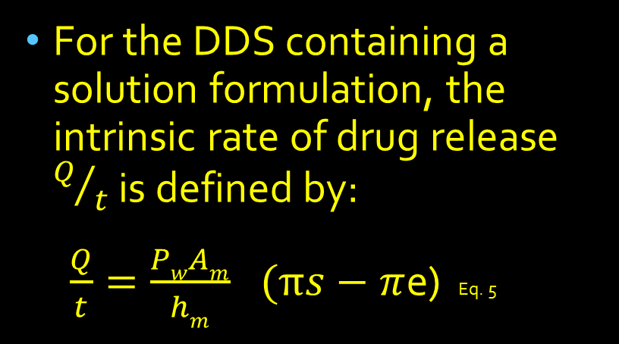
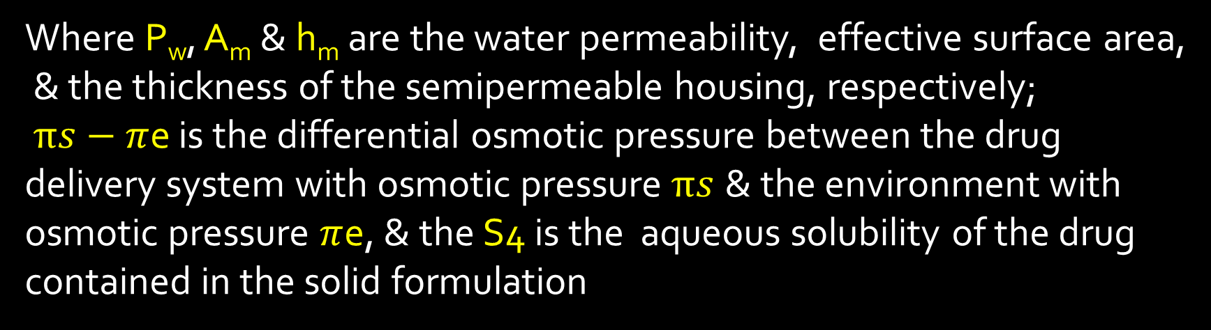
For the DDS containing a solution formulation, the intrinsic rate of drug release $Q/t$ is defined by:
$\frac{Q}{t}={\frac{PwAm}{hm}}^{}(πs−π$e) Eq. 5
For the DDS containing a solid formulation, the intrinsic rate of drug release $Q/t$ is defined by:
$\frac{Q}{t}={\frac{PwAm}{hm}}^{}(πs−π$e)S4 Eq. 6
Where P_{w}, A_{m} & h_{m} are the water permeability, effective surface area,
& the thickness of the semipermeable housing, respectively;
$πs−π$e is the differential osmotic pressure between the drug delivery system with osmotic pressure$πs$ & the environment with osmotic pressure $π$e, & the S4 is the aqueous solubility of the drug contained in the solid formulation

Slide 42
The release of drug molecules from this type of controlled-release drug delivery system is activated by osmotic pressure and controlled at a rate determined by:
  The water permeability.
  The effective surface area of the semipermeable housing
  Osmotic pressure gradient.
Representative of this type of drug delivery systems are as follows:

Slide 43
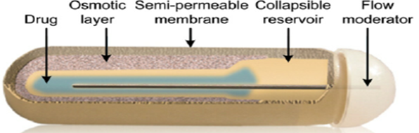
Insertable Alzet Osmotic Pump
The drug reservoir, normally a solution formulation, contained within a collapsible, impermeable polyester bag whose external surface is coated with a layer of osmotically active salt, such as NaCl.
This reservoir compartment is then
completely sealed inside rigid housing
wall with a semipermeable membrane
At the implantation site the water component in the tissue fluid penetrates through the semipermeable housing.
Figure 14

Slide 44
This creates an osmotic pressure in the narrow spacing between the flexible reservoir compartment wall & the rigid semipermeable housing.
Under the osmotic pressure differential created, the reservoir compartment is forced to reduce its volume and the drug solution is delivered at a controlled rate (Eq. 5) through the flow moderator in the system.
By varying the drug concentration in the solution, different doses of drug can be delivered at a constant rate for a period of 1-4 weeks.

Slide 45

Acutrim tablet
NO
Its an oral rate-controlled DD device, is a solid tablet of water-soluble & osmotically active phenylpropanolamine (PPA) Hcl enclosed within a semipermeable membrane made from cellulose triacetate .
The surface of the semipermeable membrane is further coated with a thin layer of PPA dose for immediate release, in the GIT, the GI. fluid dissolve the immediate releasable PPA layer, which provides an initial dose of PPA, & its water component then penetrates through the semipermeable membrane at a rate determined by ( $\frac{Q}{t}={\frac{PwAm}{hm}}^{}$) to dissolve the controlled release dose of PPA.

Slide 46
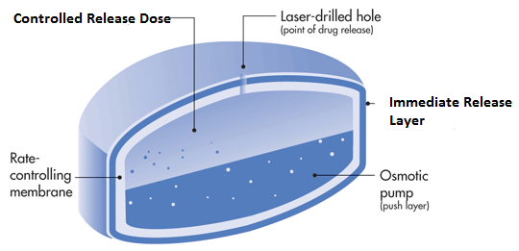
Osmotic Pump Technology
figure 18

Slide 47
NO
Under the osmotic pressure differential created(пs-пe), the PPA solution is delivered continuously at a controlled rate Eq. 6 through an orifice pre-drilled by a laser beam.
It is designed to provide a controlled delivery of PPA over a duration of 16hr for appetite suppression in a weight control program.

Slide 48
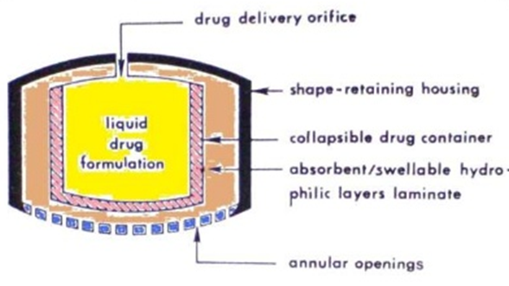
B. Hydrodynamic Pressure-Activated DDS σ 19
A hydrodynamic pressure-activated drug delivery system can be fabricated by enclosing a collapsible, impermeable container, which contains a liquid drug formulation to form a drug reservoir compartment, inside a rigid shape-retaining housing (figure 19).
Figure 19

Slide 49
A composite laminate of an absorbent layer & a swellable, hydrophilic polymer layer is sandwiched between the drug reservoir compartment & the housing.
In the GIT the laminate absorbs the G.I. fluid through the annular openings at the lower end of the housing & becomes increasingly swollen, which generates hydrodynamic pressure in the system.
The hydrodynamic pressure created, forces the drug reservoir compartment to reduce in volume & causes the liquid drug formulation to release through the delivery orifice at a rate defined by eq. 7

Slide 50

$\frac{Q}{t}= \frac{PfAm}{hm}$ (θs – θe) Eq. 7
Where $Pf, Am$ and $hm$ are the fluid permeability, the effective surface area, and the thickness of the wall with annular openings, respectively.
The (θs – θe) is the difference in hydrodynamic pressure between the drug delivery system θs and the environment θe.

Slide 51
The release of drug molecules from this type of controlled-release drug delivery system is activated by hydrodynamic pressure and controlled at a rate determined by the fluid permeability and effective surface area of the wall with annular opening as well as by the hydrodynamic pressure gradient.
In this type the hydrodynamic pressure is used as a source of energy to activate the drug release.

Slide 52
C. Vapor Pressure-Activated D. D. S.
In this type of drug delivery system the drug reservoir, which also exists as a solution formulation, is contained inside the infusion compartment. It is physically separated from the pumping compartment by a freely movable partition
(figure 20).
The pumping compartment to be delivered through a series of flow regulator and delivery cannula into the blood circulation at a constant flow rate the rate of delivery q/t is defaced by eq. 8

Slide 53
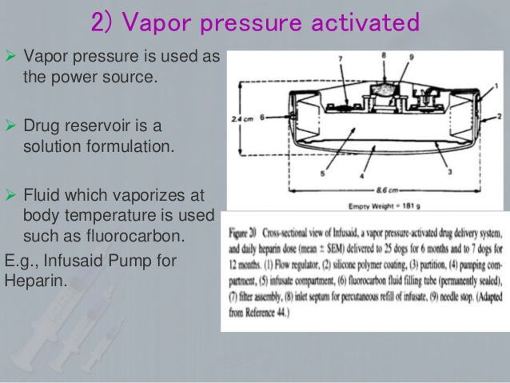
Figure 20

Slide 54
The release of drug from this type of controlled-release drug delivery system is activated by vapor pressure, & controlled at a rate determined by:
    The differential vapor pressure.
    The formulation viscosity.
    The size of the delivery cannula.
Example :
Implantable infusion pump (infusaid) for the constant infusion of:
Heparin in anticoagulation treatment.
Insulin in anti-diabetic medication.
Morphine form patients suffering from the intense pain of terminal cancer.

Slide 55
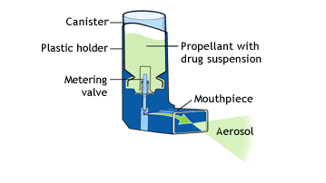
D. Mechanically Activated DDS
In this type of activation controlled DDS the drug reservoir, is a solution formulation retained in a container equipped with a mechanically activated pumping system.
A measured dose of drug formulation is delivered into a body cavity, example the nose, through the spray head by manual activation of the drug delivery pumping system.
The volume of solution delivered is controllable, as small as 10-100 µl.
Atypical example of this type of rate-controlled DDS is the MDI (figure 21) for the intranasal administration of a precision dose of Buserelin, a synthetic analog of luteinizing hormone releasing hormone (LHRH) and insulin.

Slide 56
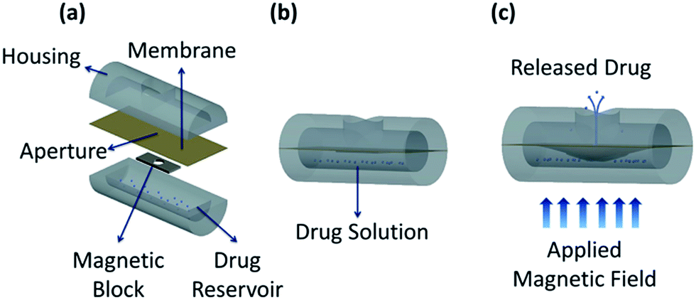
E. Magnetically Activated DDS
In this type of activation-controlled DDS the drug reservoir is a dispersion of peptide or protein powders in a polymer matrix from which macromolecular drug can be delivered only at a relatively slow rate. This low rate of delivery can be improved by incorporating an electromagnetically triggered vibration mechanism into the polymeric delivery device.
(figure 22)

Slide 57
Combined with a hemispherical design, a zero-order drug delivery profile is achieved.
A sub-dermally implantable, magnetically activated drug delivery device is fabricated by first positioning a tiny magnet ring in the core of the hemispherical drug dispersing polymer matrix and then coating its external surface with a drug-impermeable polymer, such as ethylene-vinyl acetate copolymer or silicone elastomers, except one cavity at the center of the flat surface.
This uncoated cavity is positioned directly above the magnet ring. Which permits a peptide drug to be released

Slide 58
The hemispherical magnetic delivery device produced has been used to delivery protein drugs, such as bovine serum albumin, at a low basal rate, by a simple diffusion process under non-triggering conditions figure 22.
As the magnet is activated to vibrate by an external electromagnetic field, the drug molecules are delivered at a much higher rate.

Slide 59
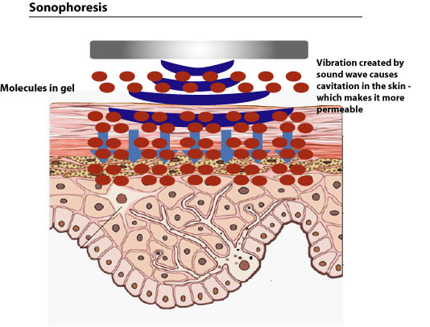
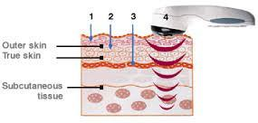
F. Sonophoresis-Activated DDS
This type of activation-controlled drug delivery systems utilizes ultrasonic energy to activate or (trigger) the delivery of drug from a polymeric drug delivery devices (figure 23).
Figure 23

Slide 60
The system can be fabricated from either a non-degradable polymer, such as ethylene-vinyl acetate copolymer, or a bio-erodible polymer, such as poly (bis (p-carboxyphenoxy) alkane anhydride).
The potential application of sonophoreses (or phonophoresis) to regulate the delivery of drugs was recently reviewed.

Slide 61
G. Iontophoresis-Activated DDS σ 25
This type of activation-controlled drug delivery systems uses electrical current to activate & to modulate the diffusion of a charged drug molecule across a biological membrane, like the skin, in a manner similar to passive diffusion under a concentration gradient, but at a much facilitated rate.
The iontophoresis-facilitated skin permeation rate of a charged molecule It consists of three components & is expressed by eq. 9.
A typical example of this type of activation-controlled DDS is the development of an iontophoretic drug delivery system (Phoresor by Motion Control) to facilitate the percutaneous penetration of anti-inflammatory drugs, such as dexamethasone sodium phosphate, to surface tissues.

Slide 62
Further development of the iontophoresis-activated drug delivery technique has recently yielded a new design of iontophoretic drug delivery system, the transdermal periodic ionto-therapeutic system (TPIS).
This new system, which is capable of delivering a physiologically acceptable pulsed direct current in a periodic manner with a special combination of waveform, intensity, frequency, and on/off ratio, for programmed duration.
It has significantly improved the efficiency of transdermal delivery of peptide and protein drugs.

Slide 63
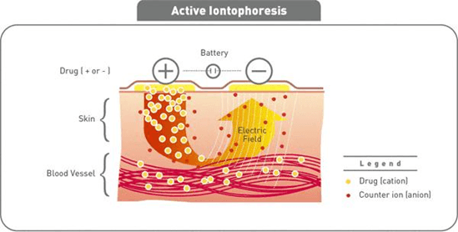
A typical example is the iontophoretic transdermal delivery of insulin, a protein drug, in the control of hyperglycemia in diabetic animals (figure 24).

Slide 64
MDI TERM Exam 15/12/2018

