Slide 1
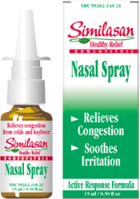
Nasal Drug delivery
References:
Novel drug delivery systems
Encyclopedia of Pharmaceutical Technology

Slide 2
I. Introduction
The nasal drug delivery has received intensive interest since ancient times.
Indian and south America use snuffing for Psychotropic drugs and hallucinogens.
It used treatment of some diseases as powder for snuffing.

Slide 3
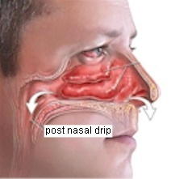
Anatomy of the Nose
Superior turbinate
Middle turbinate
Inferior turbinate
Termination of the
nasal Septum
Nasal Valve

Slide 4
Advantages
Low doses and hence less side effect.
For local and for systemic therapy.
Avoidance of hepatic first pass elimination.
Rate and extent of absorption are comparable to that of IV medication.
Potential for direct CNS Delivery.
Existence of a rich blood Vessels & a highly permeable structure in the nasal mucosa for systemic absorption
Ease and convenience

Slide 5
In the market

Slide 6
II. Physiology of the nose
The lining is ciliated highly vascular, and rich in mucus glands and goblet cells (secrete gel forming Mucin).
The blanket of the nasal mucus (5μm thick blanket) is transported in a posterior direction by the synchronized beat of the cilia.
  95% water.
  2% Mucin cross linked with High M.W Glycoprotein.
  1% Salt.
  1% Other proteins albumin, lysozyme, lactoferrin, 1% lipids

Slide 7
Physiology of the nose
Surface Area
– Nasal Mucosa -150cm²
– Vestibule- 0.6cm²
– Olfactory Epithelium-
15cm²
• Mucociliary Clearance
5mm/min
– Turnover Time 15-20min
• Volume – 150-200μL

Slide 8
Physiology of the Nose
The rate of diffusion of a nasal preparation through the mucus blanket and its rate of clearance from the nasal cavity influenced by:
Physical and Chemical properties of the formulation vehicle.
Particle size.
Surface charge of a drug.
Any other additives incorporated (which may add to reduce the diffusional resistance of the mucus blanket (Enhancers).

Slide 9
The nasal secretion in the adults have a normal
pH between 5.5 -6.5
The nasal secretion contain variety enzymes which may inactivate compounds such as:
Insulin which hydrolyzed slowly by leucine aminopeptidase in nasal secretion.
Prostaglandins, Progesterone and Testosterone
were also inactivated by other enzymes found in the nasal secretion.

Slide 10
Effect of drug and other additives on nasal ciliary function
Some Medication have negative effect on nasal ciliary function such as cocaine, atropine, antihistamines, propranolol, bile salts, xylometazoline, preservatives and hair spray.
Diseases like common cold or any that involve muco-ciliary dysfunction reduce the absorption of the drug from the nasal cavity and will affect the rate of nasal clearance and thus therapeutic efficacy of drugs.

Slide 11
Factors should be considered in the optimization of nasal drug delivery
Method and technique of administration.
Site of deposition.
Rate of clearance.
Minimization of any pathological condition.
Absorption promoters (Enhancers).

Slide 12
Absorption Enhancers
Absorption promoters have long been used to achieve a better systemic bioavailability of nasally administered drugs.
The long term use of these agents could affect the biochemical and biophysical characteristics and the functions of nasal mucosal and thus the efficiency of trans-derma permeation.
    1. The local toxic effects.
    2. The possibility of antibody formation.
    3. The tolerance potential of nasal formulations.

Slide 13
Enhancement of nasal absorption
Strategies employed for improving the nasal drug absorption are:
Structural modification:
Chemical modification of the molecular structure of drug which can alter physical and chemical properties of drugs.
Formulation design:
Selection of suitable formulation excipients:
  Viscosity modifiers
  Absorption enhancers.
  Bio- Adhesive polymers.
  Liposomes.

Slide 14
Epithelial Barriers
Cellular Uptake
– Molecular Weight –1000 Daltons
– Size – 10 Angstroms
– Polarity - Lipophilic

Slide 15
III. Fundamentals of nasal absorption
Physical or chemical parameters:
      Effect of molecular size
      Effect of perfusion rate
      Effect of perfusate volume
      Effect of pH
      Effect of drug concentration

Slide 16
Physical or chemical parameters
Effect of molecular size
Nasal absorption decrease sharply with increasing molecular weight greater than 1000 Daltons.
In a study using different molecular weight medication it was found that there was a linear correlation between the log % of drug absorbed and log molecular weight.
(Figure 1)

Slide 17
Effect of Molecular Size
100.00
Nasal
Rat
Human
10.00
% Absorption
Oral
1.00
Oral
All
0.1
0.01
1000
10.000
100.000
100
(Figure 1)
Molecular Weight

Slide 18
Physical or chemical parameters….cont.
2. Effect of perfusion rate
The perfusion rate increase nasal absorption until reaches a level that is independent of the rate of perfusion
> 2 ml/min
3. Effect of perfusate volume
As the volume increases, the 1st order disappearance of drug from perfusion solution decreased. (Figure 2)

Slide 19
Time course for the% of Phenobarbital remaining in the perfusion solution (pH 6 and 37ºC) as a function of perfusion volume used in ex vivo nasal perfusion studies
100
80
60
% remaining
40
Red 20 ml
Yellow 10 ml
Blue 5 ml
White 3 ml
30
0
15
30
45
60
75
(Figure 2)
Time (min)

Slide 20
Physical or chemical parameters…..cont.
4. Effect of solution pH
The effect of the pH of a perfusion solution on nasal absorption examined using a water soluble ionizable compound (Benzoic acid).
It was found that the extent of absorption is pH dependent, the rate of nasal absorption decreased as the pH increased. (Figure 3).
Peptide based drugs like insulin, it was found that the reduction in plasma glucose was dependent on pH of insulin solution given intra-nasally. (Figure 4)

Slide 21
The extent of nasal absorption (in 60min) of benzoic acid as a function of pH of the perfusion solution.
.
.
50
.
40
.
Percent Absorbed
.
30
.
.
20
10
2
3
4
5
6
7
8
(Figure 3)
pH of the nasal perfusion solution

Slide 22
Physical or chemical parameters…..cont.
6. Effect of drug concentration
A linear and direct relationship was found between the nasal absorption rate of 1-tyrosin and its concentration at pH 7.4 and 37ºC.

Slide 23
Linear relationship between the nasal absorption rate of 1-tyrocine concentration (pH 7.4 and 37ºC ) values are Mean ± SEM standard error mean
.
.
10
8
.
6
.
Absorption rate
4
2
0
1
2
3
4
Concentration

Slide 24
Process of drug transport across the nasal membrane
The diffusion of drug molecules through pore channels in the nasal mucosa involve:
Non-passive diffusion pathways before they reach to the blood stream.
Water soluble compounds follows the aqueous channels in drug transport.
Passive diffusion mechanisms for:
Insulin, Mannitol, and Propranolol.

Slide 25
Mechanisms and pathways
Mechanisms:
Two mechanisms of transport were involved:
  Fast rate: Lipo-philicity dependent (depends on the lipo-philicity of the drug).
  Slow rate: Sensitive to variation in M. W, (depends on the molecular weight of the compound).

Slide 26
Result:
Good systemic bioavailability for molecules smaller than 1000 Daltons without addition of penetration enhancers.
Good bioavailability with assistance of enhancers for molecular weight of 3000 Daltons.
Water soluble compounds is well absorbed and dependent upon diffusion through aqueous channels such as Sodium Chromoglycate.

Slide 27
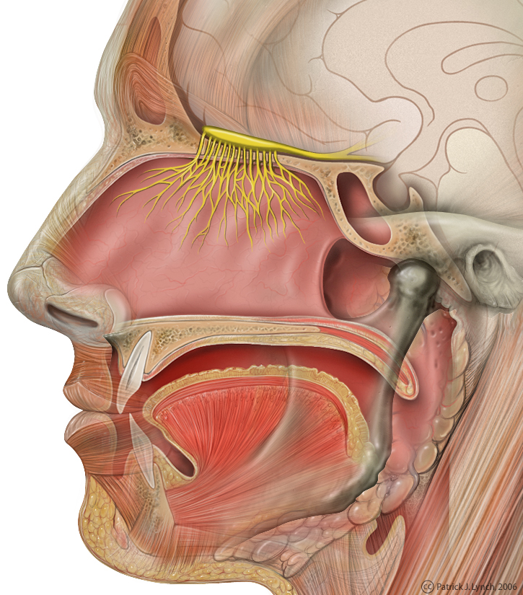
Olfactory Epithelium
Olfactory epithelium:
It is the entrance for medications and other substance to enter Central Nervous System, and the peripheral circulation following nasal absorption.
Facilitate the drug delivery to the brain.

Slide 28
Enhancement in absorption
Structural modification.
Chemical modification of the molecular structure of the drug will modify physicochemical properties of a drug to enhance absorption.
Salt or ester formation.
The drug could be converted to form a Salt or an ester for achieving better Trans Nasal Permeability, such as formation of a salt with increase solubility or of an esters with better nasal membrane permeability

Slide 29
Formulation design.
The proper selection of formulation excipients could improve stability and hence increase nasal absorption.
Surfactant.
Incorporation of surfactant in into nasal formulation could modify the permeability of a drug and hence facilitate absorption.
Application of bio-adhesive polymers.
Results from increase in residence time of drugs in the nasal cavity and a higher local concentration in the mucous lining on nasal mucosa surface

Slide 30
Surfactants and Bile Salts used as absorption Promoter for enhancement of NDD
Atropine | Sodium Lauryl Sulfate
Buserelin | Bacitracine
Calcitonin | Polyacrylic acid
Gentamycin | Sodium glycocholate
Glucagons | Sodium glycocholate
Insulin | BL9, 1a-Lysophosphatidylcholine, Disodium carbenoxolone, Saponin, Sodium carprate, Sodium Caprylate,
Interferon | Azone, Sodium cholate, Sodium glycocholate and oleic acid,
Progesterone | Polysorbate 80
Testosterone | Polysorbate 80
Colecystokinin | Sodium glycocholate

Slide 31
Bile Salts
Inhibit aminopeptidase activity in nasal mucosa.
Form transient hydrophilic pores in the membrane bilayer.
Reduce the viscosity of mucus.
Remove the epithelial cells, which constitute a major permeability barrier.
Solubilizing drug in bile salts micelles, thus creating a transmembrane concentration gradients.

Slide 32
Special Formulation:
1. Sustain release Nasal Formulation:
Nasal absorption of Insulin was enhanced in dogs using a powder formulation prepared from microcrystalline cellulose and Carbopol to form gel in contact with nasal mucosa. (without suppressing mucociliary clearance).
2. Deliver drug in microsphere (10-15um) to produce good Bio-adhesive characteristics
Advantage: ability to control rate of drug clearance and protect drug from enzymatic degradation
Prepared from polymers like starch, gelatin: increase half life of clearance to 3 h.

Slide 33
Special Formulations
Use of physiological modifying agent:
Increase nasal blood flow like Histamin, Leukotriene.
Inflatable nasal device with its wall constructed from a micro-porous membrane (for long acting controlled delivery of a drug suspension).

Slide 34


