Slide 1
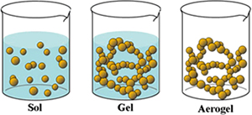
Gels and Magmas
Joel L. Zatz
Rutgers- The State University of New Jersey,
Pharmaceutical Dosage Forms

Slide 2
A- Gel
Definition “USP”
Semisolids preparation, being either suspensions of Small inorganic particles
or Large organic molecules
Interpenetrated with liquid.

Slide 3
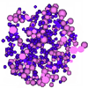
The inorganic particles such as Bentonite, form a three dimensional house of cards structure throughout the gel.
This is two-phase system:
      The inorganic particles.
      The continuous phase.
The gel mass consists of floccules of small distinct particles. Frequently called a magma or milk.
Gel and magmas are considered colloidal dispersions since they each contain
particles of colloidal dimension.

Slide 4
The large organic molecules exist in solution as randomly coiled flexible chain. These are either:
      Natural product. Or
      Synthetic polymers.
Which tend to entangle with each other because of their random motion.
The macromolecules are distributed throughout the
liquid in such a way that no apparent boundaries exist
between them and the liquid.

Slide 5
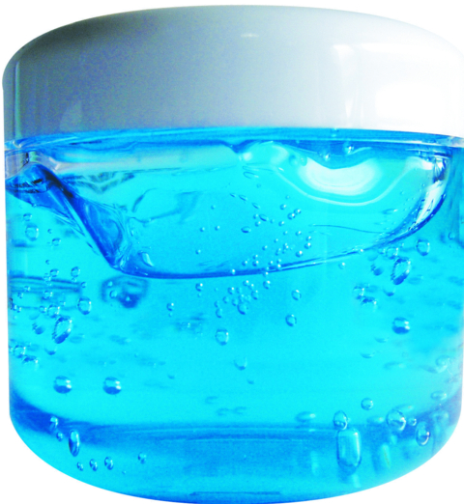
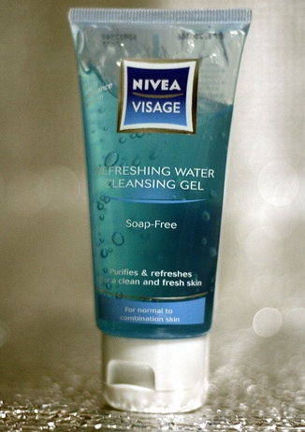
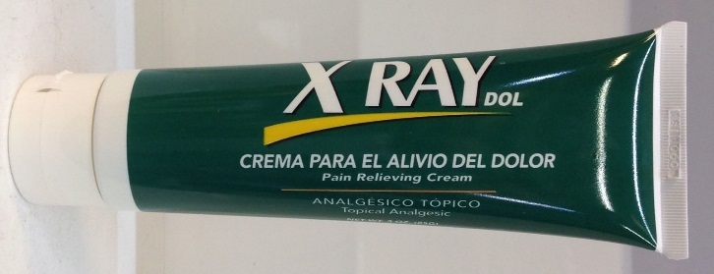
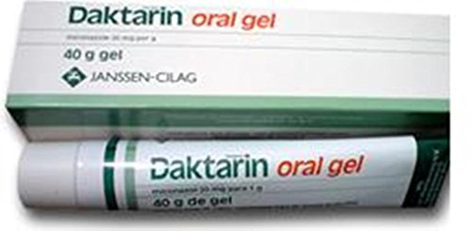
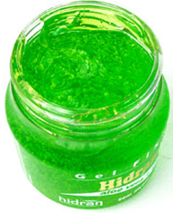
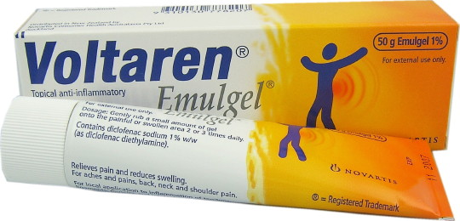
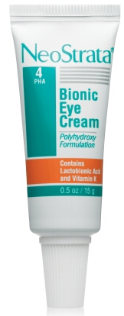
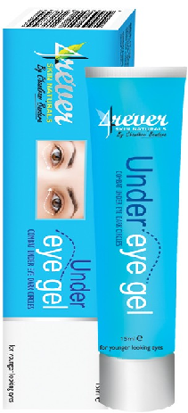
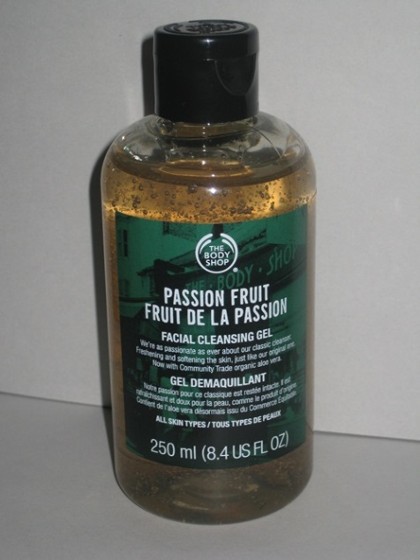

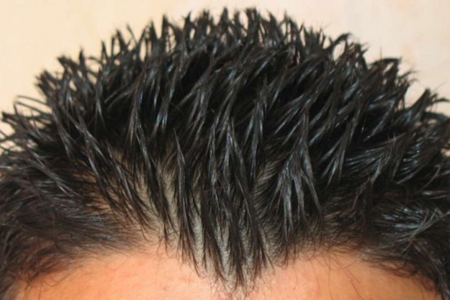

Slide 6
B- Uses
To prepare capsule shells from gelatin.
For topical drugs applied directly to the skin.
To Mucous membranes.
To the eye.
For long acting forms of drugs injected intramuscularly or implanted into the body.
Gelling agents are useful as binders in the tablet granulations,
Thickeners in the oral liquids and suppository bases.
In cosmetics in a wide variety of products such as shampoos, fragrance , skin and hair preparations.

Slide 7
C. Classification
The classification of a gel is depends on some characteristic of either one phase or two phases.
Gels are divided into:
Organic Gel (contain polymer as gel former) these are further subdivided according to the chemical nature of the dispersed organic molecules.
Inorganic Gel such as bentonite.
The nature of the solvent such as hydrogel (Aqueous base).
Oily base gel such as Plastibase Organogel.
Polypeptide Polypeptides (gelatin) and synthetic block copolymers, like poloxamers.
Solid gels with low solvent concentration are known as Xerogels.

Slide 8
Xerogels.
Xerogels are often produces by evaporation of the solvent, leaving the gel framework behind. They can be returned to the gel state by introduction of an agent that, on imbibition, swells the gel matrix,
Examples:
Dry gelatin, Tragacanth ribbons and acacia tears, and dry cellulose and polystyrene.

Slide 9
D. Characteristics
Gelling agents for pharmaceutical and cosmetic use should be:
Inert.
Safe.
Nonreactive with other formulation components.
Incompatibility in the gel is occur by the combination of a cationic drug, preservative, or surfactant with an anionic gel former.
Inactivation or precipitation of the cationic substance is possible

Slide 10
Characteristics…..
The gel should exhibit little viscosity change under the temperature variations of the normal use and storage.
Cost consideration.
Microbial contamination.
Many gels, those of a polysaccharide are susceptible to microbial degradation.
The gel characteristics should match the intended use.
  Topical gel
  Ophthalmic gel must be sterile.
Consumers tend to prefer gel products with high
optical clarity.
Notes:
Shear rate and gel.

Slide 11
Aim
The aim is to produce:
Stable.
Elegant.
Economical gel product adequately suited for its intended use.

Slide 12
Terms
Syneresis:
When the gel is stands for some time, it often shrinks and some of the water will pressed out. Syneresis becomes more obvious as the concentration of polymer decreases. It occurs in Organic and Inorganic gels
Swelling:
Taking up water by the gel and increase the volume of the gel, solvent penetrate the gel matrix so that gel-gel interactions are replace by gel solvent interactions.
Imbibition's:
  Taking up water by the gel without increase in the
Notes:
Swelling:
Gels can swell, absorbing liquid with an increase in volume. This can be looked on as the initial phase of dissolution. Solvent penetrates the gel matrix so that gel-gel interactions are replaced by gel-solvent interactions.
Limited swelling is usually the result of some degree of cross-linking in the gel matrix that prevents total dissolution. Such gels swell considerably when the solvent mixture possesses a solubility parameter comparable to that of the gallant.
Syneresis:
Many gel systems undergo contraction upon standing. The interstitial liquid is expressed, collecting at the surface of the gel. The mechanism of contraction has been related to the relaxation of elastic stresses developed during the setting of the gel.

Slide 13
Structure
Inorganic particles are capable of gelling a vehicle by the formation of a specific structure in the medium.
Clays, such as Bentonite or kaolin, possess a lamellar structure that can be extensively hydrated.
The flat structure of Bentonite particles are negatively charged at the face, and positively charged at the edges.
The attraction forces between the face and the edges,
creates a three dimensional network of particles throughout the liquid, which immobilizing the solvent.

Slide 14
Characteristics of this gel
The interactions between the particles are fairly weak, being broken by stirring or shaking.

Slide 15
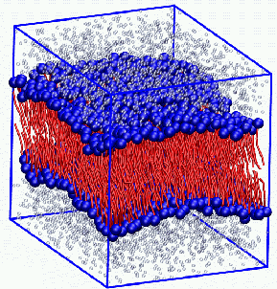
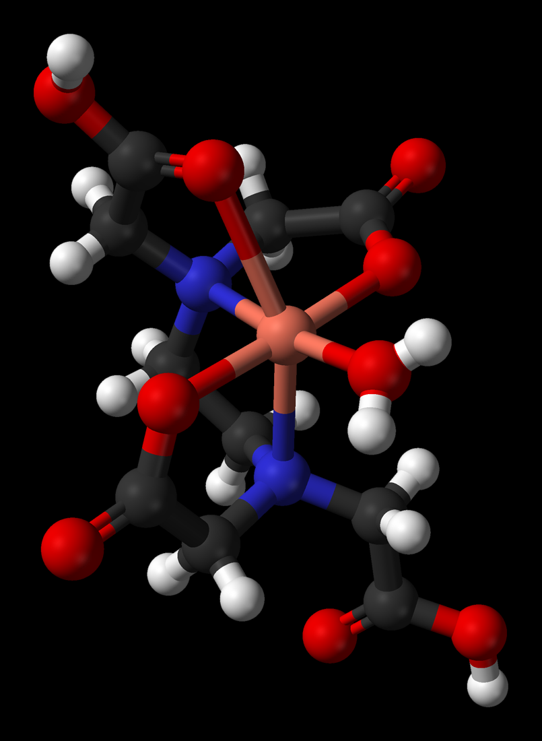
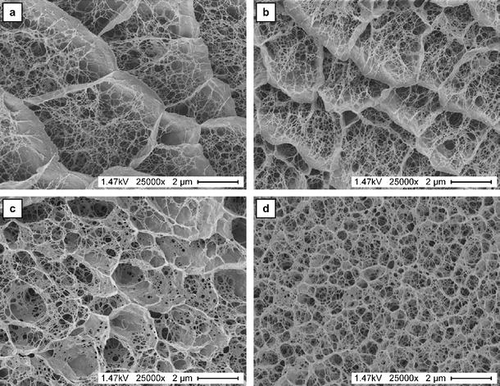
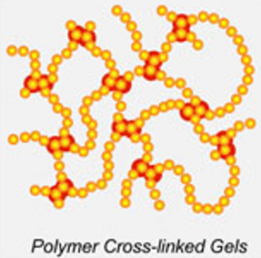
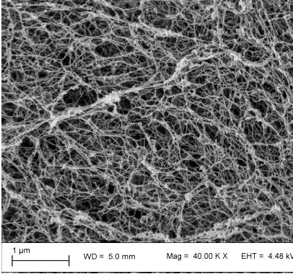
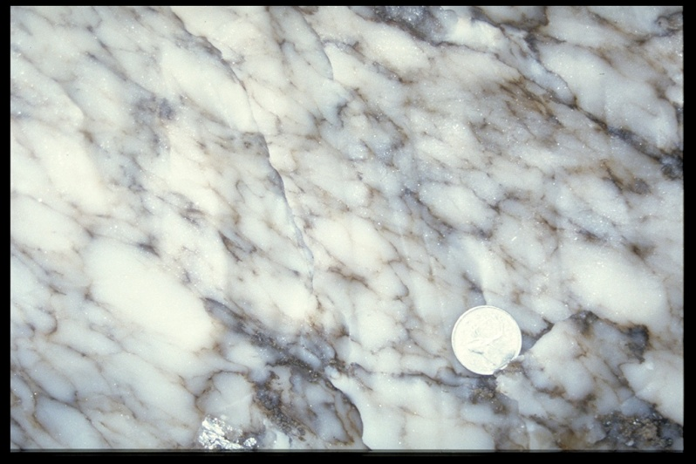

Slide 16
Structure continue
The long chains of organic gel formers are extended in solvents, as in aqueous gels as the result of hydrogen bond formation between water and hydroxyl groups of the gelling agents.
In a poor solvent, the gel molecule are more tightly coiled, preferring self-interaction to interaction with the solvent so its more viscous.
Molecular entanglement is responsible for the viscosity and structure of organic gels.

Slide 17
Structure
1. Salting out.
Salts may attract part of the water and the polymer, allowing the formation of more intermolecular secondary bonds, leading to gelation and precipitation. This is known as salting out.
2. Multivalent captions
Multivalent have a strong effect on the solutions of anionic polymers. Bridging of the polymers by di- or trivalent cations.
Example (addition of copper to solution of Na- CMC or calcium to sodium alginate, leads to gel formation.

Slide 18
3. Addition of Alcohols
Alcohols alter the solvent’s characteristics, changing the solubility parameter.
The addition of alcohol often make Coacervation rather than gelation.
Coacervation is the production of a viscous, solvated, polymer-rich phase. Leaving behind a phase that is mostly solvent and, therefore, poor in polymer.

Slide 19
The effect of Tem. on Gel formation
The effect of temperature depends on the chemistry of the polymer and its mechanism of interaction with the medium.
Many gel formers are more soluble in hot than cold water. If the temp. is reduced once the gel is in solution, the degree of hydration is reduced and gelation occurs.

Slide 20
Effect of tem. Continue.
Some polymers exhibit thermal gelation. These polymers are more soluble in cold water; solutions of these materials gel on heating.
Examples include methylcellulose and poloxamer.
Gelation caused by changes in hydration with changes in temperature tends to be reversible; gels liquefy and set again as the temperature is cycled. Gelation caused by chemical reaction, as in salt bridging or cross-linking is irreversible. Gel resulting from chemical cross linking oftern cannot be liquefied by dilution or temperature changes

Slide 21
Effect of molecular weight
Molecular weight is an important factor in gel formation. Very long polymers can entangle to greater extent, leading to higher viscosity at given concentration.

Slide 22
Rheology
Inorganic Gel
Gels of this type of gelling agent are typically pseudo-plastic, exhibiting non-Newtonian flow behavior characterized by Decreasing viscosity with increasing shear rat.
This due to break down the structure of system.
The week structure of inorganic particles dispersed in water is disrupted by an applied shear stress. As shear stress is increased, more and more inter-particulate associations are broken, resulting in a greater tendency to flow.

Slide 23
Organic gels
The gel for organic gelling agents tend to be more resistant to flow compared to inorganic gel.
The applied shear to the macromolecules in the gel formulation, force these molecules to align themselves in the direction of flow. The molecules straighten out, becoming less entangled as shear increases, thus lessening the resistance to flow.

Slide 24
Stability
Stability in gel mean: the chemical integrity of dispersed active ingredients must be assured over the shelf life of the product.
The rheological behavior of the gel for external use is complex matter!
Topically and for Cosmetics.
Notes:
The formulation and manufacture of a gel system is not complete without an evaluation of the stability of that system.

Slide 25
A change in rheological behavior must be must be taken seriously because it will affect the properties of the final product.
Example:
A small decrease in the viscosity of a clear hair dressing may be much less significant than the same change in a topical products with suspended active ingredients.
The viscosity test is useful for batch to batch comparison.

Slide 26
Definition of instability of Gel:
A gel formation that is unstable would exhibit some irreversible change in its rheological properties to be unacceptable in the final use.
Example:
Setup during storage and can no longer be expressed from a tube.
Undergo separation of phases, Either of the liquid (as in syneresis) or of the solid as (in particle sedimentation).
Or gel suffer from loss of viscosity or consistency, changing from semi-solid to viscous liquids.

Slide 27
Other tests.
These tests expose the product to stressful conditions to determine the range of conditions under which the product will perform well such as:
Freeze-thaw cycling to see whether separation or syneresis will occur.
Storage at various temperatures give a good information about the storage requirements for the gel.
Storage at elevated temperatures, however, should not be too high, not more than 45 to 50ºC.
Shipping a batch around the country and see if any changes occur during the transportation.

Slide 28
Practical test:
A shipping test is useful, shipping a batch of gel around the country subjects it to the bumps and shocks and temperature variations that the product will experience when marketed.
If it arrives and is still a good gel, it has passed an important test.

Slide 29
GEL-FORMING COMPOUNDS
A number of polymers are sued to provide the structural network that is the essence of a gel system. These include natural gums, cellulose derivatives, and carbomers.
Although most of these function in aqueous media, several polymers that can gel nonpolar liquids are also available.
Certain colidal solids behave as gellants as a result of asymmetric flocculation of the particles. High concentrations of some nonionic surfactant can be used to produce clear gels in systems containing up to about 15% mineral oil. These are employed mostly as hair dressings.

Slide 30
Gel-Forming Compounds
There are many polymers used to form a gel structure, such as:
Natural Polymer.
Acrylic Polymers.
Cellulose derivatives.
Polyethylene.
Colloidally dispersed Solids, Certain colloidal solids behave as galling agents.
Surfactants (nonionic ) can be used to produce clear gels in systems containing up to about 15% mineral oil. (these are used mostly as hair dressings.

Slide 31
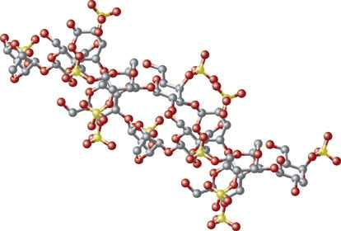
Natural Polymers
Natural gums have been used in commerce since the beginning of recorded history.
They are branched-chain polysaccharides.
Most are anionic (negatively charged in aqueous solution or dispersion).
Most of them are plant extract, its widely used in food and other industries including pharmaceutical.
Some of them are used for more that one reason (emulsifier, suspending agent and decrease sedimentation in suspension preparation.

Slide 32
Disadvantages:
These are subject to microbial degradation & support microbial growth.
Aqueous systems containing gums should contain suitable preservatives.
Cationic antimicrobials are not compatible with the anionic gums and should usually be avoided.

Slide 33
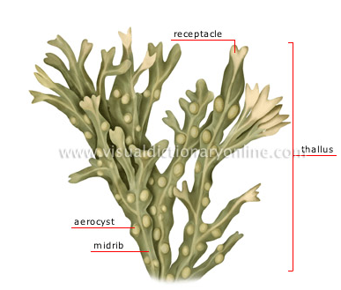
1. Alginates:
These are polysaccharides, containing varying proportions of:
  D-Mannuronic and.
  L-Guluronic acids.
Obtained from brown seaweed in the form of monovalent and divalent salts.
The most widely used are:
  Sodium alginate.
  Calcium alginate.

Slide 34
  Gelation occurs by:
      Reduction of pH.
      Reaction with divalent cations.
      Neutral pH in the presence of polyvalent ions.
  Gel strength is a function of alginate concentration;
  0.5% is practical minimum.
  Higher calcium concentration (with limits) result in stronger gels.
  Gel properties and gelation rate depends on calcium concentration and temperature.

Slide 35
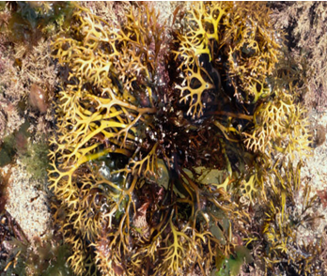
2. Carrageenan
All Carrageenans are anionic.
It is Hydrocolloid extracted from red seaweed,
Its a mixture of sodium, potassium, ammonium, calcium, and magnesium sulfate esters of polymerized galactose and 3, 6 anhydrogalactose.
The main copolymer types are:
Kappa, Lambada and Iota. All the carrageenan are anionic.

Slide 36
Kapa & Iota fraction form thermally reversible gels in water.
This is attributed to a temperature-sensitive molecular
rearrangement,
At high temperature the copolymers exist as random coils;
cooling results in formation of double helices that act as
cross-link.
Kappa is brittle, are strongest in the presence of potassium ion.
Iota are elastic& remain clear in the presence of calcium.
Lampada used mainly in the food and pharmaceutical preparations.

Slide 37
3. Tragacanth
Tragacanth is defined in the NF as the dried gummy Extracted from Astragalus Gummifer labillardiere.
These plants are found in the mountains of the near & Middle East; most commercial Tragacanth comes from Iran.
The quality are un-even and the prices has increased considerably Quality and price variations.
The rheological properties of Tragacanth dispersions depend markedly on:
The grade
On the treatment.

Slide 38
Tragacanth is a complex material composed of an acidic polysaccharide (Tragacanth acid) containing calcium, magnesium, and potassium, and a smaller amount of neutral polysaccharide, Tragancanthin.
The gum swells in water and form a gel.
The concentrations needed to form a gel is 2% or above.
Hydration takes place over a period of time, so that development of maximum gel strength requires several hours.

Slide 39
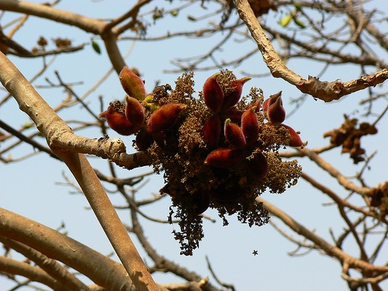
Indian Tragacanth

Slide 40
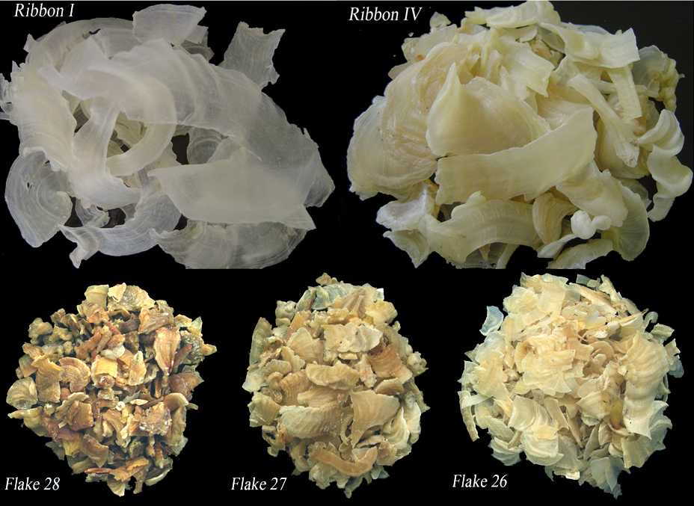
Tragacanth Flacs

Slide 41
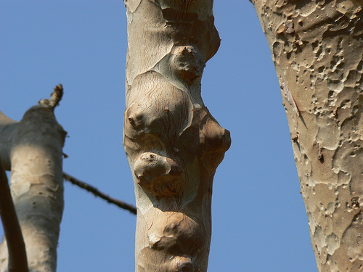
Karaya Tragacanth

Slide 42

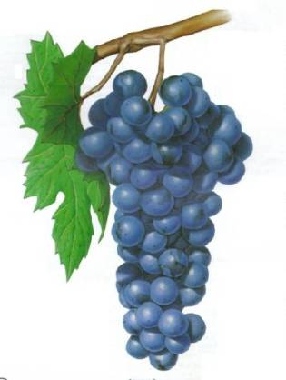
4. Pectin
Pectin, is a polysaccharide extracted from the inner rind of citrus fruit or apple pomance.
Used in pharmaceutical jellies as well as in food.
The gel is formed at acidic pH in aqueous solution containing calcium.
The quality of gel forms is depends on:
  The concentration of additives.
  The pH.
  The characteristics of the raw materials.
  Gel formation is more extensive in pectins with a low methoxyl content.

Slide 43
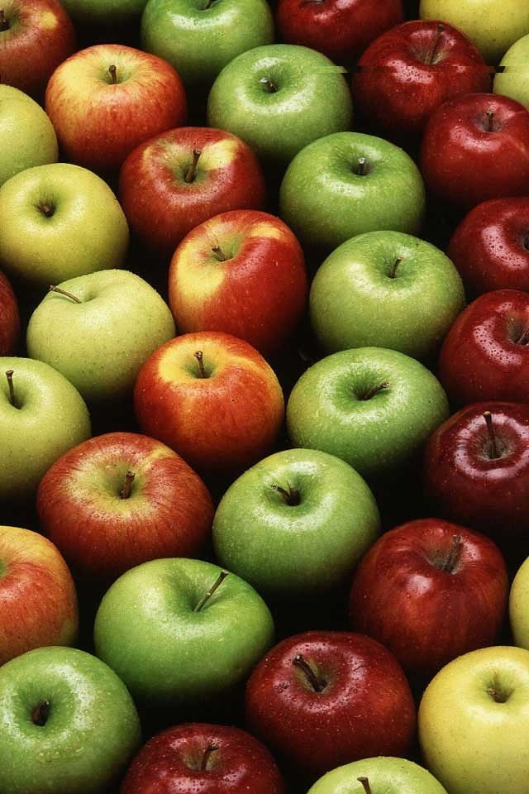
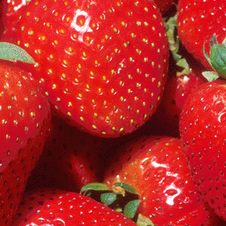
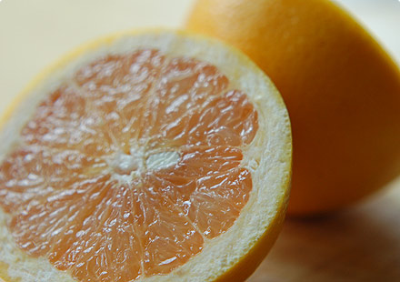
Citrus Fruits

Slide 44
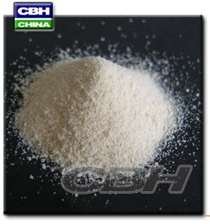
5. Xanthan Gum
It is used as stabilizer in suspensions & emulsions at concentration below 0.5%.
In higher concentration in aqueous media(1% & above) yield viscous solution that are jellylike in nature.

Slide 45
6. Gellan Gum
It is polysaccharide produced by fermentation, it has been approved for food industry from the FDA.
Gel strength is a function of gum concentration and ionic content. The gum is highly efficient; as little as 0.05% is required for gel formation.
To produce a uniform gel, the gum is first dissolved in deionized water heated to 70 ⁰C to 75⁰C, an electrolyte is added (calcium salt) and then cooled down to
25 ⁰C.
The setting temperature for the gel is usually in the rang of 30 to 45 ⁰C

Slide 46
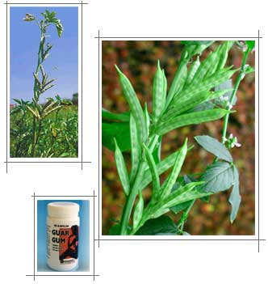
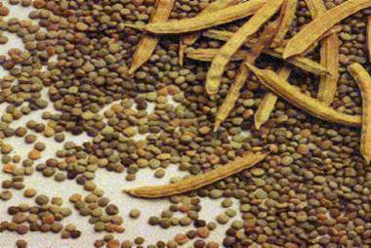
7. Guar Gum
Guar gum is a nonionic polysaccharide derived from seeds. Aqueous guar solution can be cross-linked by several polyvalent cations to form gels.

Slide 47


8. Chitosan
Chitosan is a natural biopolymer derived from the outer shell of lobster.
Chitin is extracted and partially de-acetylated to produce Chitosan.
Unlike most gums, Chitosan carries a positive charge (at pH below 6.5) and is thus attracted to a variety of biological tissues and surfaces that are negatively charged.
Concentrated aqueous solutions have
a gel-like consistency.

Slide 48
B. Acrylic Polymers
Carbomer:
It is one member of a group of acrylic polymers cross-linked with a polyalkenyl ether.
Manufactured under the trade name Carbopol 934P.
It is used as a thickening agent in a variety of pharmaceutical and cosmetic products.
The suffix P indicate a highly purified polymer, suitable for use in oral dosage forms.
Carbomer 934 is also use widely in topical preparations.

Slide 49
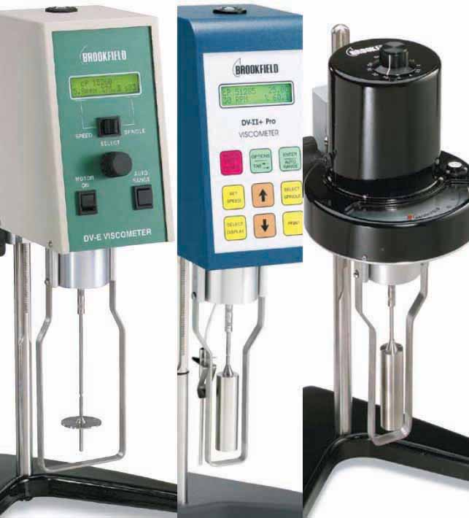
Acrilic polymer continued
The viscosity of carbomer dispersions is lowered in the presence of ions;
The addition of 1% of sodium chloride causes more than a 50% drop in viscosity (20rpm) of carbomer 941, 1% at neutral pH.

Slide 50
C. Cellulose Derivatives
It is a natural polymer found in plants.
Cellulose derivatives are subject to enzymatic degradation.
Treatment in the presence of various active substances results in breakdown of the cellulose backbone .
Factors affecting the viscosity of the materials:
Degree of substitution.
Molecular weight of the resultant polymer.

Slide 51
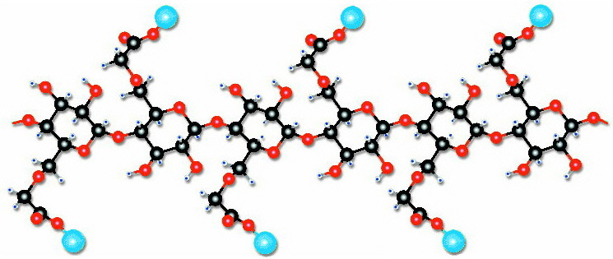
1. Carboxymethylcellulose
Known as sodium carboxymethylcellulose, Na-CMC and cellulose gum.
Anionic polymer available in a variety of grades that differ in molecular weight and degree of substitution.
Gelatin require addition of electrolyte .

Slide 52
2. Methylcellulose (methocel)
The solubility of this polymer in water decreases as the temperature is raised.
If the aqueous solution is heated the viscosity increases markedly at a certain point as the result of formation of gel structure, this known as thermal gelation.

Slide 53
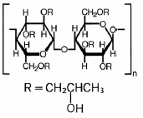
3. Hydroxypropyl Cellulose
It is soluble in water and in many polar organic solvents.
Its useful as a gelling agent for such liquids and for mixtures of water and organic liquids, such as alcohol.

Slide 54
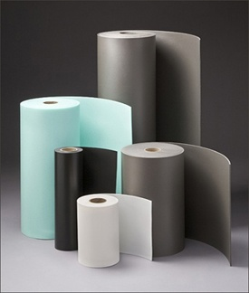
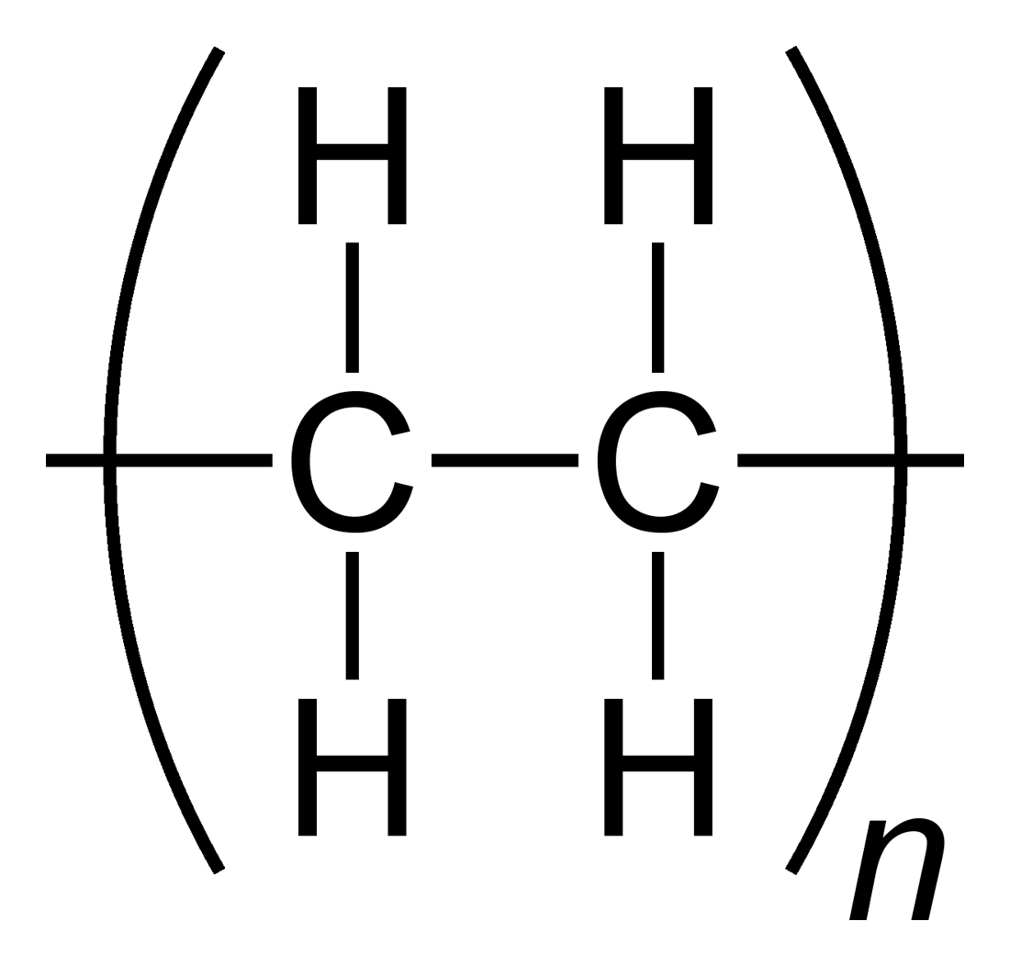
D. Polyethylene
Various forms of polyethylene and its copolymers are used to gel hydrophobic liquids.
The result is a soft, easily spreadable semisolid that forms a water-resistant film on the skin surface.

Slide 55
Polyethylene continued.
To form the gels, it is necessary to disperse the polymer in the oil at elevated temperature above 80°C and then shock cool to precipitate fine crystals that make up the matrix.

Slide 56
E. Colloidally Dispersed Solid Inorganic materials
Certain finely divided solids can function efficiently as thickening agents in various liquid media.
The gel formation depends on establishment of a network in which colloidal particles (colloidal suspension) of the solid are connected in an asymmetric way.
  Microcrystalline silica.
  Clays.
  Microcrystalline cellulose.
.

Slide 57
1. Microcrystalline Silica
It is function as a gellant in a wide range of liquids.
Network formation results from attraction of the particle by polar force, mainly hydrogen bonding.
Silica with high surface area is the most efficient in producing the chicken-wire structural.
Low concentration are required in non-polar liquids.
Higher concentration in polar liquids are required.

Slide 58
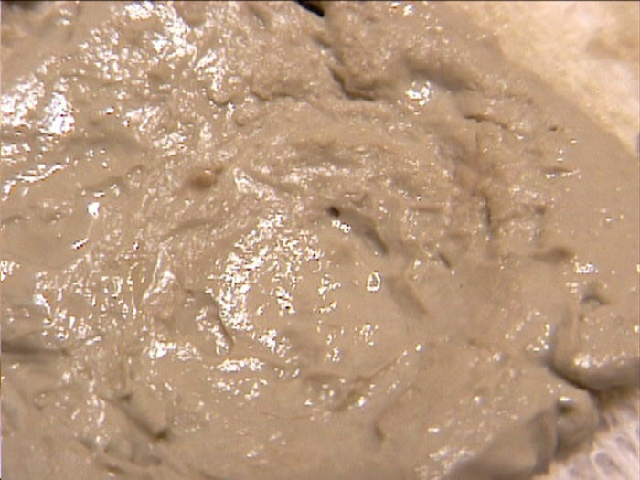
2. Clays
3. Microcrystalline Cellulose.
Is a solid used as a stabilizer and thickener in aqueous systems.
The characteristics of the gel formed from this type of solid is depends on the method of preparation.
High shear is required to break down the powdered raw material into primary particles.

Slide 59
F. Surfactants
Clear gel can be produced by combination of :
Mineral oil, Water, and high concentration
(20 to 40%) of certain Nonionic surfactants.
These combination results in the formation of micro-emulsions.
Notes:
Poloxamer 407 function as surfactant.

Slide 60
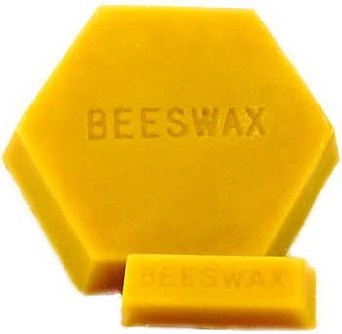
Other Gellants
Various waxy materials are used in non-polar media.
Such as beeeswax, carnauba wax, and cetyl esters wax.

Slide 61
Bio-adhesives
Definition
The interfacial attraction and adherence of two surfaces, at least one of which is biological in origin.
Bio adhesives of pharmaceutical interest are mucoadhesives.
This implies that the substrate for adhesion is the mucus layer itself.
Uses: Buccal, Ophthalmic, Nasal, Vaginal, etc.

Slide 62
Bio-adhesives
Treatment was only partly successful because traditional formulations were rapidly removed from the site of application.
Several gel forming polymers, notably CMC and carbomer, have been found to interact with mucus, swelling and adhering to mucosal tissue when applied topically.

Slide 63
Requirements
There are several physicochemical properties of polymer molecules that promote the development of mucoadhesion:
The charge.
Solubility and swelling. The swelling of the polymer exposing more sites for bond formation with the site of application
Molecular weight: higher MW or longer chain length favors chain entanglement and interaction after the polymer and mucin have interpenetrated.
Concentration: the optimum concentration for maximal bio adhesion.

Slide 64
Topical formulation
Ophthalmic
Epidermal.
Nasal preparation.
Vaginal preparations.
Mouth cavity.

Slide 65
Formulation
Mineral Oil Gel
Ingredients | % by weight
Polyethylene (A-C 617, Allied Chemical) | 10
Mineral oil, 75 | 90
With simple agitation gradually heat the mixture
to 90 °C and mix until homogeneous.
Cool quickly with agitation.

Slide 66
Clear Gel
Ingredients | % by weight
Mineral oil | 10
Polyoxyethlene 10 oleyl ether (Brij 97) | 20.7
Polyoxyethylene fatty glyceride (arlatone G) | 8.6
Sorbitol | 6.9
Purified Water | 43.5
Heat all the ingredients except the water to 90 C.
Heat the water separately to about 95 C.
Add the water to the other ingerdients with moderate
agitation.
Pour at about 60c

Slide 67
Zinc Oxide Gel
Ingredients | % by weight
Water | 76
Carbomer 934P | 0.8
Sodium Hydroxide, 10% solution | 3,2
Zinc oxide | 20
Disperse the carbomer in the water.
Add the sodium hydroxide with slow agitation to prevent
Inclusion of air.
Add the zinc oxide in the same manner and mix until homogeneous gel obtain.

Slide 68
Sun-screening Gel
Ingredients | % by weight
Ethanol (SD-40) | 53
Carbomer 940) | 1.0
Glyceryl-p-amino benzoate | 3
*Monoisopanolamine | 0.09
Water | 52.91
Disperse the carbomer 940 in the alcohol.
Dissolve the glyceryl-p-amino benzoate in the solution.
Slowly add the monoisopropanolamine.
Slowly add the water and stir carefully to avoid air entrapment.
The solution will clear up and gel.
*Dispersent

Slide 69
Antifungal/Corticosteroid Topical Gel
Ingredients | % by weight
Sulconazole nitrate | 1.0
Hydrocortisone 17-Valerate | 0.2
Ethanol | 50.0
Propylene glycol | 33.0
Isopropyl myristate | 5.0 for absorption through s
Water | 5
PEG-5-CETETH-20 | 4.2
Salicylic acid | 0.5
Hydroxypropyl cellulose | 0.69
Ascorbyl palmitate | 0.2
NaOH 1N to adjust pH to 4 | QS

Slide 70
Combine the ethanol, propylene glycol, and isopropyl myrisstate in a suitable mixing vessel, with rapid mixing, add the PPG-5-ceteth-20 and mix until uniform.
With rapid mixing, slowly add the ascorbyl palmitate, sulconazole nitrate, and salicylic acid and continue mixing until all solids are dissolved.
Prepare the NaOH solution in a separate vessel (0.079 100 Kg batch).

Slide 71
Add 80% of the water and the NaOH solution to the main mixing vessel and mix until uniform.
Add the remainder of the water followed by the hydrocortisone 17-Valerate.
Mix rapidly for 15 min, then add the hydroxyproply cellulose with rapid mixing for about 2jpirs to obtain the desired ge;

Slide 72
Lidocaine Hydrochloride Topical Gel
Ingredients | % by weight
Lidocain Hydrochloride | 1.0g
Chitosan | 4.0 g
Lactic Acid | 1.9 ml
Methylparaben | 0.1 g
Disodium EDTA | 0.2 g
Water Qs to make | 100 g

Slide 73
Dissolve lidocaine Hcl, Methylparaben, and EDTA.
Add the Chitosan F in water and mix followed by the lactic acid.
Mix for 3 min, at 5000 rpm in homomixer.

Slide 74
Aluminum Hydroxide Gel USP
It is an aqueous suspension of a gelatinous insoluble aluminum hydroxide.
Other additives permitted by USP:
    Peppermint oil,
    Glycerin,
    Sorbitol,
    Sucrose,
    Saccharin,
    Flavorants and sweeteners and antimicrobial agents.
Notes:
it is an aqueous suspension of a gelatinous precipitate composed of insoluble aluminum hydroxide.
Hydrated aluminum oxide (4% of aluminum oxide).
The dispersed phase is prepared by chemical reaction, using various reactants.
Other additives permitted by USP:
Peppermint oil, Glycerin, Sorbitol, Sucrose, Saccharin, or other flavorants and sweeteners and antimicrobial agents.

Slide 75
Usage
Neutralizing the gastric hydrochloric acid (it coats the inflamed or the ulcerated gastric surface.
Treatment of hyperacidity of peptic ulcer.
The disadvantage of is its constipating effects.
Dose: 10 ml four or more daily.
Aluminum hydroxide has the capability to interfere with the bioavailability of tetracycline by chelating with the antibiotic in the gastrointestinal tract.

