Slide 1
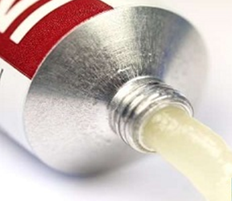
External Preparations
Ointment
A.F.Winfield
Lecturer: Dr. Majid R. Feddah

Slide 2
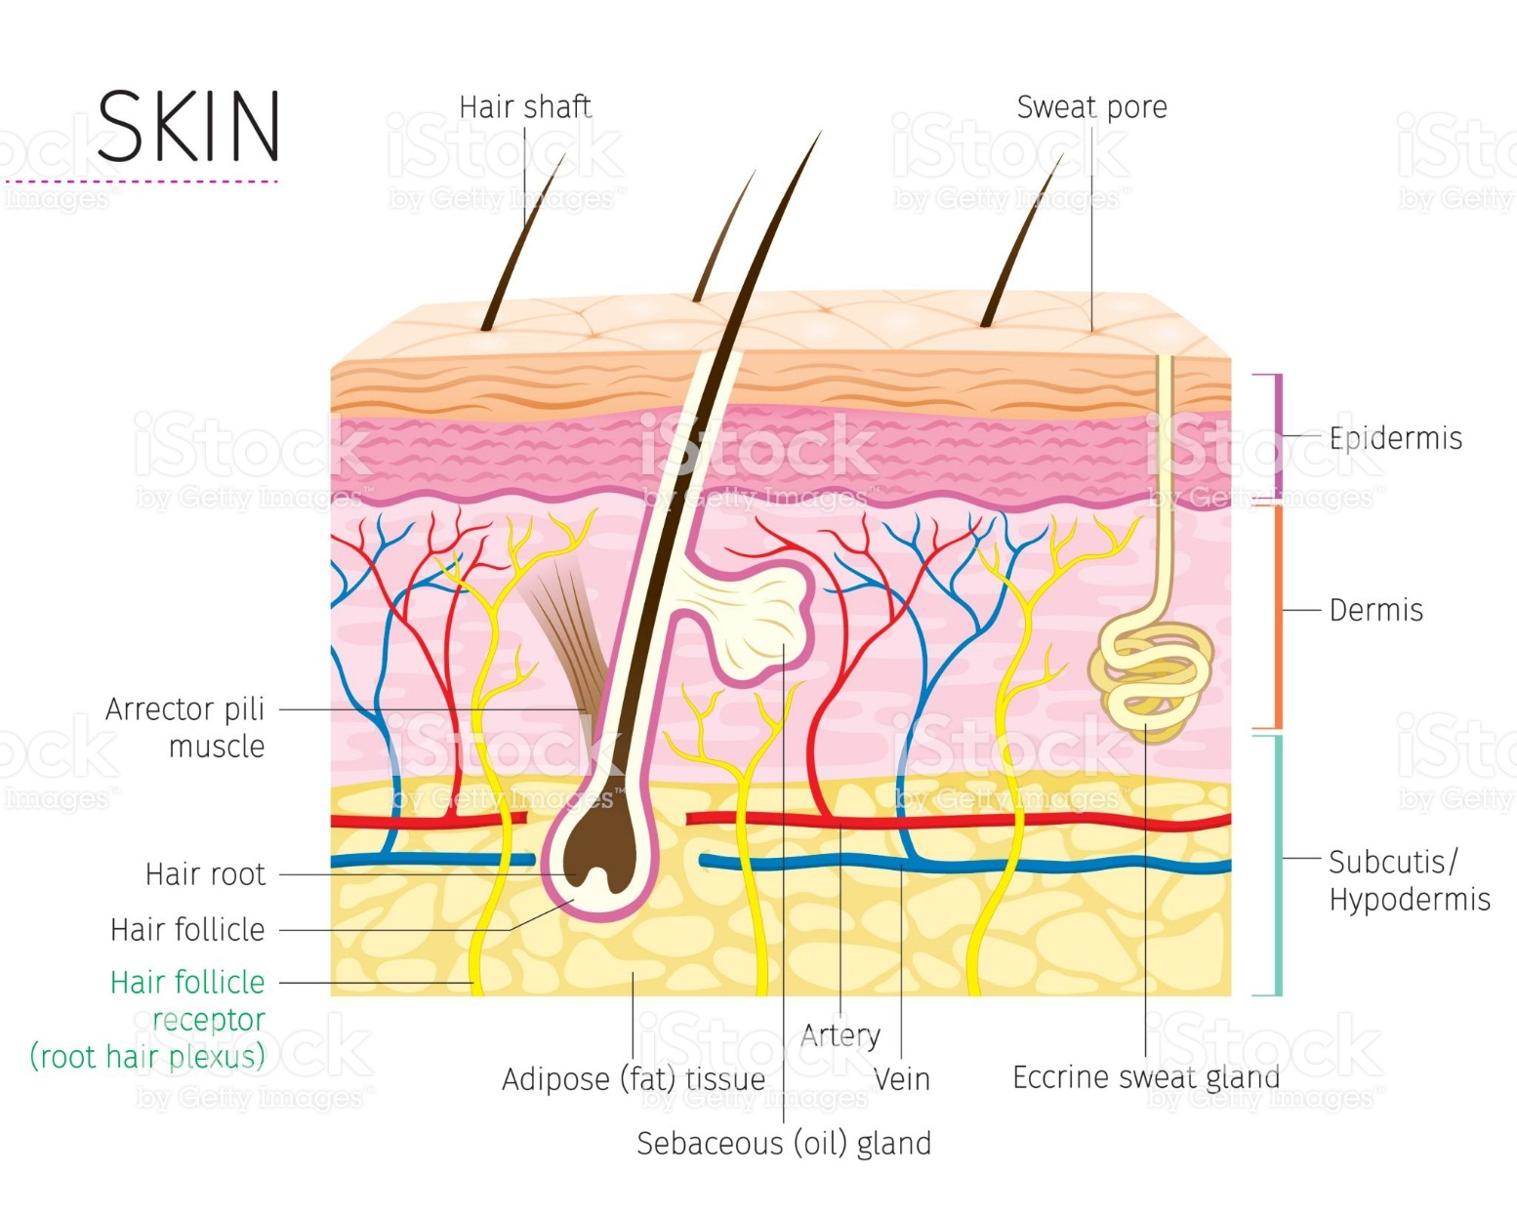
Skin
The largest organ in the body: It has three regions:

Slide 3
Skin preparation
There are a large number of different external preparations including:
Solids:
Dusting powders are applied to the skin for a surface effect such as drying or lubricant, or an antibacterial action.
They are made of fine particle size powders together with any medicament.
Liquids:
Soaks have an active ingredient dissolved in an aqueous solvent and are often used as astringents, for cooling or to leave a film of solid on the skin.
0ily vehicles can be used in bath additives to leave an emollient film on the skin surface.

Slide 4
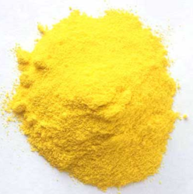
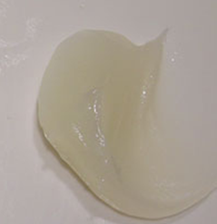
Ointments
Semi solid preparation for external application on the skin or mucous membranes.
Medicated
Non-medicated (bases for other preparations) or for their emollient or lubricating effect .
Sulphur
Ointment Base

Slide 5
Ointment Bases
According to USP 2 classified into 4 groups:
Hydrocarbon bases.
Absorption basses.
Water removal bases.
Water soluble bases.

Slide 6
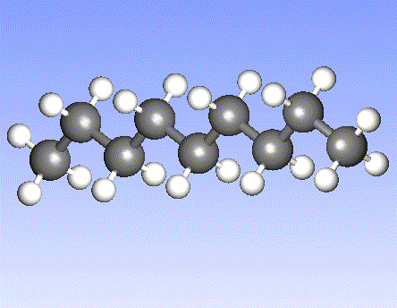
1-Hydrocarbon base
Oleaginous base
Properties:
Water free.
Aqueous preparations may be incorporated into them.
Uses:
Used mainly for their “Emollient effect”.
Protect the skin against the escape of moisture.
Occlusive dressings, can remain on the skin for prolonged periods of time without drying out.
Because of their immiscibility with water are difficult to wash off.

Slide 7
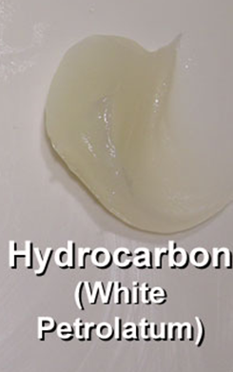
Examples:
Petrolatum
White petrolatum,
Yellow ointment
White ointment

Slide 8
A. Petrolatum USP Vaseline®
It is a mixture of semi-solid hydrocarbons obtained from petroleum.
Properties
It is an oily mass, varying in color from yellow to light amber.
It melts at temperatures between 38°C to 60°C.
Could be used alone or in combination with other agents as an ointment base.
It is known as “yellow petrolatum”, & petroleum jelly.

Slide 9
B. White Petroleum USP White Vaseline®
It is purified mixture, of semisolid hydrocarbons from petroleum that has been decolorized.
It is used for the same purpose as petrolatum, but due to its lighter color it is considered more esthetic to be used in cosmetics preparations.
Also used for treatment of diaper rash
Another name (white petroleum jelly).

Slide 10
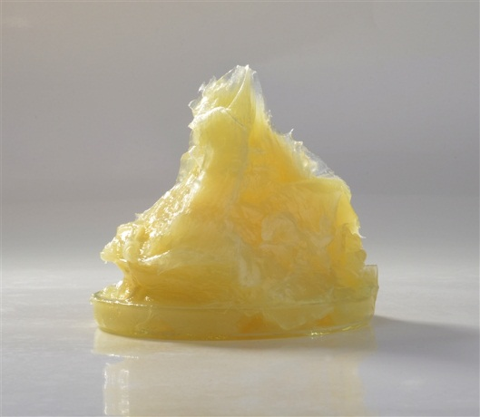
C. Yellow ointment, USP
“simple ointment”.
Yellow Wax 5g
Petrolatum 95g
Yellow wax is the purified wax obtained from the honeycomb of the bee.
Preparation:
Melting the wax on a water bath.
Add the petrolatum until the mixture is uniform.
Cooling with stirring until congealed.

Slide 11
D. White ointment USP
This ointment differs from yellow ointment by substituting white wax and white petrolatum in the formula.
White wax 5g
White petrolatum 95g
Melting the wax on a water bath.
Add the petrolatum until the mixture is uniform.
Cooling with stirring until congealed.

Slide 12
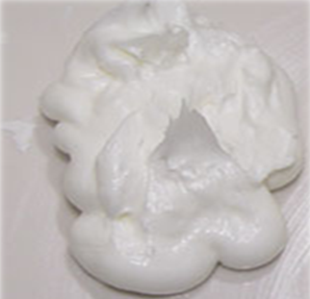
2-Absorption bases
There is two types:
Those that allow the incorporation of aqueous solutions, resulting in the formation of W/O emulsion.
(Hydrophilic petrolatum & Anhydrous Lanolin)
Those that are already W/O emulsion bases that permit the incorporation of small, additional quantities of aqueous solution
(e.g. lanolin and cold cream)
W/O emulsion
Notes:
The soothing, moisturizing, and healing effects of lanolin.
2. to soothing severely dry skin, and easing the chapped and cracked skin
3. on the nipples of nursing mothers.
Lanolin is a natural and organic chemical that is mainly known for its moisturizing effects on the skin. However,

Slide 13
Absorption Bases continued……
Properties and uses:
Emollients
Occlusive dressing, but not as the hydrocarbon bases.
Absorption bases are not easily removed from the skin with water washing.

Slide 14
Hydrophilic Petrolatum USP (W/O)
For preparation a 1000g
Cholesterol 30g
Stearyl Alcohol 30g
White wax 80g
White petrolatum 860g
Melt 1, 2 and 3 until liquefied, add 4 and allow the mixture to cool down and congeal while stirring.
Hydrophilic Petrolatum USP, has a capacity to absorb up to three times its weight water.
Used to incorporate Water soluble drugs into an oleaginous base.

Slide 15
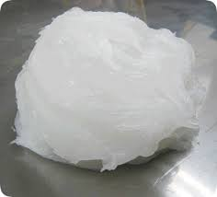
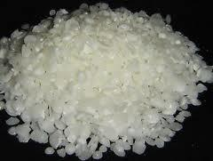
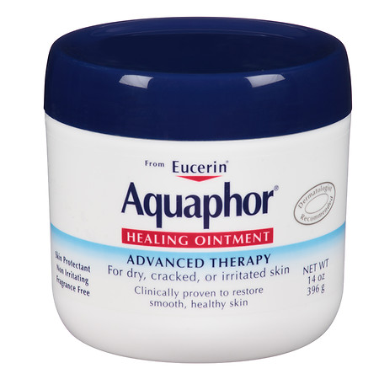
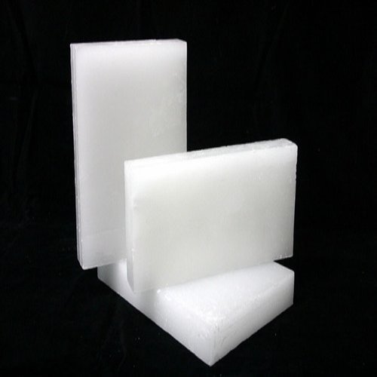
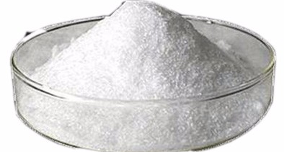
Ingredients of Hydrophilic Petrolatum
Stearyl Alcohol
White Petrolatum
Cholesterol
White Wax

Slide 16
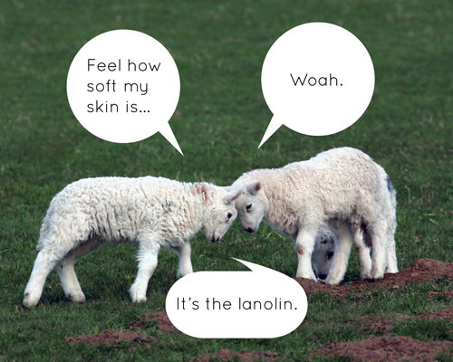
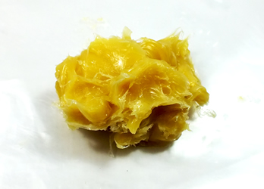
Anhydrous Lanoline

Slide 17
Anhydrous Lanolin
(Refined Wool Fat)
Obtained from wool of sheep.
Wax like substance that has been
cleaned, and decolorized.
It contain not more than 0.25% water.
Insoluble in water.
Mix without separation with twice its weight of H₂O.
The addition of water results in formation of W/O emulsion.

Slide 18
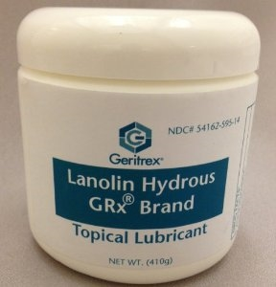
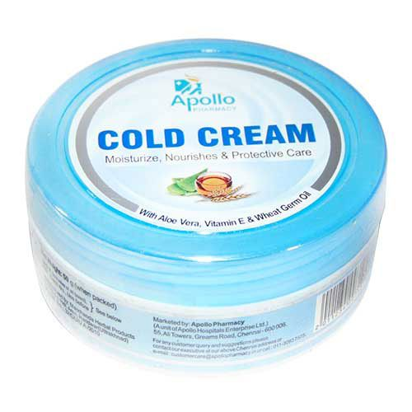
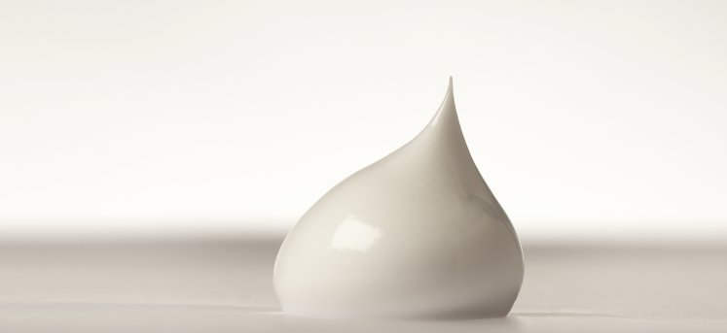
Those that are already W/O emulsion bases that permit the incorporation of small, additional quantities of aqueous solution (e.g. lanolin and cold cream)
Cold Cream

Slide 19
Lanolin (Hydrous Wool Fat)
Lanolin is a semisolid, fatlike substance obtained from the wool of sheep.
It is a w/o emulsion that contain between 25 to 30% of water.
Modified Lanolin
Lanolin that has been processed to reduce the contents of free lanolin alcohols and any detergent and pesticide residues.

Slide 20
Cold Cream
Semi-solid, white, W/O emulsion prepared with:
  Cetyl esters wax.
  white wax.
  Mineral oil.
  sodium borate.
  Purified water.
The sodium borate combines with the free fatty acids present in the waxes to form sodium soaps that act as the emulsifiers.
Cold is used as:
Emollient and as ointment base.

Slide 21
3-Water removal base
It is a an oil in water emulsion (O/W).
look like cream in the appearance.
Easily washed.
They have the ability to absorb serous discharges in dermatologic diseases.
The absorption of some medication from this base through the skin is better from other bases.
.

Slide 22
Example
Hydrophilic ointment, USP
It is an emulsion (O/W), contains sodium lauryl sulfate as the emulsifying agent.
Oil phase:
Stearyl alcohol and white petrolatum
Aqueous phase:
Propylene glycol and water
Preservatives:
Mehylparaben and propylparaben / preserve.
  Uses:
As water removable vehicle from medicinal substances.

Slide 23
4-Water soluble base
Properties
Water soluble base do not contain oleaginous components.
They are completely water-washable and often referred to as greaseless.
They used for incorporation of solid substances or non-aqueous materials. Because it become very soft by the addition of aqueous solution.

Slide 24
A. Polyethylene Glycol Ointment
It is an example of a water-soluble base.
Polyethylene Glycol 3350 400g
Polyethylene Glycol 400 600g
COCH₂(CH₂OCH₂)_{n} CH₂OH
The chain length may be varied to achieve polymers having desired viscosity and physical (solid, semisolid, or solid) form.
If firmer ointment is required, the formula may be altered to permit up to equal parts of the two ingredients.

Slide 25
Selection of an appropriate base
The selection of the base depends on:
Stability of the drug in the ointment base.
The desire for the base that is easily removed by washing with water.
Desirability of occlusion of moisture from the skin.
Desirability for topical or percutaneous drug absorption.
Desired release rate of the drug substance from the ointment base.

Slide 26
Preparation of ointment
There are two methods for preparation of ointments:
Incorporation method.
Particle size of the active ingredients.
The components are mixed until a uniform preparation is attained.
Equipment used in the preparation:
In a small scale, the mortar and pestle.
A spatula are used to rub the ingredients together on ointment slab.

Slide 27
(Parchment paper) to cover the working slab.
It is desirable to reduce the particle size of the solids before incorporating to the base to get ointment not gritty texture.
This is done by levigating (To make into a smooth, fine powder or paste, as by grinding when moist )
or mixing the solid material in a vehicle in which it is insoluble to make a smooth dispersion.

Slide 28
Levigating agent used are:
Mineral oil for oleaginous or bases where oils are the external phase.
Glycerin for bases where water is the external phase.
After levigation, the dispersion is incorporated into the ointment base by spatulation or with the mortar and pestle until the product is smooth and uniform.

Slide 29
Incorporation of liquids:
Liquid substances are added to an ointment base after knowledge of an ointment bases capacity to accept the volume required.
Hydrophilic ointment bases used for incorporation of aqueous solution.
Addition of aqueous preparation to a hydrophobic base
First the aqueous solution incorporated into a small amount of a hydrophilic base.
Second that mixture then added to the hydrophobic abase.
Mixing until uniform dispersion is attained

Slide 30
Fusion method
The act or procedure of liquefying or melting by the application of heat
By the fusion method, all or some of the components of an ointment are combined by being melted together and cooled with constant stirring until congealed.
Components not melted and / or heat sensitive are added to the congealing mixture as it is being cooled and mixed.
Heat labile substances added last, when the temperature of the mixture is low enough not to cause decomposition of the ingredients.

Slide 31
in a small scale, the fusion process conducted in a porcelain dish or glass beaker.
In large scale, it is carried out in large steam-jacketed kettles.
After congealing the ointment may be passed through an ointment mill (in large scale), in small scale rubbed with spatula or in a mortar to ensure uniform texture.
When this method is used?
In materials do not lend themselves well to mixture by incorporation method. Such as:
Beeswax, paraffin, Stearyl alcohol, and high molecular weight polyethylene glycols

Slide 32
This process performed either:
The material with the highest melting point are heated to the lowest required temperature to produce a melt.
The additional material then are added with constant stirring during cooling of the melt until the mixture is congealed.
Or melting the components having the lowest melting point first and adding the remaining components together under slowly increasing temperature

Slide 33
Preservation of Ointments
Parahydroxybenzoates.
Phenols.
Benzoic acid.
Quaternary ammonium salts and other compounds are used as preservatives in external used preparations.

Slide 34
Compendial requirements
Ointments and other semisolid dosage forms must meet USP testes for:
Microbial content.
Minimum fill.
Packaging.
Storage and labeling.
In addition
Viscosity test.
Drug release tests involve diffusion cell.

Slide 35
Pastes
Are vehicles (aqueous or oily) with a high concentration of solid material than ointments.
They are thick so they don’t spread.
Preparation as done as the ointment preparation.
It can be used to absorb serous secretion.
It is not suitable to be applied on hairy parts.
Examples: Zinc oxide

Slide 36
Pastes and Ointment
Like ointments are intended for external application to the skin.
They differ from ointment by:
    They contain a larger percentage of solids.
    Thicker and stiffer.
    Less greasy.
    More absorptive

