Slide 1
Emulsion
Dr. Majed R. Feddah

Slide 2
I. Introduction
Emulsion consists of two immiscible liquids one of which is uniformly dispersed throughout the other as droplets of diameter greater than 0.1µm.
To prepare a stable emulsion a third phase, an emulsifying agent, is required.
Emulsions is a useful way to present oils and fats in a palatable form.
Emulsions for external use are known as a lotion.

Slide 3
Oil in Water or Water in Oil
Oil
Water
Water in Oil
Oil in Water

Slide 4
Emulsions can vary considerably in viscosity and can present as liquids or semisolids.
Liquid emulsions can be used for oral, topical and parenteral medicaments while semisolid emulsions are usually only used topically.

Slide 5
Emulsion Types
Simple Emulsion
Oil in Water, (O/W) the oil phase distributed as globules in the aqueous phase (continuous phase).
Water in oil, (W/O) the water is distributed through out the oil phase (continuous phase).
Multiple Emulsion:
  W/O/W
  O/W/O

Slide 6
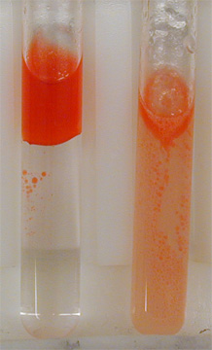
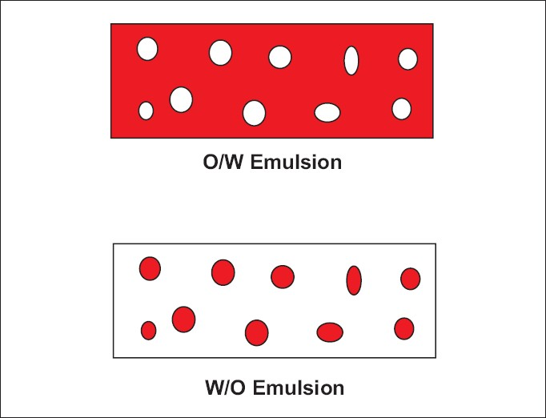
Determining the type of emulsion
Water soluble dye to be dusted on the surface of the emulsion:
  O/W the dye will be dissolve the color & diffuse through the system.
  W/O, the dye will stay on as clumps on the tope of the emulsion.

Slide 7
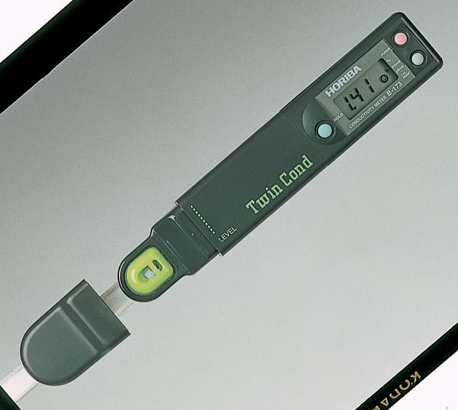
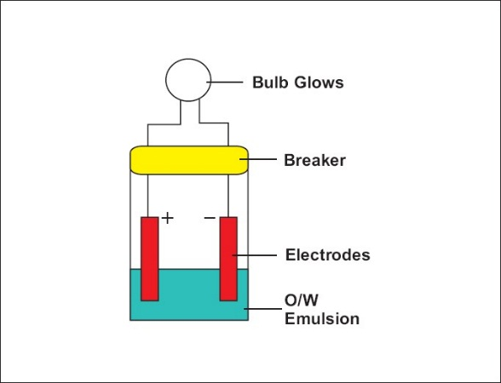
2. Dilution Method
Dilution of the emulsion with water, if the emulsion mixed freely with water, thus it is O/W, if not so its W/O.
Electrical current test:
Electrodes connected to the external electric source and immersed in the emulsion, if the external phase is water a current will pass through the emulsion.
A conductivity Meter
Basic Method

Slide 8
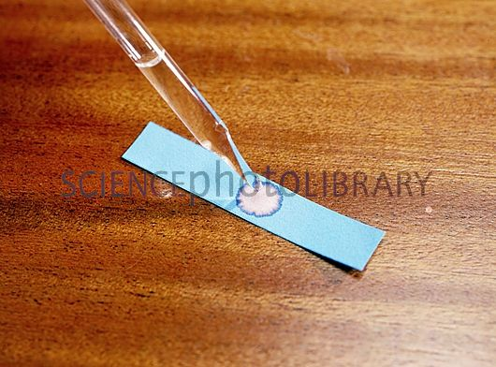
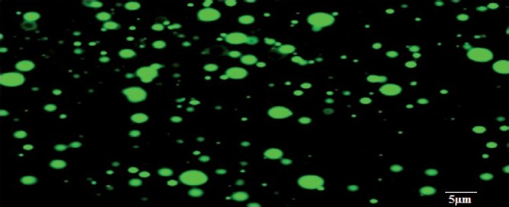
4. Staining tests
Filter paper soaked in cobalt chloride solution and allowed to dry
The filter paper will turns from blue to pink on exposure to stable O/W emulsion.
5. Fluorescence test upon exposure to UV light
  o/w: shows spotty fluorescence under the microscope
  w/o: shows continuous fluorescence under the microscope
Cobalt chloride strip
Cobalt chloride color turns to pink when wetted

Slide 9
Pharmaceutical Applications
Convenient of orally water insoluble liquids, when the dispersed phase has unpleasant taste.
Increase the absorption (some ingredients such as vitamins are absorbed completely when emulsified with emulsifying agent).
For patients how can’t getting medicine and nutrition's orally. (I.V Emulsion)
In many cosmetics preparations (dermatological products, lotions and creams) because the ability for spreading is high over the skin.

Slide 10
In diagnostic agents in x-ray examination.
In aerosols preparation for producing foams.
To prepare stable & homogeneous mixtures of two immiscible liquids.
It permits the administration of a liquid drug in a form of globules.
Reduce the droplet size of the oil, make it more readily absorbed.
If the active ingredients irritating the skin, are less irritant when used as internal phase.

Slide 11
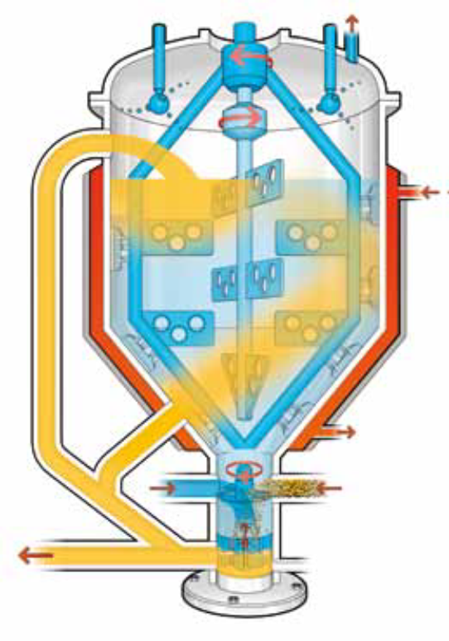
Methods of Emulsion Preparation
Emulsion may be prepared in different methods depends on:
The nature of emulsion component.
Available emulsion equipment's.
In small scale a mortar and pestle, a mechanical blender, a homogenizer.
In large scale, large tanks, and high speed mixer homogenizer may be used to prepare an emulsion

Slide 12
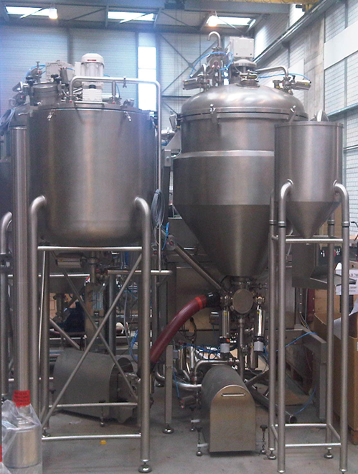
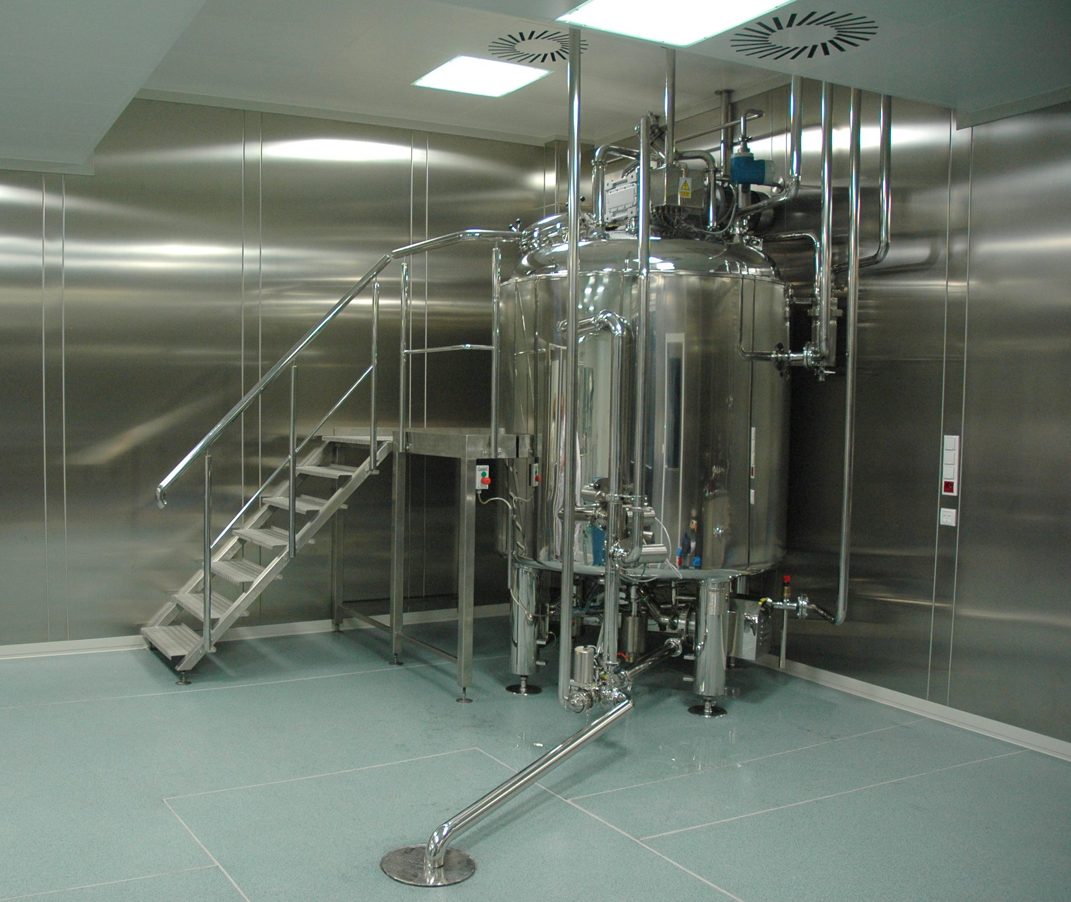

Slide 13
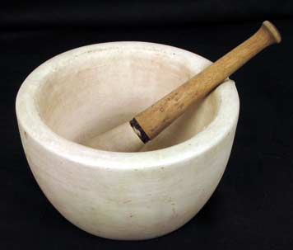
In small scale
Continental or dry gum method.
English or wet gum method.
Bottle method.

Slide 14
Continental Dry Gum Method
The method is also referred to as the 4-2-1 (Oil-Water-Gum).
In this method:
The O/W emulsifier is triturated with the oil in a dry wedgewood or porcelain mortar, until mixed.
A rough surface should be used, to reduce the globules size.
Then the two parts of water are added all at once.
The mixture triturated immediately, rapidly & continuously until the primary emulsion is formed.
creamy white and produces a crackling sound.

Slide 15
Other liquid ingredients that are soluble in the external phase may then be added.
Solid substances such as preservatives, stabilizers colorants, and any flavoring material usually dissolved in a water then added to an emulsion.
Any substances that may interfere with the stability of emulsion may added at the end.

Slide 16
English or Wet Gum method
The same proportion of water, gum and oil is used.
Triturating of acacia with water in a mortar.
The oil then is added slowly in portions.
The mixture is triturated to emulsify the oil.
The mixture is thoroughly mixed for several minutes to insure uniformity of the emulsion.
Other substances may be added.

Slide 17
Bottle Method
It is used for volatile oils or oleaginous substances of low viscosity.
The powder acacia is placed in a dry bottle.
Two parts of oil then added.
The bottle is then shaken in a caped container.
A water is then added in portions.
When a primary emulsion is formed the other ingredients is added.
It is not suitable for viscous oils.

Slide 18
Theories of Emulsification
No universal theory of emulsification.
Because emulsion can be prepared using several different types of emulsifying agent, each of which depends for its action on a different principles to achieve a stable products.
Any theory of emulsification should explain the followings:
  The stability of the product.
  The type of emulsion formed.

Slide 19
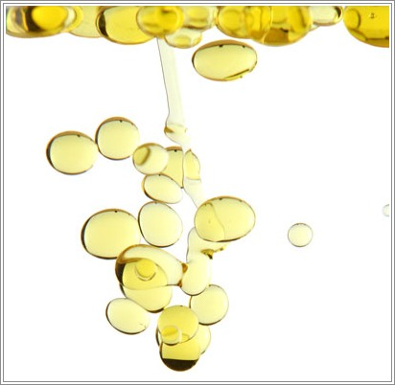
What happened when two immiscible liquids are agitated together?
Failure the two liquids to remain mixed, because :
The cohesive force between the molecules of each separate liquid is greater than the adhesive force between the two liquids.
Hence the droplets have a tendency to coalesce.

Slide 20
Surface Tension Theory
Surface tension is the force at the liquid surface which keeps the liquid together. This is why liquids tend to form spherical drops when they are sprayed in air.
  If two drops of the same material or miscible liquid come in contact they will coalesce.
  If two immiscible drops come together they will resist coalescence and tend to maintain their spherical shapes.
  The forces at the drop surface responsible for keeping the liquids apart (immiscible) is called “ interfacial tension”.
Surface Active Agents (Surfactant) or wetting agents can be used to reduce the interfacial tension between the two liquids acting as emulsifiers or emulsifying agents.
  Basically surfactants decrease the tendency of the “like/same” drops to coalesce.

Slide 21
Types of Emulsifying Agents
Surface active agents:
Adsorbed at oil/water interfaces to form monomolecular films - reduce interfacial tension.
Hydrophilic Colloids:
Form multi-molecular film around the dispersed droplets of oil in water (O/W) emulsion.
Finely divided solid particles:
Adsorbed at the interface between two immiscible liquid phases and form a film of particles around the dispersed globules.

Slide 22
Summary
All of them form a film around the globules, either mono, or multi layer, or particulate.
Classification of Dispersed Systems
Class | Range of particle size | Characteristics of the system | Examples
Molecular Dispersion | Less than 1.0nm (mµ) | Invisible in SEM, pass through ultra filters | Oxygen molecules, ordinary ions, Glucose
Colloidal Dispersion | 1.0nm to 0.5µm | Could be detected under SEM | Colloidal silver solution
Coarse Dispersion | Greater than 0.5µm (µ) | Visible under microscope, not pass through normal filter

Slide 23
1. Surfactant
Monomolecular Adsorption:
Surface active agents, reduce the interfacial tension.
form monomolecular layer films.
The film formed is:
Flexible, reform rapidly in case of broken or disturbed.
The presence of surface charge, cause repulsion and enhance stability of the emulsion.
Combination of more then one emulsifier are used in the preparation of emulsion.

Slide 24
Examples
Atlas of surfactants, recommends that:
The hydrophilic Tween be combined with a lipophilic Span, varying the proportion so as to produce the desired O/W or W/O emulsion.
Tween 40 (polyoxyethylene sorbitan monopalmitate) and Span 80 for stabilization of emulsion.
Mix of different emulsifying agents produce stable emulsion such as , (sodium stearate, cholesterol, sodium lauryl sulfate, glyceryl monostearate, tragacanth and span).

Slide 25
The type of emulsion produced, depends on the properties of emulsifying agent used.
This characteristics is called Hydrophile-Lipophyl balance and referred to as (HLB).
It is the polar, and non-polar nature of the emulsifier.
Example: Sodium stearate C₁₇H₃₅COONa
─ The non-polar hydrophobic C₁₇H₃₅ is the lipophilic go to oil.
─Polar group hydrophilic ─ COONa go to water.
The balance between the lipophilic and the hydrophilic will determine the type of emulsion formed

Slide 26
Whether a surfactant is an
      Emulsifier.
      Wetting agent.
      Detergent.
      Solubilizing agent.
It will be predicted from a knowledge of (HLB).
Each emulsifying agent is assigned an HLB value.
The usual range of HLB is between 1 to 20.
Material that are highly polar or hydrophilic have higher number of HLB than materials less polar lipophilic low number of HLB.

Slide 27
Materials having an:
HLB value (3-6) are lipophilic & produce W/O.
HLB value (9-12) are hydrophilic and produce O/W.
Rule of Bancroft
The type of emulsion is a function of the relative solubility of the surfactant, the phase in which it is more soluble being the continuous phase.
Emulsifying agent with a high HLB is soluble in water and results in the formation of an (O/W) emulsion.
The reverse situation is true with surfactant of low HLB, which tend to form (water in oil) emulsions.

Slide 28
HLB Values of emulsifying agents
Emulsifying agent | HLB value
Acacia | 8.0
Sorbitan monolaurate | 8.6
Sorbitan monostearate | 4.7
Polysorbate 20 | 16.7
Polysorbate 60 | 14.9
Polysorbate 80 | 15.0
Sodium lauryl sulphate | 40.0
Sodium oleate | 18.0
Tragacanth | 13.2
Triethanolamine oleate | 12

Slide 29
II. Multi-molecular Adsorption & film formation
Its hydrated Hydrophilic colloids, they considered as surface active agents because they appear at the oil water interface.
They differed from the surfactants in:
They do not cause an sufficient lowering of the interfacial tension.
They form multi-layer rather a monolayer film at the interface.

Slide 30
The action as emulsifying agents is due to the multilayer formation around the droplets, so, strong film which resist coalescence.
Another effect promoting stability is the significant increase in the viscosity of the dispersion medium.
These emulsifying agents are hydrophilic, and they tend to promote the formation of O/W emulsions.

Slide 31
III. Solid Particle Adsorption
Those solids particles are wetted by both oil and water, so they can act as emulsifying agents.
They presents water and oil interface, where they produce a film around the dispersed droplets.
By this way it prevent coalescence.
  Powders which are wetted mainly by:
  Water form O/W emulsion.
  Oil they form W/O emulsion.

Slide 32
Physical Stability of Emulsions
Finished product and stability:
  Absence of coalescence of the internal phase.
  Absence of the creaming.
  Maintenance of elegance with respect to appearance, Odor, Color, and other physical properties.
  Agglomeration of the internal phase and separation from the product.

Slide 33
Creaming, resulting from flocculation and concentration of the globules of the internal phase.
Is not considered as a mark of instability.
Creaming results from flocculation, which, represent potential steps toward complete coalescence of the internal phase.
In pharmaceutical dosage forms creaming is results in lack of uniformity of drug distribution.

Slide 34
Phase Inversion
It is the change of emulsion type from W/O to O/W or vice versa.
It is considered as emulsion irreversible instability.
Example:
An oil in water emulsion stabilized with sodium stearate can be inverted to the water in oil by adding calcium chloride to form calcium stearate.
Inversion occur by alteration in phase volume ratio.
Phase inversion can happen if:
  Insufficient surfactant or emulsifying agent is used
  Inappropriate emulsifying agent is used; e.g., high HLB surfactant for a w/o emulsion
  Changing temperature or pH
  Adding salts

Slide 35
Classification of the emulsion instability
Flocculation and creaming.
Coalescence and breaking.
Miscellaneous physical and chemical changes.
Phase inversion.

Slide 36
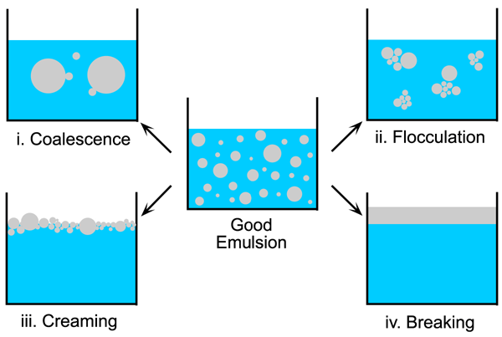
Instability of Emulsion

Slide 37
Creaming and Stocks Low
If the dispersed phase is less dense than the continuous phase (the case in O/W) emulsion, the velocity of sedimentation become negative, that results in upward creaming.
If the dispersed phase is heavier than the contiguous phase (the case in W/O) emulsion, the globules will settle in the bottom of the container (creaming in the downward direction).

Slide 38
Factors reducing creaming in emulsion
Viscosity:
Increasing the viscosity of the external phase, by adding thickening agents such as Methylcellulose, Tragacanth, or Sodium alginate.
Globules size:
Reduction in the globules size by homogenization to reach below 2 to 5 µm.

Slide 39
Coalescence and Breaking
Creaming is a reversible process.
It can re-dispersed by mixing and homogenization, as the oil globules are still surrounded by the protective film of the emulsifying agent.
Breaking is irreversible.
In this case the film surrounded the globules are destroyed and the oil tend to coalesces

Slide 40
Coalescence and Breaking
Reduction in the globules size does not necessarily lead to increased the stability of the emulsion.
Optimum degree of dispersion for each particular system exists for maximum stability.
Viscosity alone does not produce stable emulsion, however viscous emulsion are more stable than mobile ones.
The phase volume ratio, the volume of oil and the volume of water in the emulsion, the best is 50 parts of water:50 parts of oil.

Slide 41
Effect of Electrolytes
Emulsion can be stabilized by electrostatic repulsion between the droplets, by increasing their zeta potential.
Lecithin is used to stabilize emulsion.
Lecithin produces very stable emulsion of triglyceride acids in water for intravenous administration.
The stability of these emulsion some times is poor because in clinical practice they are mixed with electrolytes, amino acids, and other compounds for parenteral nutrition.
The addition of positively charged species such as sodium and calcium ions or cationic amino acids, reduces the zeta potential and may cause flocculation.
Heparin, an anticoagulant, is a negatively charged polyelectrolyte that causes rapid flocculation in emulsions containing calcium and lecithin.

Slide 42
Evaluation of Stability
Size frequency analysis form time to time as the product ages.
Microscopic observation of separated internal phase.
The particle diameters are measured, and a size frequency distribution of particles ranging from 0-0.9, 1-1.9 etc.
Accelerating the separation process, which normally takes place under stress conditions.
  These methods employ freezing, thaw-freezing cycles, and centrifugation.
  Electrical conductivity changes, during short heating cooling heating cycles.
The stability index indicates the relative change in conductivity between two cycles.
The smaller the conductivity, the greater is the stability of the emulsion.

Slide 43
Source of contamination in emulsions
Contamination may be introduced from a variety of sources including:
Natural emulsifying agents, for example, starch, acacia gum etc, .
  Water, if not properly stored.
  Carelessly cleaned equipment.
  Poor closures on containers.
  Environment where the emulsion prepared.
  Container and closures systems.

Slide 44
Preservation of Emulsion
Is it necessary to achieve sterile condition in an emulsion?
What about emulsion for parenteral use?
Different components of emulsion:
Water, Oil, emulsifying agents, color, odor, and microbial contaminations.
Bacteria degrade nonionic & anionic emulsifying agents, (glycerin, and vegetable gums) which, presents as thickeners in the formula, resulting consequence deterioration of the emulsion.
The main problem is to get adequate concentration of preservative in the system.

Slide 45
Factors should be considered to achieve this:
Emulsion is an heterogeneous system, hence partitioning of the preservative is occurs between water and oil phase.
Bacteria grow at the aqueous phase, and the preservative partitioned to the oil phase, hence the concentration of the preservative in aqueous phase in not enough to prevent bacterial growth.
The phase volume ratio is significant in this regards.
The preservative must be in an un-ionized state to penetrate the bacteria membrane.
The preservative must not be bound to other ingredients in the emulsion since the complex form (preservative-X) are ineffective as preservatives.

Slide 46
Preservatives used in Emulsions
Benzoic acid: (0.1% ) at pH below 5.
Esters of parahydroxybenzoic acid
such as methyl paraben (0.01 – 0.3%).
Chloroform Water (0.25% V/V).
Chlorocresol (0.05 - 0.2%).
Phenoxyethanol (0.5 - 1.0%).
Quaternary ammonium compounds (cetramide).
Organic mercurial compounds such as phenylmercuric nitrate and acetate (0.002 -0.01%).

Slide 47
Rheologicl properties of Emulsion
The flow properties of emulsion is important according to the type of use:
In dermatological preparations:
Spreadability is essential.
In case parenteral preparations:
Flow of emulsion through needles is important.
The removal of emulsion from bottle and tubes
The behavior of an emulsion in the various operations employed in the large-scale preparations.
Most emulsion exhibit Non-Newtonian flow.

Slide 48
Antioxidant
Some oils are liable to degradation by oxidation and therefore antioxidant may be added to the formulation.
Antioxidants used in oral emulsions which are odorless and tasteless include ascorbic acid, citric acid, sodium metabisulphite and sodium sulphite.

Slide 49
Micro-emulsions
Clear, transparent solution, solubilized systems, micro-emulsions may not be thermodynamically stable.
Its between stable solubilized solutions and ordinary emulsions.
Micro-emulsion contain droplets of oil in a water phase or droplets of water in oil with diameters of about 10 to 100 nm.
A third phase is used for emulsification of the system such as surfactant and co-surfactant .
The micro-emulsion is studied as drug delivery system for the following reasons:
To increase bioavailability of the drug poorly soluble in water by incorporation of the drug into the internal phase.
Micro-emulsion have also been considered as topical drug delivery systems.

Slide 50
Micro-emulsion continued
Hydrophilic surfactants may be used to produce transparent o/w emulsion of many oils including flavor oils and vitamin oils such as A, D and E.
Surfactant in the HLB range of 15 to 18 have been used in preparation of such emulsions.
Surfactants commonly used in the preparation of such oral liquid formulations are:
Polysorbate 60
Polysorbate 80

Slide 51
Advantages of microemulsion
Rapid and efficient oral absorption of drug compared to solid dosage form.
Enhance trans-dermal drug delivery through increased drug diffusion into the skin.
Potential application of micro-emulsion in the development of artificial red blood cells and in the targeting of cytotoxic drugs to cancer cells.

Slide 52
Examples of oral emulsions
1. Mineral oil emulsion:
Mineral oil 500ml
Acacia 125g
Syrup 100ml
Vanillin 40mg
Alcohol 60ml
Purified water (qs) 1000ml
Prepared by dry gum method.
Simethicone Emulsion
Caster oil emulsion

