Slide 1
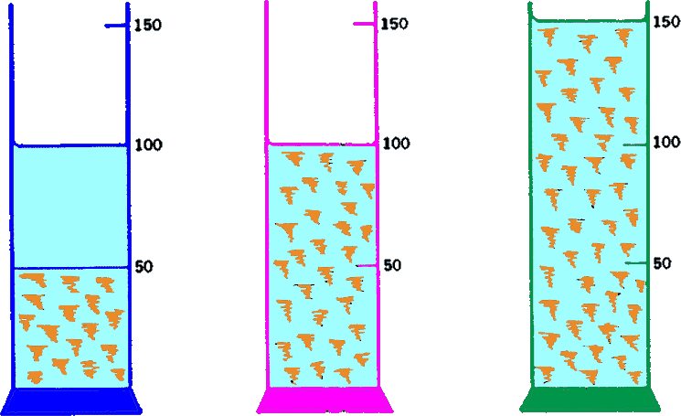
Suspensions
Alfred Martin
Lecturer Dr. Majid R. Feddah

Slide 2
Chapter Objectives
At the end student should be able to:
Describe what pharmaceutical suspensions are and what roles they play in the pharmaceutical science.
Discuss the factors that affect the stability of suspensions, and explain flocculation and deflocculation.
Describe settling and sedimentation theory, and calculate sedimentation rates.
Define and calculate the two useful sedimentation parameters, sedimentation volume and degree of flocculation.
Describe the approaches commonly used in the preparation of physically stable suspensions.

Slide 3
Introduction
Pharmaceutical suspension is a coarse dispersion in which insoluble solids particles are dispersed in a liquid medium.
When the suspended solids are less than about 1 µm in size the system is referred to as a colloidal suspension.
When the suspended solids are greater than 1 µm in diameter the system is coarse suspension.
The upper limit of particle size for individual suspendable solid in a coarse suspensions is approximately 50 to 75 µm.
Some of the small particles exhibit Brownian movement in low viscosity vehicles.

Slide 4
Classification of Dispersions
Internal Phase | External Phase | Example
Gas | Gas | Mixture (air)
Gas | Liquid | Foam
Gas | Solid | Adsorbate
Liquid | Gas | Wet Spray (Fog)
Liquid | Liquid | Emulsion
Liquid | Solid | Absorbate
Solid | Gas | Dry Spray (smoke)
Solid | Liquid | Suspension
Solid | Solid | Mixture (powders and granules)

Slide 5
When the particles of the internal phase are spherical or liquid droplets and are dispersed throughout a liquid external phase, the system called an emulsion.
Oral antibiotics, Anti-Acids, They contain high concentration of solid materials 20 to 30%.

Slide 6
The Pharmaceutical Suspension Classification
Oral suspension.
Antibiotics, oral drops, anti-acids
Topical suspension.
Calamine Lotion USP
Parenterals suspension.
Eye drops, Ear drops, etc..

Slide 7
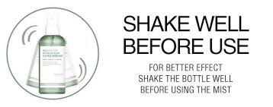
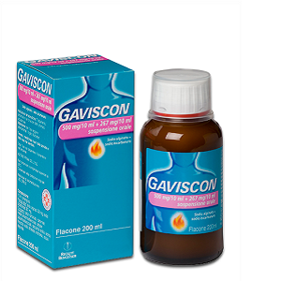
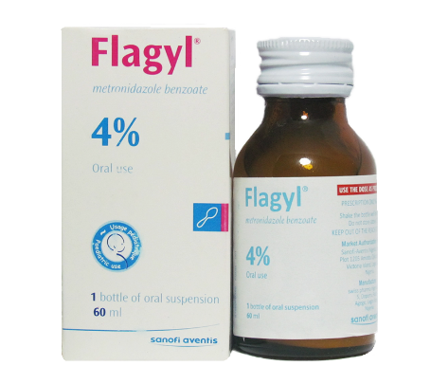
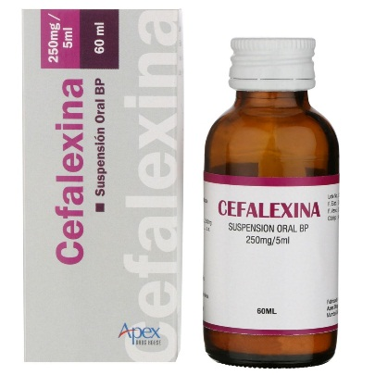
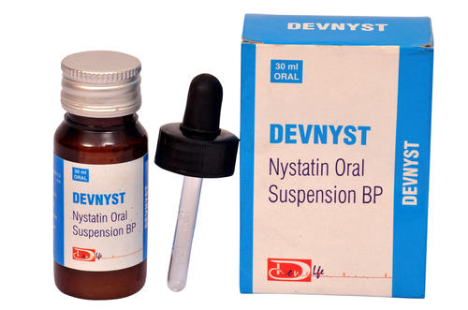
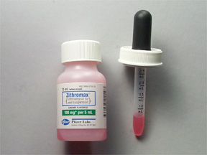
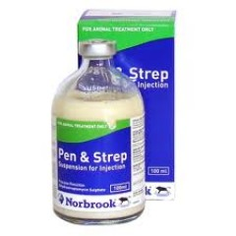

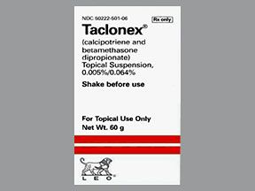
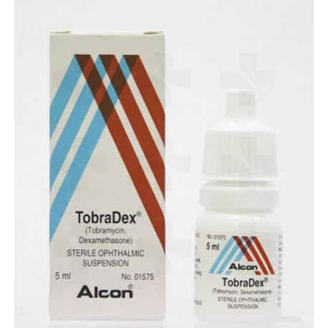
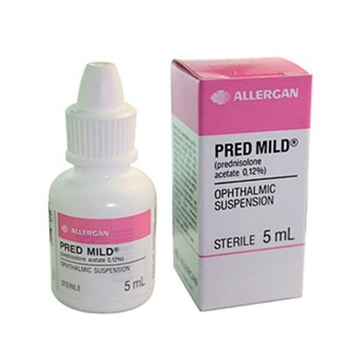
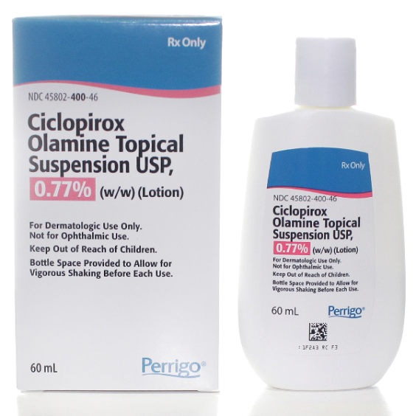
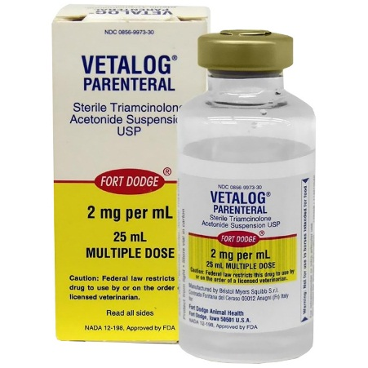
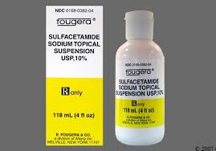

Slide 8
Oral Suspension
The solid content of an oral suspension may vary, for example antibiotic preparations may contain 125mg to 500mg of active solid per 5ml, while the drop concentrate may provide the same amount of insoluble drug in a 1 to 2 ml dose.
Antacids and radiopaque suspensions also typically contain relatively high amounts of suspended material for oral administration.

Slide 9
Vehicle
The vehicle in suspension could be:
  Syrup.
  Sorbitol solution.
  Gum-thickened water with added artificial sweeteners.
Taste and mouth feel is important formulating considerations.
In case of limited shelf life , the dosage form may be prepared as a dry granulation or powder mixture that is reconstituted with water prior to use.

Slide 10
Topical Suspensions
Historically, the externally applied “shake lotion” is the oldest example of pharmaceutical suspension.
Calamine lotion USP, as well as other dermatological preparations, are closely associated with the technical development of the pharmaceutical suspension.

Slide 11
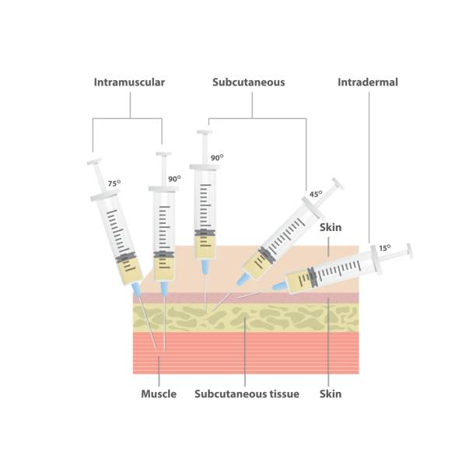
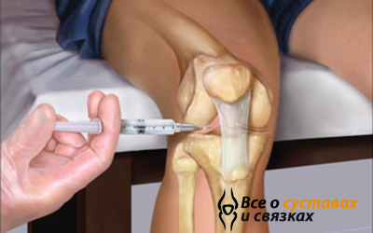
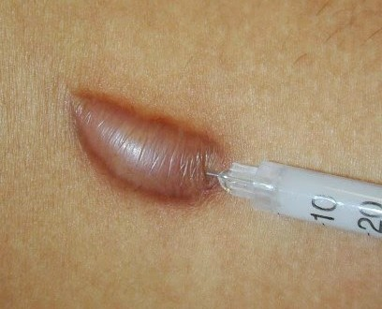
Parenteral Suspensions
The solid content of parenteral suspensions is usually between 0.5% to 5%,.
These preparations are sterile and intended to be used intra-muscular, intra-dermal, intra-lesional, intra-articular, or subcutaneous administration.

Slide 12
The viscosity should be low enough to facilitate injection.
Common vehicles for parenteral suspension include preserved sodium chloride injection or a parenteral acceptable vegetable oil.
Ophthalmic suspensions that are instilled into the eye must also be prepared in a sterile manner and isotonic.
The vehicle employed are essentially isotonic and aqueous in composition.

Slide 13
Bioavailability of Drug
The bioavailability of a drug is assumed to
increase in the following order:
1
Solution
2
Suspension
3
Capsules
4
Tablets
5
Coated Tablets
6
Controlled Release tablets

Slide 14
Particle Size Considerations
The mean particle size and the particle size distributions of suspended insoluble drugs are important considerations in formulating physically stable suspension.
Drug particle size is an important factor influencing product appearance, settling rates, drug solubility, in-vivo absorption, Re-Suspendability, and overall stability of pharmaceutical suspensions.

Slide 15
Pharmaceutical applications
Suspension may be used pharmaceutically for a number of reasons:
Drugs that have very low solubility.
Drugs that have unpleasant teats.
Dissolution of drug from a solution dosage form is faster than solid dosage form and slower than solutions.
Insoluble forms of drugs may prolong the action of a drug by preventing rapid degradation of the drug in the presence of water.

Slide 16
Criteria for good suspension
The dispersed particles Should not settle rapidly.
The settling particles should not form hard cake, but should be readily re-dispersed, when the container is shaken.
Not too viscous to poor freely from the orifice of the container, or to flow through a syringe needles.
The product must be fluid enough to spread easily over the affected area.
Must not be so mobile that it runs off the surface to which is applied.

Slide 17
Should have an acceptable odor and color.
The dispersed phase must be chosen with care so as to produce a suspension having optimum physical, chemical and pharmacologic properties.
Factors affecting the formulation of suspension:
Particle size and particle size distribution.
Specific surface area.
Inhibition of crystal growth.
Changes in polymorphic form.
These properties should not change during storage.

Slide 18
Pharmaceutically Useful Suspending Agents
Suspending Agent | pH range for max stability | Common incompatibilities
Gums Acacia Agar Carrageenan Guar gum Karya Locust bean Pectin Propylene glycol alginate. Sodium alginate Tragacanth Xanthan | 3 – 9 4 - 10 4 – 10 3 – 9 3 – 7 3 – 9 2 – 9 3 - 7 4 - 10 3 - 9 4 - 10 | Insoluble in alcohol over 10% Calcium & Aluminum ions, Borax, and alcohol over 10% Calcium and magnesium ions and alcohol over 10% Calcium and alum ions and alcohol over 10% Insoluble in alcohol over 10% Borax, insoluble in alcohol, and glycerin over 10% Zinc oxide and alcohol over 10% Calcium and magnesium ions and alcohol over 10% Calcium ions and alcohol over 10% Bismuth salts and alcohol over 40% Borax and cationic surfactants.

Slide 19
Suspending Agent | pH range for max stability | Common incompatibilities
Cellulosic Carboxymethyl methyl-cellulose. Na microcrystalline cellulose. Carboxymethylcellulose, sodium hydroxyethylcellulose | 3 – 10 | Tannins, cationic surfactants, and concentrated salt solution
Na-hydroxyethylcellulose | 2 - 10 | Insoluble in alcohol over 10%
Hydroxypropylcellulose | 2 - 10 | Insoluble in alcohol over 10%
Hydroxypropylmethylcellulose | 2 - 10 | Insoluble in alcohol over 10%
Clays Bentonite (Colloidal aluminum silicate) Colloidal magnesium aluminum silicate(hectorite) colloidal magnesium aluminum silicate (Attapulgite) Magnesium silicate (Sepiolite) | 3 – 10 3 – 10 3 – 10 3 – 10 | Calcium ions & polyvalent cations-increase viscosity Calcium ions-Increase viscosity. Calcium ions-Increase viscosity. Calcium ions-Increase viscosity.
Miscellaneous Carbomers. Gelatin (Pharmagels A & B). Polyethylene glycols (3350, 8000). Povidone (K30) Lecithin | 6 – 10 5 – 8 3 – 10 3 – 10 5 - 8 | Acids Acids, Bases, and Aldehydes Phenols Oils and Lecithin Insoluble in water

Slide 20
Physical Stability of Suspension
Physical stability of suspension:
  The condition in which the particles do not aggregate and remain uniformly distributed through out the dispersion.
This is an ideal situation and in reality not happened, so: (shake well before use)
should be written on the bottle and the should easily re-suspended by a moderate amount of agitation.

Slide 21
Interfacial Properties of Suspended Particles
The comminution of the of the particles results in the increase of the surface area of the particles, hence increase of the free surface energy which makes the system thermodynamically unstable..
In this case the particles is high energetic and tends to group to reduce the surface area.
The particles in the liquid suspension therefore tends to flocculate, and form tight fluffy conglomerates that held together by weak van der waals forces.
In some cases these particles may adhere by stronger forces to form what are termed aggregates (Cake).

Slide 22
Interfacial tension in suspension
The formation of any types of agglomerate, either floccules or aggregates, is taken as a measure of the system tendency to reach more thermodynamically stability stable state.

Slide 23
To reach the stable state the system tends to reduce the surface free energy.
Equilibrium is reached when ΔG = 0, this can be achieved by reduction of the interfacial tension, by decreasing the interfacial area
The interfacial tension between particles can be reduced by the addition of Surfactant.
But not reduced to the zero
The forces at the surface of the particles affect the degree of flocculation and agglomeration in a suspension.

Slide 24
Attraction and Repulsive Forces
Forces of attraction are:
London, Van der Waals type.
Repulsive forces arise from the interaction of the electric double layers surrounding each particles.

Slide 25
Electrical barrier on surface

Slide 26
Charged particles repel or attract each other
+
+
+
+
_

Slide 27
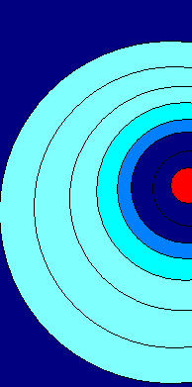
The Double Layer Model
Positive counter ion
Negative Co-ion
Highly Negative colloid
Stern layer
Diffuse layer
Ions in equilibrium with solution

Slide 28
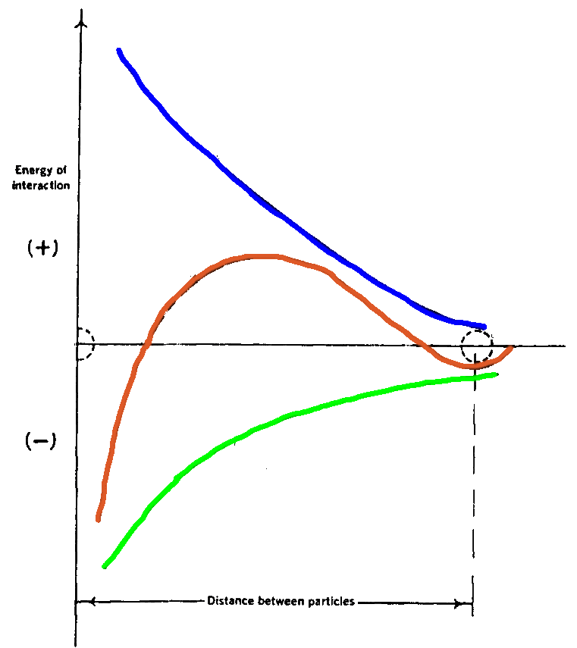
Potential Energy
Repulsion
Composite curve
Attraction
London – van der Waals

Slide 29
When the repulsion energy is high, the potential barrier is also high, & collision is stopped.
The system remain de-flocculated, and when sedimentation occurs, the particles form a close packed arrangement with the smaller particles filling the voids between the larger ones. Those particles are gradually pressed together by the weight of the ones above.
In order to re-suspend and re-disperse these particles, it is again necessary to overcome the high energy barrier, this is not easy to achieve by agitation.
The particles tend to remain strongly attracted to each other and form a hard cake.
29
Notes:
When the repulsion energy is high, the potential barrier is also high, and collision of the particles is opposed.
The system remain de-flocculated, and when sedimentation is complete, the particles form a close packed arrangement with the smaller particles filling the voids between the larger ones. Those particles lowest in the sediment are gradually pressed together by the weight of the ones above; the energy barrier is thus overcome, allowing the particles to come into close contact with each other.
In order to re-suspend and re-disperse these particles, it is again necessary to overcome the high energy barrier, this is not easy to achieve by agitation, the particles tend to remain strongly attracted to each other and form a hard cake.
When the particles are flocculated, the energy barrier is still too large to be surmounted, and so the approaching particle resides in the second energy minimum, which is at a distance of separation of perhaps 1000, to 2000 A. this distance is sufficient to form the loosely structural flocks.
29

Slide 30
Summary
30
Flocculated particles:
Are weakly bonded, settle rapidly, do not form cake, and are easily re-suspended.
Deflocculated suspension:
Particles settle slowly, and eventually form a sediment in which aggregation occurs with resultant formation of a hard cake that is difficult to re-suspend.
Notes:
30

Slide 31
Settling in Suspension
One aspect of physical stability in pharmaceutical suspension is concerned with keeping the particles uniformly distributed through the dispersion.
It is not possible to prevent settling completely over the prolonged period of time.
So it is necessary to consider the factors that influence the velocity of the sedimentation.
Particle size, Density of the particles, Density of the medium, Gravity, viscosity of the medium.

Slide 32
Problems encountered when formulating insoluble solids into suspensions
Factors need to be considered when formulating insoluble solids into a suspension.
Sedimentation:
The factors affecting sedimentation rate of particles are described in Stokes’s equation.
ν = 2r²(σ -ρ)g
9 η
ν= Velocity of spherical particle of radius r and density σ, in a liquid of density ρ, and viscosity η

Slide 33
Theory of Sedimentation
In diluted suspensions 2% or less the particles will not interfere one another during sedimentation.
In most pharmaceutical preparation this is in not the case and the concentration is much higher 20 or 30%.
In this case some estimation may be obtained by diluting the suspension and this may affect the degree of flocculation and the de-flocculation of the suspension.

Slide 34
Effect of Brownian Movement
For particles having diameter between 2 to 5 µm, (depending on the density of the particles and the density and viscosity of the suspending medium).
Brownian movement counteracts (prevent) sedimentation to measurable extent at room temperature by keeping the dispersed material in random motion.
In pharmaceutical suspension, no Brownian movement are observed, as most of them are viscous preparation with suspending agents.
Notes:
The critical radius (r )
The radium of particle below which particles will be kept in suspension by kinetic bombardment of the particles by the molecules of the suspending medium.

Slide 35
Sedimentation of Flocculated Particles
Whether the supernatant liquid is clear or turbid during the initial stages of settling is a good indication of whether the system is flocculated or deflocculated.
Sedimentation parameter:
Sedimentation volume V, or the height H.
Degree of flocculation.

Slide 36
Flocculated Particles
36
When the particles are flocculated, the energy barrier is still too large to be overcomes, and the particles remains together at a distance of separation of between 1000, to 2000 A.
This distance is sufficient to form the loosely structural flocks.

Slide 37
Optimum physical stability and appearance will be obtained when the suspension is formulated with flocculated particles in a structured vehicle of the hydrophilic colloidal type.
Flow readily from the container.
Possess a uniform distribution of particles in each dose.
37
Notes:
37

Slide 38
Flocculated
In flocculated suspensions, Floccules tend to fall together, producing distinct boundary between the sediment and the supernatant liquid.
Hence the liquid above the sediment is clear because even the small particles present in the system are associated with the floccules.

Slide 39
Deflocculated
It is not the case in the deflocculated suspension having a range of particle size, and accordance with Stokes law the larger particles settle more rapidly than the smaller ones, hence no clear boundary is formed, and supernatant remain not clear for longer time.
Whether or not the supernatant liquid is clear or turbid during the initial stages of settling is a good indication of whether the system is flocculated or deflocculated

Slide 40
Evaluation of Suspension
Sedimentation Volume.
Degree of Flocculation.

Slide 41

Sedimentation Volume
Sedimentation volume (F) = the ratio of the final or ultimate volume
of the sediment, Vu to the original volume of the suspension Vo, before
settling:
F = 0.5
F = 1
F = 1.5
Flocculation equilibrium

Slide 42
Degree of Flocculation
It is more useful parameter is than the sedimentation volume:
If we consider a suspension that is completely de-flocculated, the ultimate volume of the sediment will be small.
Writing this volume as V∝, based on equation (F = Vu/Vo), we have
F ∞ = V∞/Vo is the sedimentation volume of deflocculated.
The degree of flocculation (β) = the ratio of F to V∞ or
Notes:
The F gives only quantitative account of flocculation since it lacks a meaningful reference point.

Slide 43
Degree of Flocculation
β = ultimate sediment volume of flocculated suspension
Ultimate sediment volume of deflocculated suspension

Slide 44
Formulation of Suspension
The use of structured vehicle.
Flocculation principle.
To produce flocs that, although they settle rapidly, however, easily re-suspended with a minimum of agitation.
Flocculation in structured vehicle.

Slide 45
Wetting of Particles
Wetting the drug particles and hence the dispersion of an insoluble powder in a vehicle is the first step in manufacturing of a suspension.
In large scale production:
  when the powder (hydrophobic) is added to the vehicle it is difficult to be dispersed, because of the absorbed layer of air, it floats at the top of the container.

Slide 46
Hydrophobic & Hydrophilic
Hydrophobic.
Fine, insoluble solids that are not easily wetted by water and have high interfacial tension. Examples:
Low density organic materials and pharmaceutical substances, such as (Sulfur, Charcoal, Magnesium stearate, Aspirin, Sulfadiazine, Paraffin, Calcium stearate, Stearic acid, Boric acid powder, etc..).
Hydrophilic
Powder that have low interfacial tension and are readily wetted by water are called hydrophilic such as .
Clays (bentonite, kaolin, talk, magnesium aluminum silicate), bismuth salts, barium sulfate, carbonates, hydroxides or oxides of calcium, magnesium, zinc, and titanium dioxide

Slide 47
Suspension of the drug particles
Hydrophilic solids can be suspended easily in water without the aid of a water –dispersible surfactant or wetting agent.
Hydrophobic solids can be suspended in oil and non polar vehicles with the use of lipid-soluble surfactants.

Slide 48
Crystal Growth
Crystal growth is attributed to one of the followings mechanisms:
“Ostwalt ripening” is the growth of large particles at the expense of small ones, taking in mined the difference in solubility rates of different size particles.
Temperature fluctuations on storage temperature cycling of a difference of 20°C or more.
Change from one polymorphic form to another more stable crystalline form.
The size reduction by crushing and grinding can produce particles whose different surfaces exhibit high or low solubility rates, and this effect can be correlated to differences in the free surface energy introduced during comminuting.

Slide 49
Crystal growth control
Crystal growth and changes in particle size distribution can be controlled by:
Selection of particle with narrower range of particle sizes.
Selection of more stable crystalline form of the drug, which usually exhibits decreased solubility in water (which have the highest melting point.
Avoidance of the use of high energy milling during particle size reduction.
Use of wetting agent (water-dispersible surfactant) in formulating to dissipate free surface energy of particles by reducing the interfacial tension between the solid and suspending vehicle.

Slide 50
Use protective colloid, such as gelatin, gums, or cellulosic derivatives, to form a film barrier around the particle, thus inhibiting dissolution and subsequent crystal growth.
Increase the viscosity of the vehicle to retard particle dissolution and subsequent crystal growth.
Avoidance of temperature extremes during product storage, such as the exposure to freeze-thaw conditioning.
Most drugs vary in particle size and in particle shape. This influence the physical stability, appearance, bioavailability and potency of pharmaceutical suspension

Slide 51
Formulation of Suspension

Slide 52
1. Structured Vehicles
Structured vehicles are pseudoplastic and plastic in nature.
It acts by entrapping the particles in the vehicle so no settling occurs.
These vehicles facilitate the reformation of a uniform dispersion when shear is applied.
Disadvantages:
Formation of hard cake when settled.
Notes:
Structured vehicles are pseudoplastic and plastic in nature.
Thixotropy associated with these two types of flow.
It acts by entrapping the particles so that, ideally, no settling occurs.
The shear thinning property of these vehicles does, however, facilitate the reformation of a uniform dispersion when shear is applied.
Disadvantages:
formation of hard cake when eventually settled.

Slide 53
2. Principle of flocculation
Once the powder is properly wetted and dispersed, attention should be given to keep these powders flocculated and to prevent them from forming compact sediment that is difficult to re-disperse.
Materials used to produce flocculation is suspensions.
1. Electrolytes 2. Surfactants 3. Polymers

Slide 54
Electrolytes
Electrolytes acts as flocculating agent by:
Reducing the electric barrier between the particles.
Formation of bridge between adjacent particles so as the link them together in a loosely arranged structured.
Example
Bismuth Subnitrate in water.

Slide 55
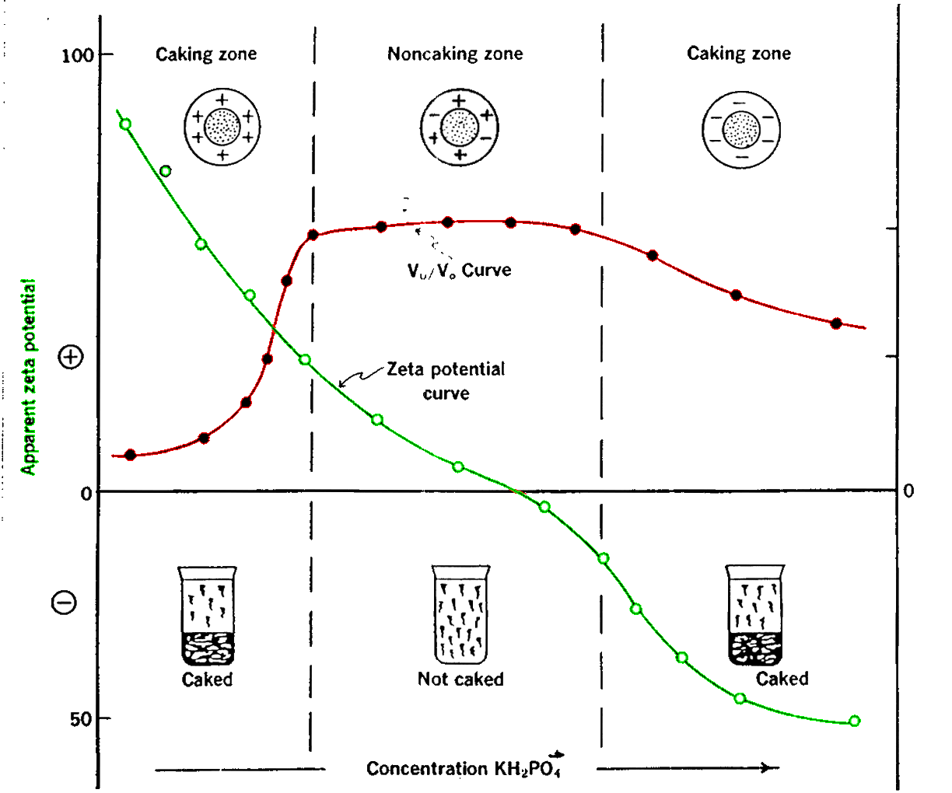
Bismuth sub nitrate suspension/ Addition of KH2PO4
Monobasic potassium phosphate

Slide 56
Some Considerations
The same results was obtained when AL₂CL₆ was added to a suspension of sulfamerazine in water.
In this system the initial zeta potential of the sulfamerazine particles is negative and is reduced by adsorption of the trivalent aluminum Cation.
Colloidal and coarse dispersed particles may possess surface charges that depend on the pH of the system.
Some time the desired surface charge can be achieved by adjustment of the pH by addition of HCL or NaOH
to produce a positive, zero or negative surface charge.
56
Notes:
56

Slide 57
Surfactant are useful in preparation of suspension.
Why?
By reducing the interfacial tension between solid particles and liquid:
The contact area is lowered.
The air is escape from the surface of the particles.
Wetting and dispersion are promoted.
Glycerin and similar hygroscopic substances are in levigating the insoluble materials, the Glycerin flows into the voids between the particles, to displace the air and during mixing operation.

Slide 58
Surfactants
Ionic and nonionic surfactants are used as flocculating agent in the suspension.
Examples:
Anionic /Docusate sodium, sodium lauryl sulfate.
Nonionic/ Polysorbate 65, Polysorbate 80, Octoxynol-9.
The concentration of surfactant is critical since these compound may also act as wetting and Deflocculating agents to achieve dispersion.

Slide 59
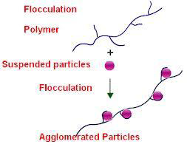
Polymers
Polymers are long chain, high molecular weight compounds containing active groups spaced along their length.
These act as flocculating agents because part of the chain is adsorbed on the particle surface, with the remaining parts projecting out into the dispersion medium.
Bridging between these portions
leads to the formation of floccules.

Slide 60
Flocculation in Structured Vehicles
Although the controlled flocculation approach is good in regards of physical and chemical stability of the system.
A suspending agent is added to the system to retard sedimentation of the flocs to increase the sedimentation volume.
Examples:
Carboxymethycellulose (CMC), Carbopol 934, Veegum, Tragacanth, or Bentonite.
Alone or in combination.

Slide 61
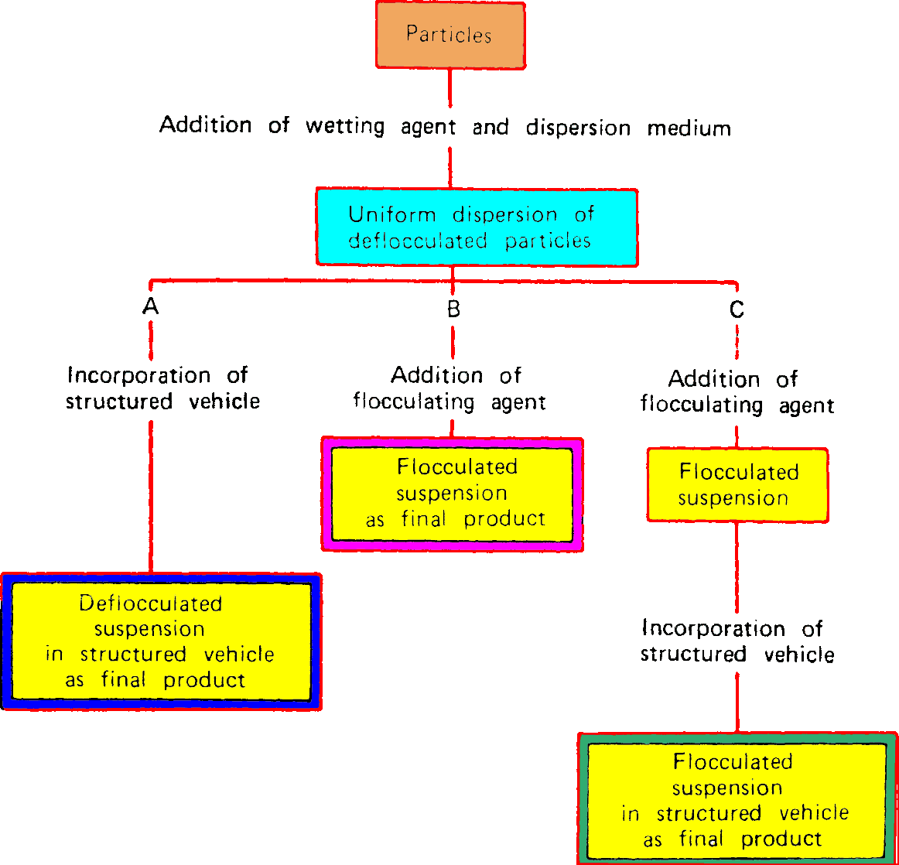
Formulation Overview
61
Notes:
61

Slide 62
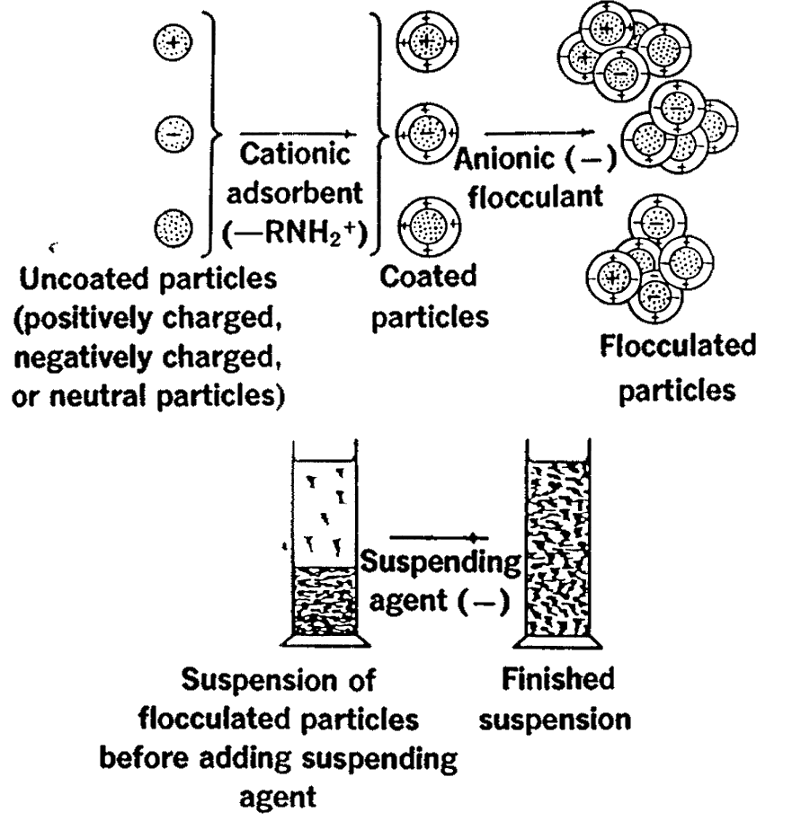
Formulation of Structured vehicle

Slide 63
Rheologic Consideration
The principles of Rheology may be applied to a study of the following factors:
The viscosity of a suspension, Which affect the settling of particles.
The change in flow properties of the suspension when the container is shaken.
The spreading qualities of the lotion when it is applied to an affected area.
In manufacturing and handling of suspension during the transfer and filling.

Slide 64
Ideal Suspending Agent
The only shear that occurs in the suspension during storage is due to a settling of the suspended particles (negligible).
When the container is shaken, and the product is poured from the container high shearing rate is applied. So!
Ideal suspending agent:
High viscosity at negligible shear (during the shelf life of the product)
Low viscosity at high shearing rates (during pouring from the bottle or spreading in the skin.

Slide 65
Suspending Agents
These agents works by modifying the vehicle viscosity, so they slowing down the sedimentation.
Most of them form Thixotropic as well as pseudo-plastic (forms a gel on standing and becomes fluid when disturbed).
Care should be taken when selecting a suspending agent.

Slide 66
Suspending Agents
1. Natural polysaccharides.
  Tragacanth, acacia gum, starch, agar, guar gum, carrageenan, sodium alginate.
  Care should be taken in natural materials because of:
  Microbial contamination
  Variability in the quality.
  Variability in the price.

Slide 67
2. Semi-synthetic polysaccharides.
These are derived from naturally occurring polysaccharides and cellulose.
  Methylcellulose (Celacol, Cologel), Hydroxyethylcellulose (Natrasol 250), sodium Carboxymethylcellulose (carmellose sodium).
  Microcrystalline cellulose (Avicel).
3. Clays.
These are naturally occurring inorganic materials mainly hydrated silicates.
  Bentonite, Aluminum magnesium silicates, Magnesium aluminum alginate.

Slide 68
4. Synthetic thickeners.
  Carbomer (Carboxyvinyl polymer, Carbopol).
  Colloidal silicon dioxide (Aerosil, Cab-o-sil), Polyvinyl alcohol.
5. Miscellaneous compounds.
  Gelatin and other viscosity increasing agent.

Slide 69
Kaolin and Morphine Mixture BP
Ingredients | Mater Formula | For 150 ml
Light kaolin | 2 g | 30 g
Sodium bicarbonate | 500 mg | 7.5
Chloroform, morphine tincture | 0.4 ml | 6 ml
Water | To 10 ml | To 150 ml
Formulation note:
Light kaolin is a diffusible solid, no suspending agent is required.
For relief of the symptoms of diarrhea and upset stomachs.

Slide 70
Method of preparation
Weight the light kaolin in place in the mortar.
Dissolve the sodium bicarbonate in 100 ml of water.
Gradually add this to the kaolin in the mortar with mixing to disperse the solids.
Add the chloroform and morphine tincture.
Wash the mixture into a tarred , amber bottle.
Make up to volume with water.
Close the bottle, and label .

Slide 71
Label information
Store in a cool, dry place.
Should be freshly prepared.
Shelf life ( 2 to 4 weeks)
Shake well before use.

Slide 72
Preservation of Suspension
Water is the most common source of microbial contamination.
All the natural occurring additives such as acacia, Tragacanth may be source of microbes and spores.
Care should be taken when preservatives are added to the preparation as some of them could be adsorbed to the solid leaving the vehicle not preserved.
Benzoic acid and Hydroxybenzoates.

Slide 73
Physical Stability of Suspension
Rising the temperature: Leads to unstable suspension.
Freezing: During freezing process, cause the particles to aggregate, and it remain aggregated even when the ice is melted.
In temperature fluctuation: Particle growth were observed (change the particle size and particle size distribution and the polymorphic form of the particles.

Slide 74
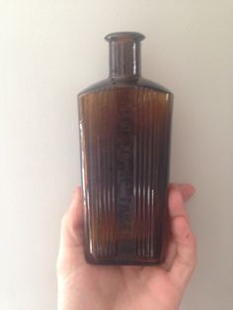
Containers for suspensions
74
Suspension should backed in amber bottles, plain for internal use and ribbed for external use.
There should be adequate air space above the liquid to allow shaking and ease of pouring.
Notes:
74

Slide 75
Special labels and advice for suspensions
75
The most important additional label for suspensions is :
“Shack well before use”.
“Store in a cool place”.
“Don’t apply to a broken skin”
Notes:
75

Slide 76
Summary
Suspensions are very important form of liquid medicines next to solutions.
They can be used for systemic or for local treatment through different routes of administration.
Physical stability of the suspension can be challenging and it is very important to understand the factors affecting and control the sedimentation process.
The additives (excipients) used in suspensions can be those which are commonly used for solutions but their role is different.

