Slide 1
Real-Time Object Detection Using YOLO
This project is aimed at detecting every object in real time whether it's in an image, a video, or a live webcam feed using the YOLO (You Only Look Once) object detection algorithm.
Group Members: Abdelraheem / Tameem
Supervisor: Hossam Mustafa
computer vision

Slide 2

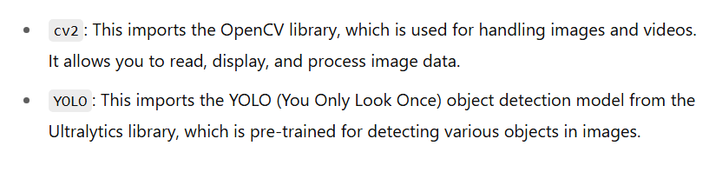

Slide 3

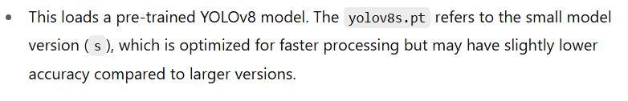

Slide 4

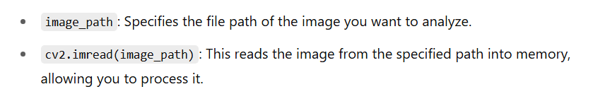

Slide 5
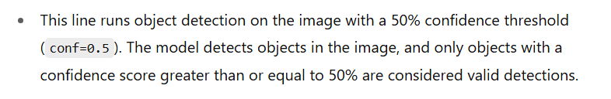

Slide 6



Slide 7
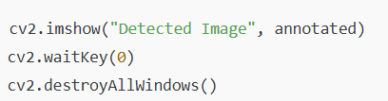
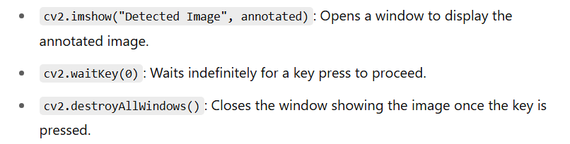

Slide 8
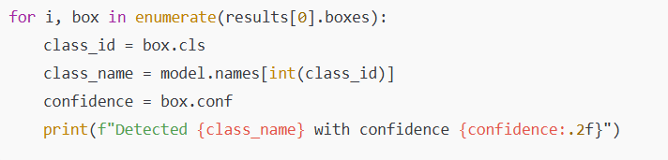
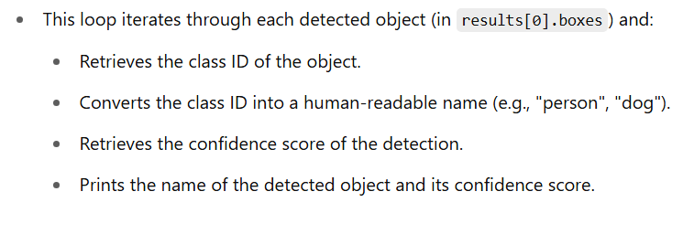

Slide 9
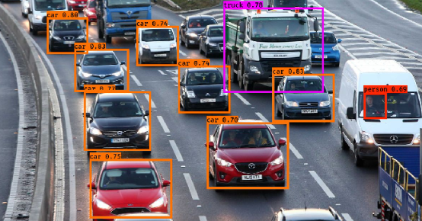
Output Result of the Object Detection Code
This image shows the result of running the object detection code. Each detected object (e.g., car, person,truck) is identified with a colored bounding box and a class label using class IDs.

Slide 10

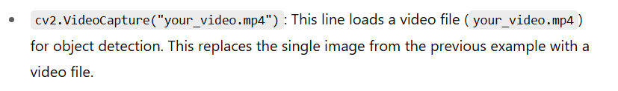

Slide 11
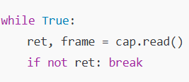
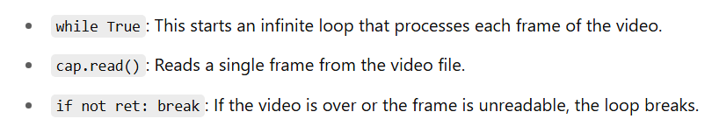

Slide 12
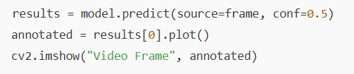
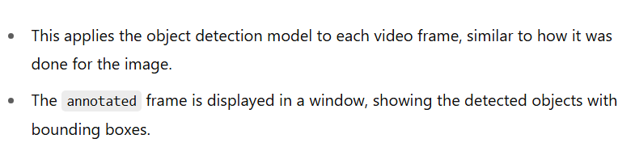

Slide 13



Slide 14
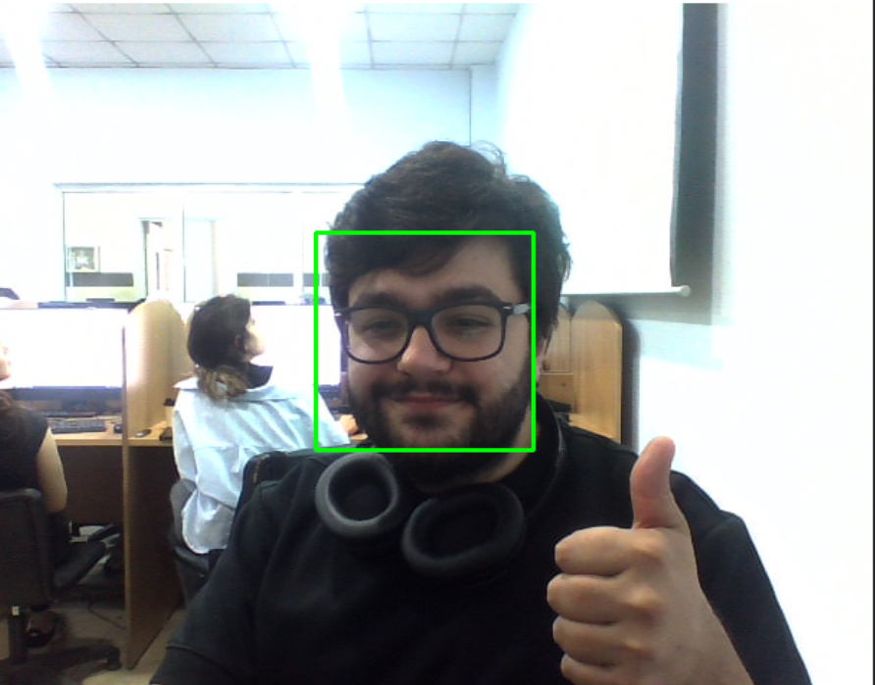
Webcam Video Capture Detection Result
This image simulates the result from the webcam video stream detection using real-time object recognition. Detected objects are labeled live with bounding boxes.

