Slide 1



MEDICAL IMAGE CLASSIFICATION
USING CNN

Slide 2


PROJECT OVERVIEW
  Goal: Build a deep learning model to classify medical images.
  Dataset: MedNIST – includes multiple categories like Abdomen, Brain, Chest, etc.
1
2
3
4
5
Dataset download and preparation
Data visualization and preprocessing
CNN model development
Model training and evaluation
Final predictions and insights

Slide 3




DATASET DESCRIPTION
  Medical images organized by class in separate folders.
  Manual allocation of 2,000 images per class for testing.
  Training data remains after splitting.
  Number of categories identified and displayed.

Slide 4
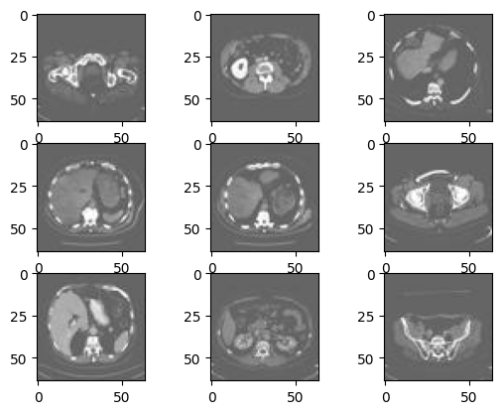
IMAGE PREPROCESSING
  All images scaled to the same size (64x64 pixels).
  Grayscale format used to simplify the model input.
  Pixel values normalized to enhance training performance.
  Data loaded and structured using image generators.

Slide 5

CNN MODEL DESIGN
01
Built a sequential Convolutional Neural Network (CNN).
02
Layers include convolution, pooling, flattening, and dense layers.
03
Activation functions and final classification layer for output.
04
Model designed to learn complex image features.

Slide 6
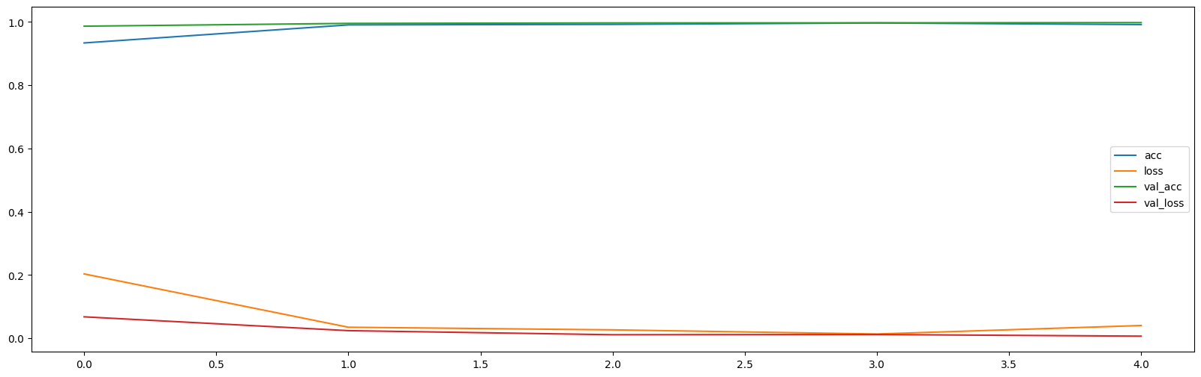
MODEL EVALUATION
  Training and validation loss observed over epochs.
  Accuracy tracked to assess learning progression.
  Plotted graphs reveal how well the model generalizes.
Accuracy
Loss
0.9948
0.0240

Slide 7
VISUALIZATION OF RESULTS
  Visual samples of predicted vs actual categories.
  Highlights strengths and weaknesses of the model.
  Helps assess model reliability visually.

Slide 8


THANK YOU!
Done By:
Yara Mubaydeen 202110754
Farah Masoud 202110430
Inrabim Al Titi 202111335

