Slide 1

How The Web Works
Let’s learn something!

Slide 2
How The Web Works
This lecture will discuss the following:
  How the web works
  What do we mean by “Full-Stack”
  A brief overview of the course tech
  Why we chose Django for the course
Let’s get started!

Slide 3
How The Web Works
Before we can begin to learn about all the technologies in this course, we need to understand how the web works and what constitutes the “Full-Stack”

Slide 4
How The Web Works
So what happens when your at home and you open up your browser and visit a website?
Let’s breakdown the basic steps!

Slide 5
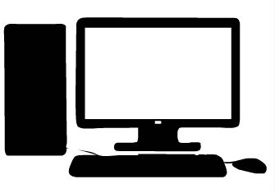
How The Web Works
You start off by typing the URL into your browser.
www.abc.com

Slide 6
How The Web Works
Your computer then sends this request as a packet, which includes the IP address of the website you want.
123.456.789.10
www.abc.com

Slide 7
How The Web Works
It sends this request through wires, or a satellite which eventually links to wires using your ISP.
123.456.789.10
www.abc.com

Slide 8
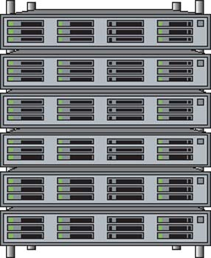
How The Web Works
Your ISP will then re-route the request to the appropriate server location, using the IP address as the guide.
123.456.789.10
www.abc.com

Slide 9
How The Web Works
Once your request reaches the server, it can send back the website you asked for.
www.abc.com
123.456.789.10

Slide 10
How The Web Works
However a full website with content is too big to send as a single packet of data.
www.abc.com

Slide 11
How The Web Works
To solve this, the server sends back the website split up into many packets
www.abc.com

Slide 12
How The Web Works
The packets come with instructions on how to get back to you and reassemble once they reach you.
www.abc.com
Home IP Address

Slide 13

How The Web Works
The packets don’t care how they get to you, just the final location.
www.abc.com
Home IP Address

Slide 14
How The Web Works
Once the packets reach you, they are reassembled to show the page.
Home IP Address

Slide 15
How The Web Works
All of this moves at close to the speed of light, so it happens very fast.
Home IP Address

Slide 16
What really happens when you navigate to a URL
This is a higher-level explanation, So we will dive in details

Slide 17
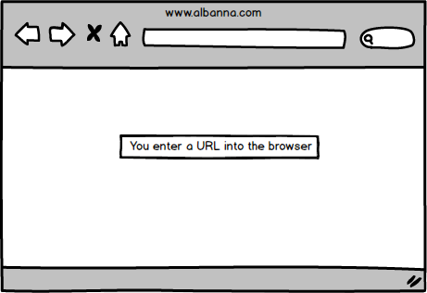
URL in Address Bar
http://www.albanna.com

Slide 18
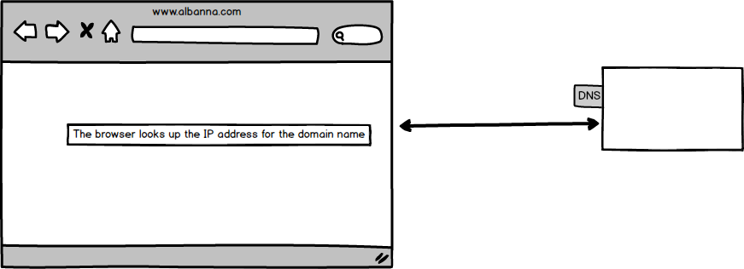
Domain Name System

Slide 19
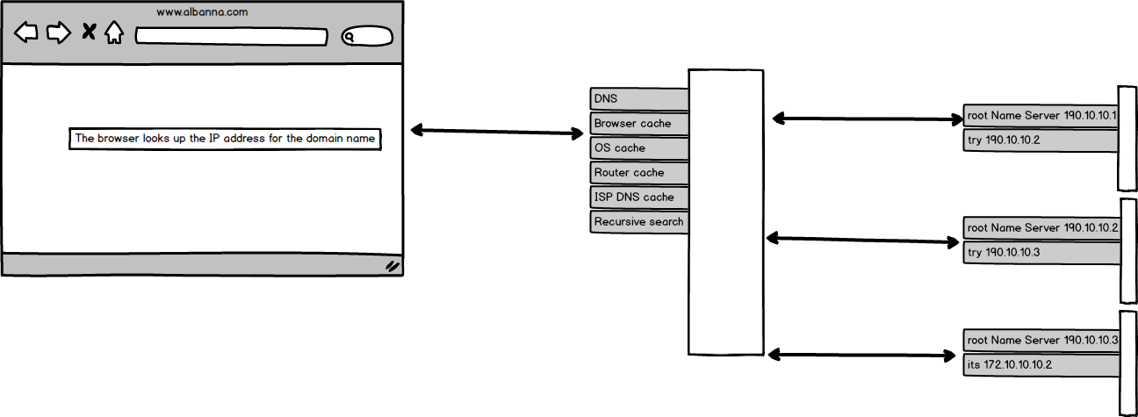
Domain Name System
Notes:
Browser chache 2 – 30 min
OS chache for windows user system call getHostByName()
Round robin DNS and geographic DNS

Slide 20
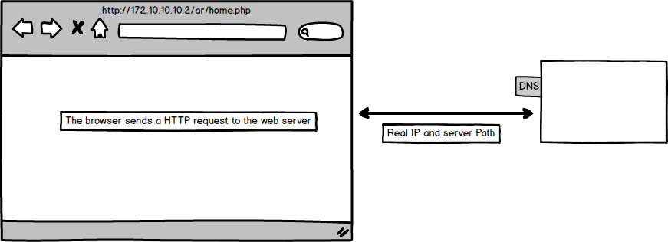
Domain Name System
ipconfig /flushdns
sudo killall -HUP mDNSResponder
sudo /etc/init.d/nscd restart

Slide 21
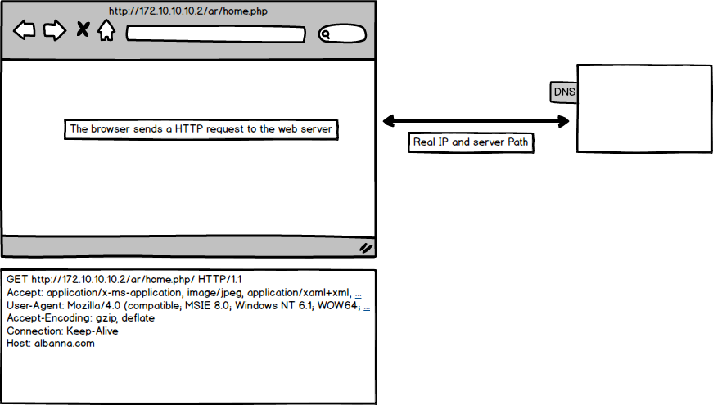
Http Request

Slide 22
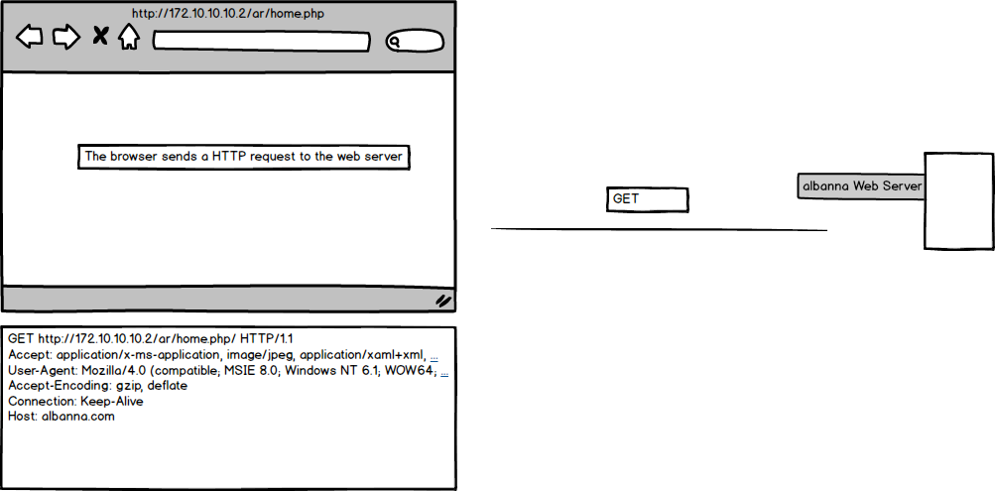
Http Request

Slide 23
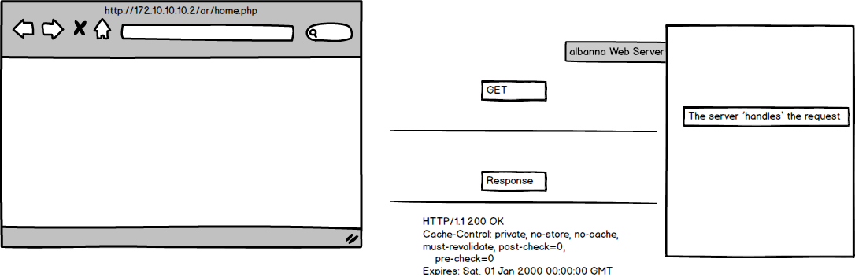
Http Response

Slide 24
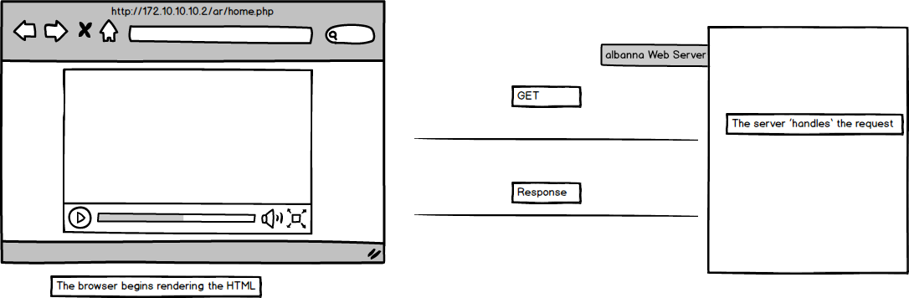
HTML Rendering

Slide 25
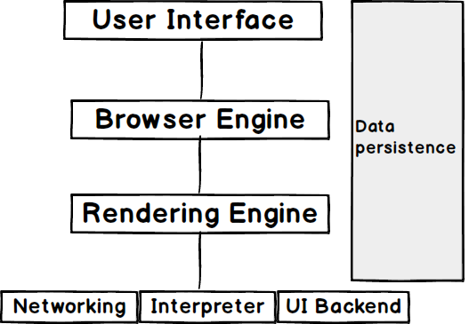
Brower Components
Notes:
Browser Engine marshell actions set of API that connect Render engine with User Interaface
The Rendering Engine: The rendering engine, as the name suggests is responsible for rendering the requested web page on the browser screen. The rendering engine interprets the HTML, XML documents and images that are formatted using CSS and generates the layout that is displayed in the User Interface. However, using plugins or extensions, it can display other types data also. Different browsers user different rendering engines:
* Internet Explorer: Trident
* Firefox & other Mozilla browsers: Gecko
* Chrome & Opera 15+: Blink
* Chrome (iPhone) & Safari: Webkit
Networking: Component of the browser which retrieves the URLs using the common internet protocols of HTTP or FTP. The networking component handles all aspects of Internet communication and security. The network component may implement a cache of retrieved documents in order to reduce network traffic.
JavaScript Interpreter: It is the component of the browser which interprets and executes the javascript code embedded in a website. The interpreted results are sent to the rendering engine for display. If the script is external then first the resource is fetched from the network. Parser keeps on hold until the script is executed.
UI Backend: UI backend is used for drawing basic widgets like combo boxes and windows. This backend exposes a generic interface that is not platform specific. It underneath uses operating system user interface methods.
Data Persistence/Storage: This is a persistence layer. Browsers support storage mechanisms such as localStorage, IndexedDB, WebSQL and FileSystem. It is a small database created on the local drive of the computer where the browser is installed. It manages user data such as cache, cookies, bookmarks and preferences.

Slide 26
Render Main Flow
Loading the resources
Parsing the HTML
Create render tree
Layout the render tree
Painting

Slide 27
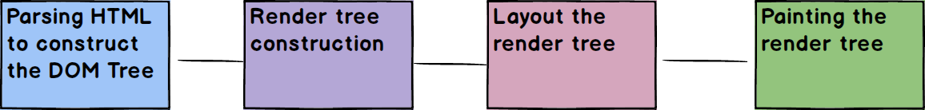
Render Main Flow

Slide 28
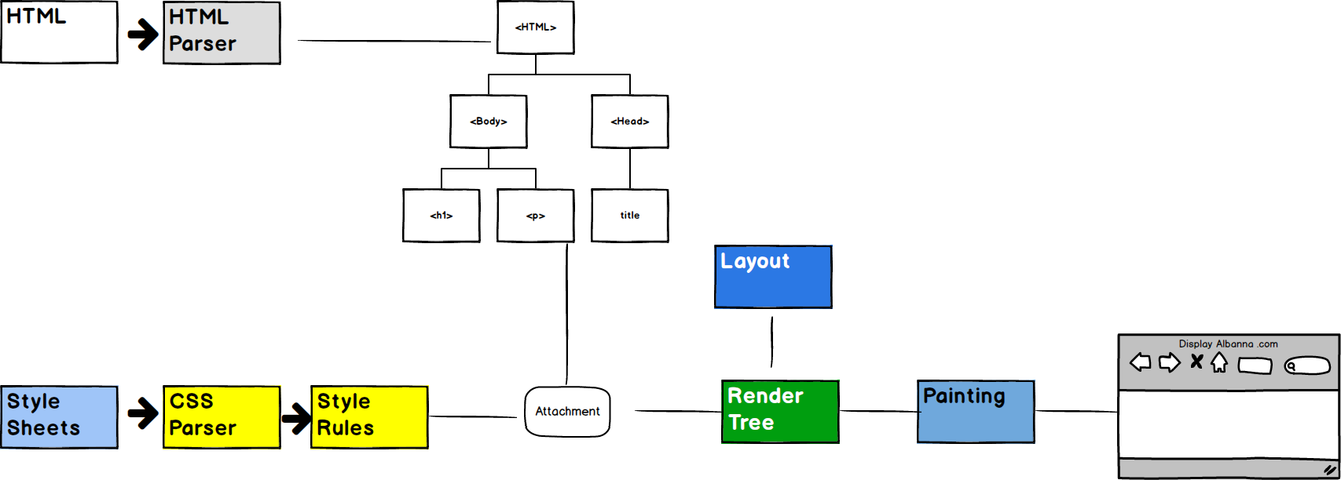
Render Main Flow

Slide 29
How The Web Works
https://www.html5rocks.com/en/tutorials/internals/howbrowserswork/#Resources

Slide 30
How The Web Works
There are two main components of a website
  The Front-End
  The Back-End

Slide 31
How The Web Works
The Front-End is what you see as a user on the website.
The Back-End is the technology used to actually decide what to show you on the Front-End.

Slide 32
How The Web Works
The Front-End revolves around three technologies:
  HTML
  CSS
  Javascript

Slide 33
How The Web Works
You will hear about Front-End technologies such as jQuery and Bootstrap, but those are all built using the previous three.

Slide 34
How The Web Works
HTML - HyperText Markup language
Every website will have HTML, it is the structure of a page.
You can view it by right-clicking and selecting “View Page Source”

Slide 35
How The Web Works
CSS - Cascading Style Sheets
CSS is the actual styling of the website.
Colors, fonts, borders, etc is all defined by CSS.
CSS is not mandatory, but almost all sites have it.

Slide 36
How The Web Works
Javascript allows you to add interactivity to the website, including programming logic.
Any site with interactivity uses Javascript in some way, otherwise the site is “static”.

Slide 37
How The Web Works
The first half of the course focuses on the Front-End.
The Front-End always uses those three technologies.
However the Back-End is where a multitude of options come up!

Slide 38
How The Web Works
The Back-End of a site has three components:
  The Language
  The Framework
  The Database

Slide 39
How The Web Works
Technologies such as Php, Node.js, Ruby/Rails, Java, Python, etc. are all viable options for a website.
So how do we decide which to choose?

Slide 40
How The Web Works
Our course Back-End uses:
  Python as the language
  Django as the Framework
  SQLite as the Database

Slide 41
How The Web Works
Python is a great language to learn, it’s simple, powerful, and has many libraries.
Django is the most popular framework for Python, it’s fast, secure, and scalable.
SQLite comes with Django and Python making it an easy choice.

Slide 42
How The Web Works
As we continue along with the course we will be discussing each of these topics in much more detail, but for now you should have a high-level view of what we use in this course to turn you into a Full-Stack Web Developer with Django!

Slide 43
How The Web Works
As we continue along with the course we will be discussing each of these topics in much more detail, but for now you should have a high-level view of what we use in this course to turn you into a Full-Stack Web Developer with Django!

Slide 44
Let’s get started!

